Slide 1
Lesson 10: Breaking the Code
The Periodic Table

Slide 2
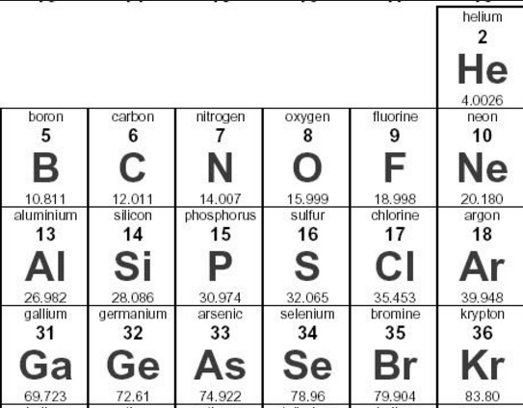
Monday, September 25, 2017
Periodic Table
Objective: I will be able to explain the arrangement and describe general properties of the periodic table.
Entry Task:
Do you expect carbon (C)
to be more similar to boron (B),
nitrogen (N), or silicon (Si)?
Refer to the image.
Why?

Slide 3
Key Question
What information does the periodic table reveal about the elements?

Slide 4
You will be able to:
  use the periodic table to identify elements that are metals, nonmetals, metalloids, alkali metals, alkaline earth metals, transition elements, halogens, noble gasses, lanthanides, and actinides
  describe the general properties of elements, that are periodic in nature
  predict the general properties of an element based on its location on the periodic table and identify elements that will exhibit similar chemical behavior

Slide 5
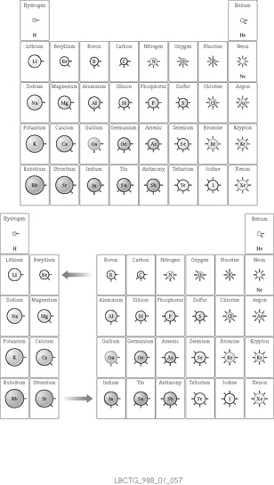
For the card sort, you created a Periodic Table of the Main Group Elements

Slide 6
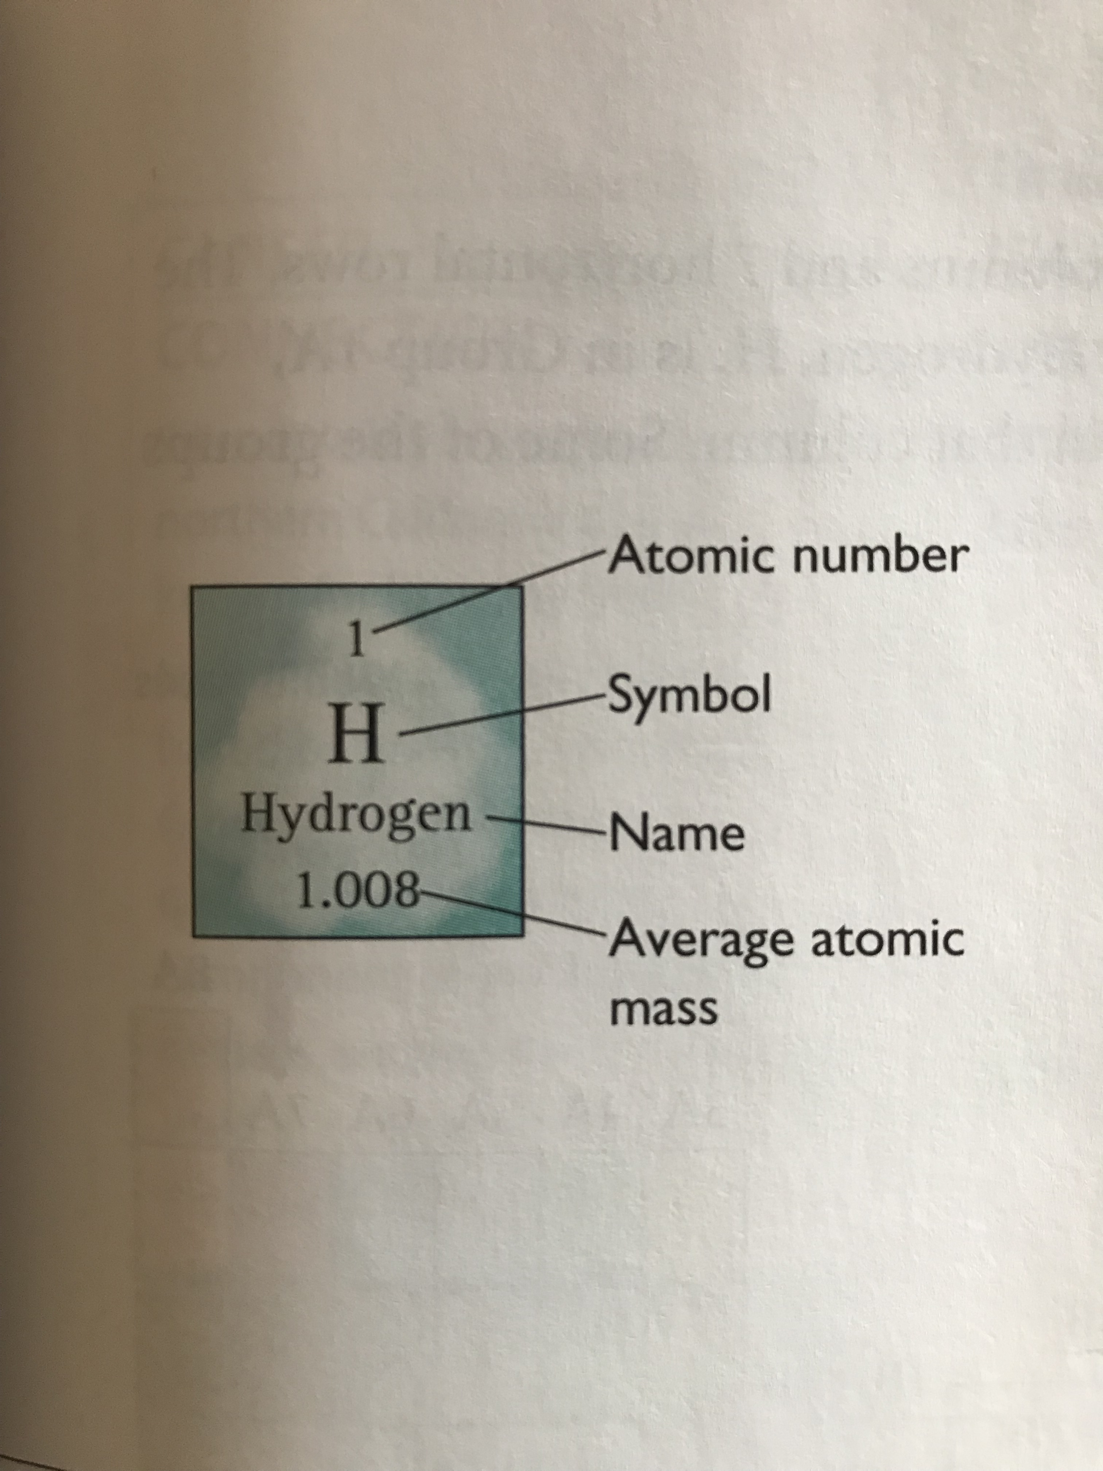
Key Vocabulary
Atomic Number: The consecutive whole numbers associated with the elements on the periodic table. The atomic number is equal to the number of protons in the atomic nucleus of an element.
Note: atomic number is always an integer, while average atomic mass is often presented as a decimal

Slide 7
More Key Vocabulary
Group: A vertical column in the periodic table. Elements in a group have similar properties.
Period: Horizontal rows on the periodic table.
Alkali metals: The elements in Group 1A.
Alkaline earth metals: The elements in Group 2A.
Halogens: The elements in Group 7A.
Noble gases: The elements in Group 8A. They are called “noble” gases because they are not reactive.

Slide 8
period
Alkali metals Noble gases
Alkali Earth metals Halogens
1A
8A
group
2A 3A 4A 5A 6A 7A

Slide 9
The card sort table of Main Group Elements can be opened up to accommodate more elements.

Slide 10
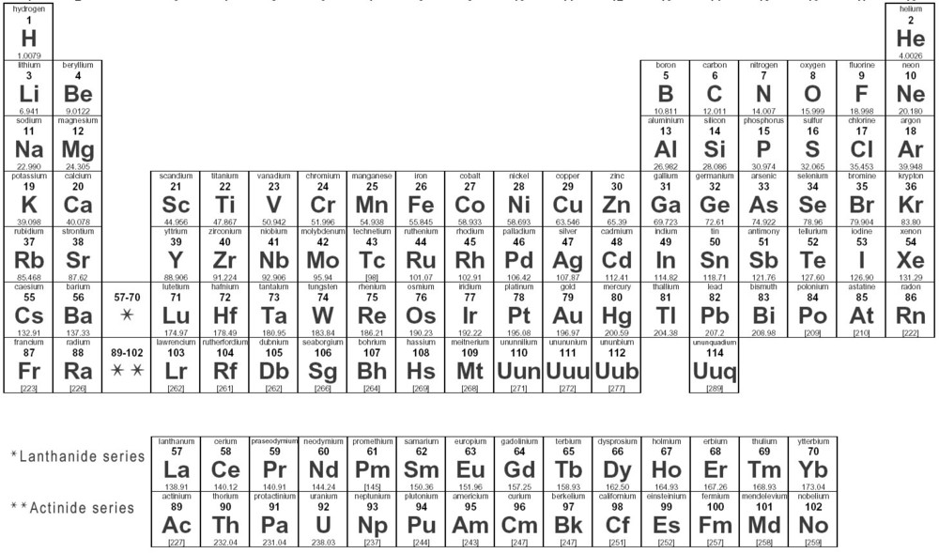
Behold the Transition Elements,
the Lanthanides, and the Actinides

Slide 11
Even More Key Vocabulary
Main group elements: The elements in Groups
1A to 8A.
Transition elements: The elements in Groups
1B to 8B.
Lanthanides and actinides: The two rows of 14 elements each that are often placed separately at the bottom of the periodic table so the table will fit comfortably on a sheet of paper.

Slide 12
The Periodic Table, textbook edition
Main Group
Transition Elements
Main Group
Lanthanides
Actinides

Slide 13
The Periodic Table, widescreen edition
Main Group
Main Group
Transition
Lanthanides
Actinides

Slide 14
Discussion Notes (cont.)
Metals: Elements that are excellent conductors of heat and electricity. They generally are shiny and malleable (flexible). They are found to the left of the stair-step line on the periodic table.
Nonmetals: Elements that are poor conductors of heat and electricity. They generally are dull and brittle. They are found to the right of the stair-step line.
Metalloids: The elements between the metals and nonmetals. They are found along the stair-step line.

Slide 15
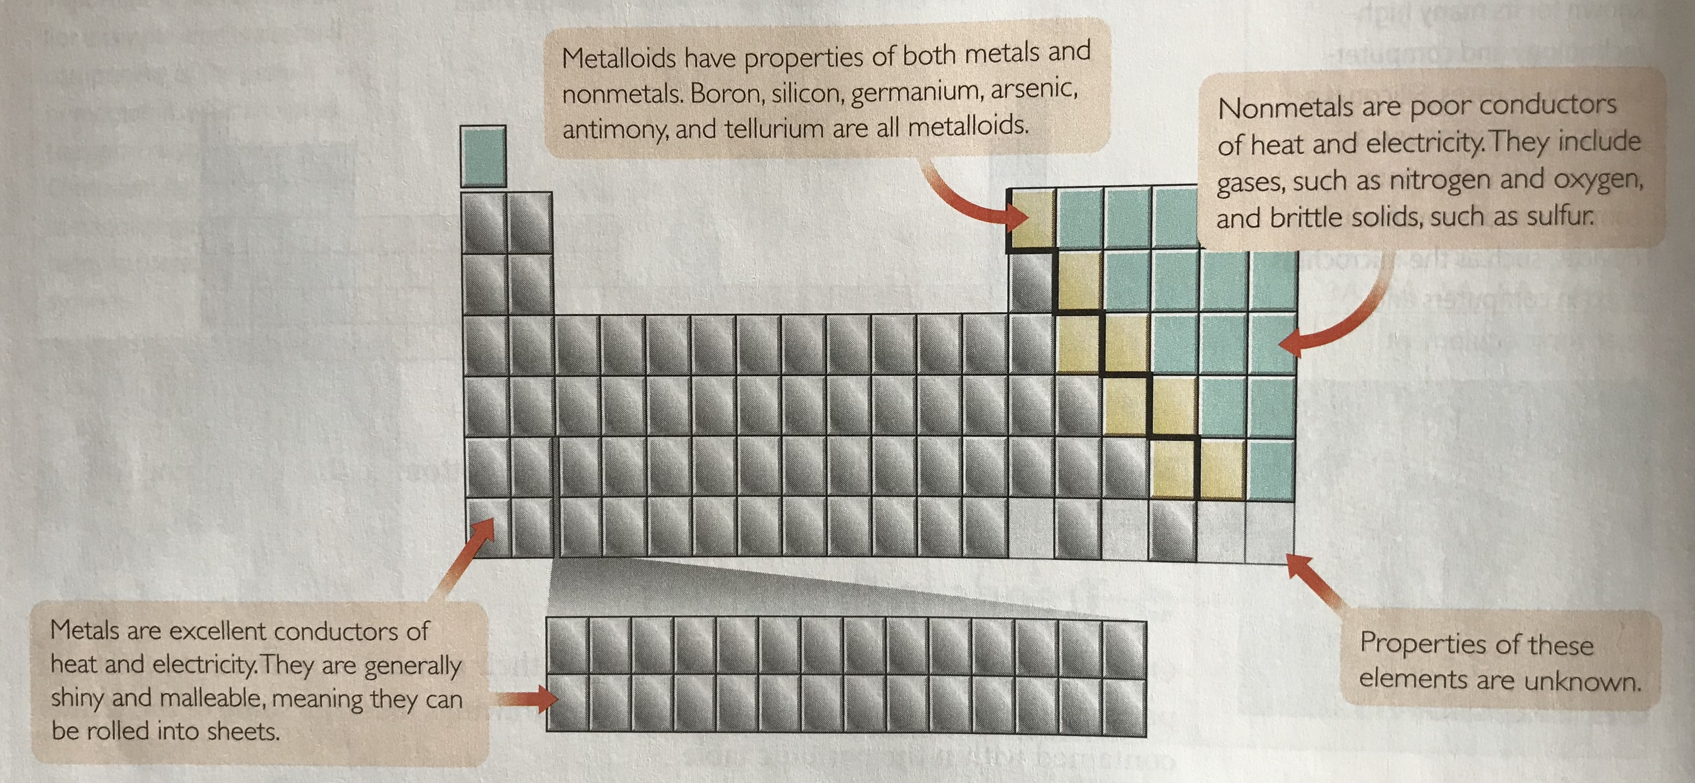
Metals, Nonmetals, and Metalloids

Slide 16
Periodic Table Patterns
Horizontal patterns:
Atomic Mass - increases L-R (exceptions - iodine, argon)
Radius - decreases L-R across rows
“Sticks” - increase in # L-R across rows
Compound chemical formula - changes L-R as follows:
Cl → Cl₂ → Cl₃ → H₄ → H₃ → H₂ → H → nothing

Slide 17
Periodic Table Patterns
Vertical patterns:
Atomic Mass - decreases Top to Bottom
Reactivity - Some columns increase T-B, some decrease T-B
“Sticks” - Same # of “sticks” within a column
Radius - increases T-B
Softness - increases in METALS T-B

Slide 18
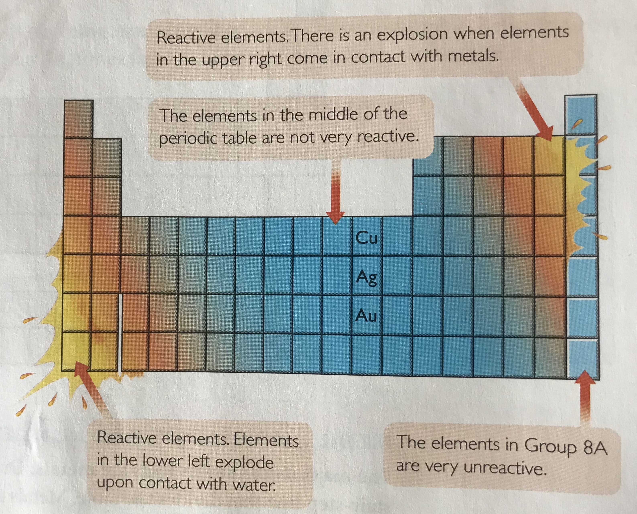
Reactivity

Slide 19
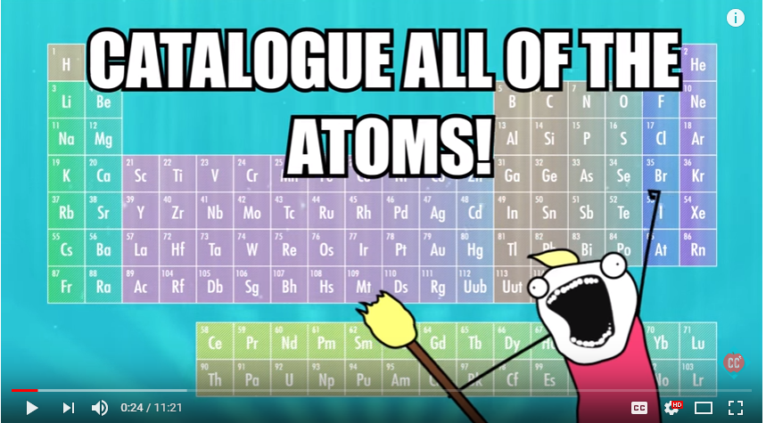
The Periodic Table: Crash Course
https://www.youtube.com/watch?v=0RRVV4Diomg

Slide 20
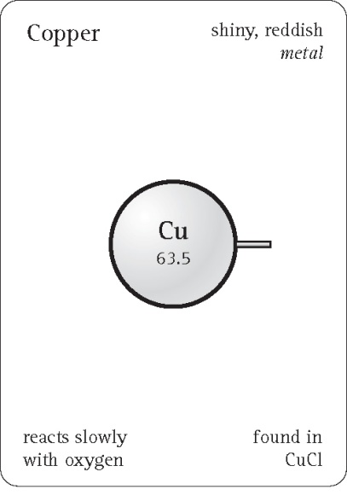
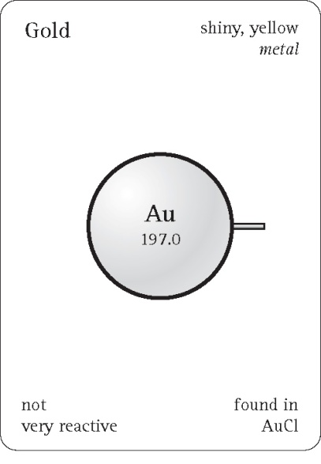
Check-In
Look up silver, Ag, on your periodic table. Use these cards for Cu, copper, and Au, gold, to create a card for silver.

