Slide 1
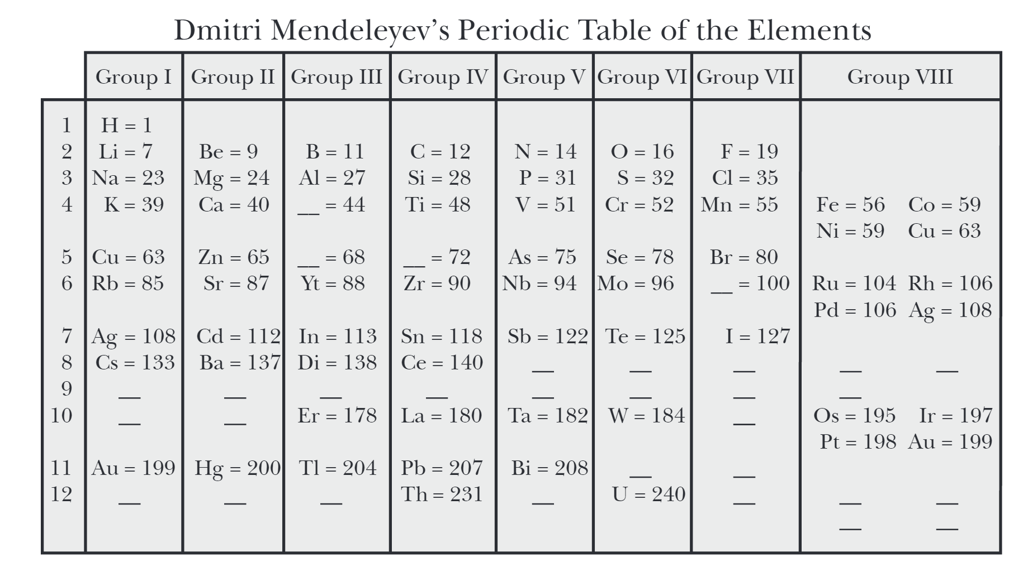
Tuesday, September 19, 2017
Periodic Table
Objective: I will be able to explain the arrangement of the periodic table.
Entry Task:
How do you think elements are organized in this table?
What do you think the creator of the chart was trying to do?

Slide 2
Introducing the Periodic Table
Comparing some reactions
From 1st to last: lithium, sodium, potassium, rubidium, cesium
Not included: Francium
Demonstrates property of reactivity.
Reactivity: Whether an element or a compound will chemically combine with other substances to form compounds, also describes the speed of a reaction

Slide 3
Periodic Table Card Sort
Use handout and card set to “make” your own periodic table
NO CHEATING!! Don’t look up the answer, try to make sense on your own first.
Start with column of Be (beryllium), Mg (magnesium), Ca (calcium), and Sr (strontium)
Use patterns on the cards to try to fill in the rest of the table

Slide 4
Periodic Table Card Sort
What are some patterns you sorted by?
Did you have to abandon any characteristics and pck new ones?
Did you discover any new characteristics or patterns during the activity?

Slide 5
Periodic Table Card Sort
Missing Element: Ge (germanium)
Which card did you choose for Ge?
What other properties can we predict for Ge?

Slide 6
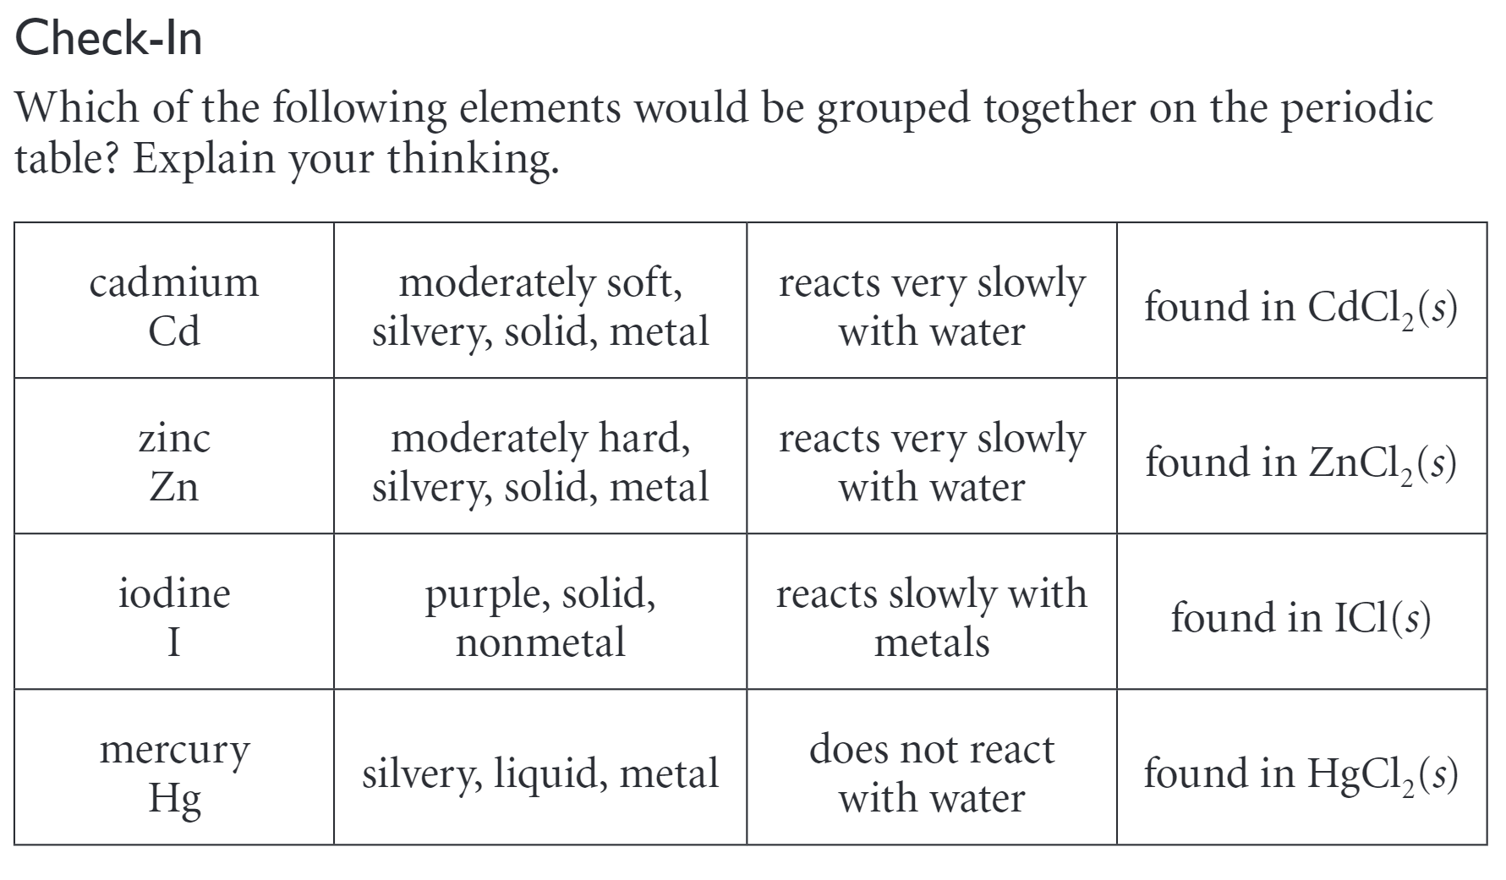
Check in
Write answer in notebook

Slide 7
Check in
All metals, all compound with Cl₂

Slide 8
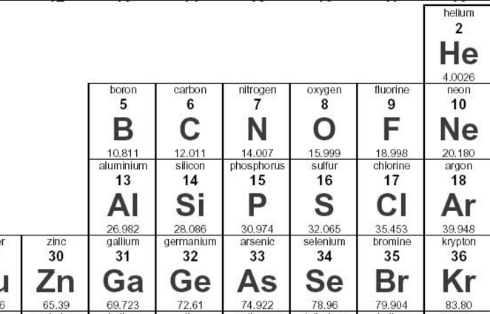
Exit Task
Do you expect carbon (C) to be more similar to nitrogen (N), boron (B), or silicon (Si). Refer to the image below. Why?
Homework:
Penny Lab Prelab Qs 1-8
L9 Qs 1, 2, 4
due Wednesday 9/20

