Slide 1
Living By Chemistry
SECOND EDITION
Unit 4: TOXINS
Stoichiometry, Solution Chemistry, and Acids and Bases

Slide 2
Lesson 81: Drop In
Molecular Views

Slide 3
ChemCatalyst
Examine the gummy bear in the sugar solution you prepared in class yesterday.
What does the gummy bear’s appearance suggest about the solution?
Is the solution saturated? Why or why not?
Imagine that you have 1 L of a 2.0 M sugar solution in a large container. You pour out 100 mL into a beaker.
Did the concentration of sugar in the large container change?
Did the number of moles of sugar in the large container change?

Slide 4
Key Question
How can you convert from molarity to moles of solute?

Slide 5
You will be able to:
  describe solution concentration on a particulate level
  calculate the number of moles of particles from the molarity and the volume of a solution
  differentiate between particles in ionic and molecular solutions

Slide 6
Prepare for the Activity
  Work in groups of four.
  Never taste substances in the laboratory.

Slide 7
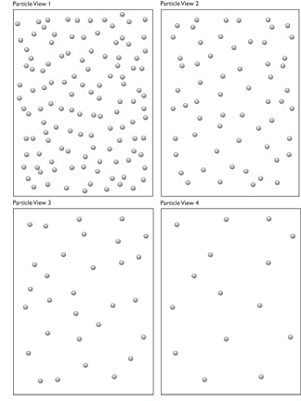
Discussion Notes
The particle views represent molecules dissolved in water.
4 in.
3 in.
Particle view 1
120 particles
Number density:
10 particles/in²
Particle view 2
60 particles
Number density:
5 particles/in²
Particle view 3
30 particles
Number density:
2.5 particles/in²
Particle view 4
15 particles
Number density:
1.25 particles/in²

Slide 8
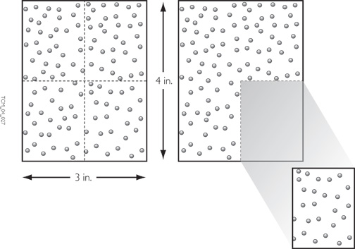
Discussion Notes (cont.)
Any sample cut out of the original Particle View 1 has the same concentration of dots per square inch as the large sample.

Slide 9
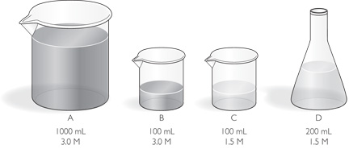
Discussion Notes (cont.)
Concentration does not depend on the size of the sample.
In order to create solutions C and D, you must dilute the original solution to half its molarity.

Slide 10
Discussion Notes (cont.)
The relationship between the number of moles of particles in a solution and the volume of the solution is proportional.
Number of moles = k • volume of solution (in liters)

Slide 11
Wrap Up
How can you convert from molarity to moles of solute?
  The relationship between moles of molecules in a solution and liters of solution is a proportional one described by the formula M = mol/L, where M is the molarity of the solution.
  The concentration (or molarity) of a solution does not change with the size of the sample.
  In calculating the number of moles of particles in an ionic solution, it is necessary to take into account all the ions in the formula.

Slide 12
Check-In
How many moles of sugar, C₁₂H₂₂O₁₁, are in 52 mL of a 0.50 M solution?
How many moles of sugar, C₁₂H₂₂O₁₁, are in 26 mL of a 0.50 M solution?

