Slide 1
Organism reproductive system of an octopus and a seahorse

Slide 2
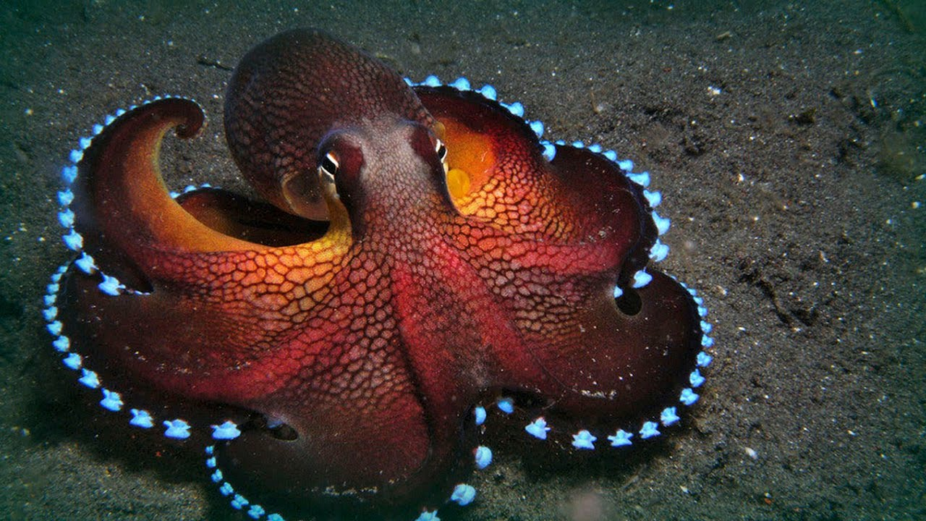
Maldives Octopus
The maldives octopus is a cephalopod(These species are distinct because of their ability to learn and to solve problems, as well as their tentacles and other adaptations to their ocean environment.) mollusk with eight sucker-bearing arms, a soft saclike body, strong beaklike jaws, and no internal shell, they are mostly made up of muscles.
-Octopuses are nocturnal animals
-There are about 300 different recognized species of octopuses
-Usually the female dies shortly after giving birth because its weak
-The female will try to eat the male after mating because it won't eat again until the young are born months later

Slide 3
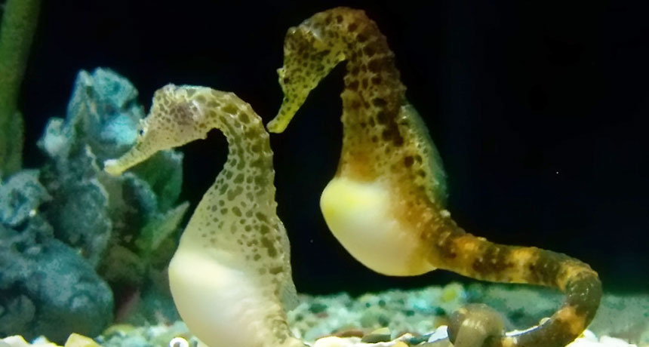
Seahorse
A small marine fish with segmented bony armor, an upright posture, a curled prehensile tail, a tubular snout, and a head and neck suggestive of a horse.
-The male is the one that gets pregnant and gives birth.
-The female seahorse deposits up to 1,500 eggs in the male's pouch.
-The male carries the eggs for 9 to 45 days until the seahorses emerge fully developed, but very small.
-There are 47 different species of seahorses.

Slide 4
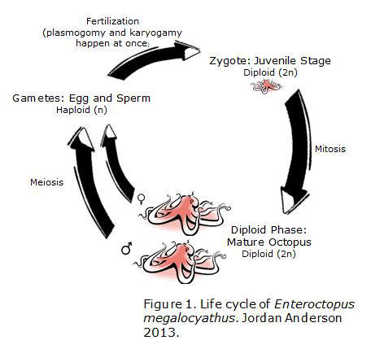
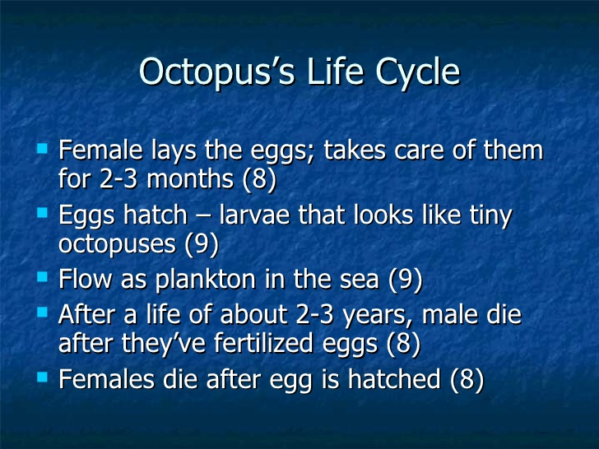
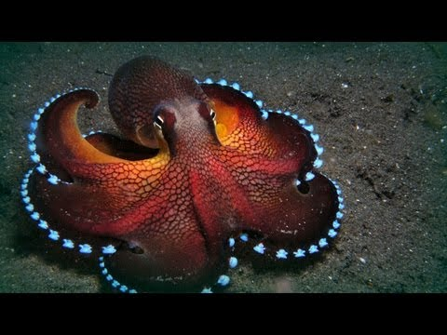
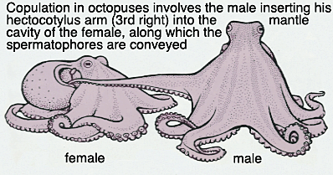
Octopus reproductive strategy

Slide 5
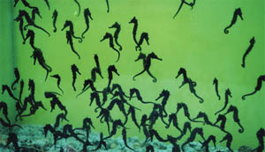
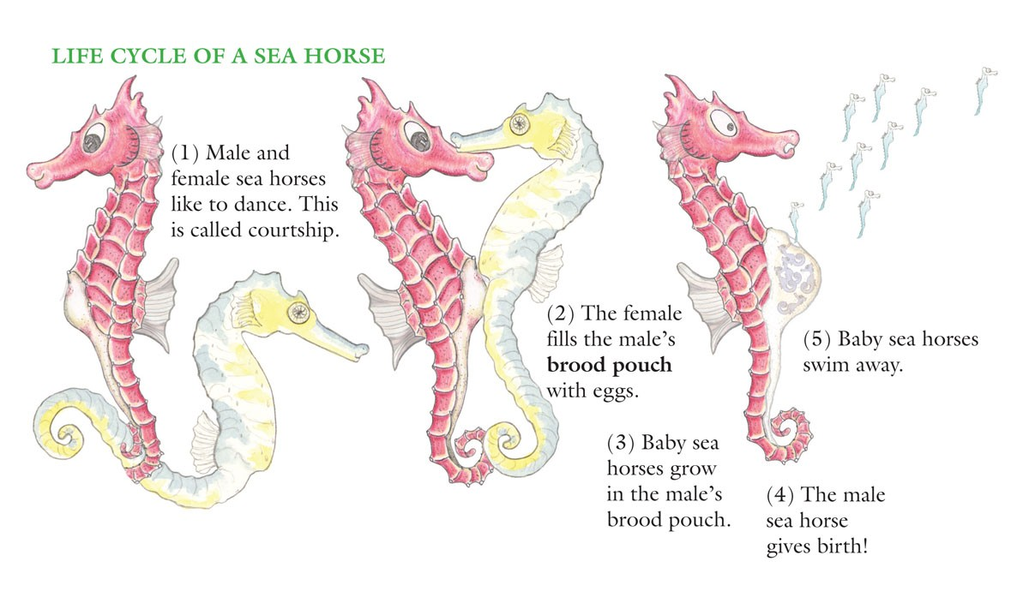
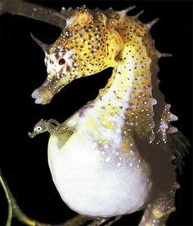
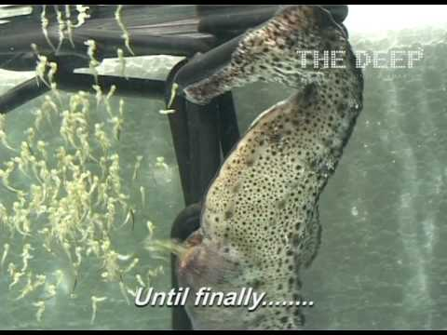
Seahorses reproductive strategy

Slide 6
Similarities
-They are both sexual animals
-Both involve gametes
-They both change colors to blend in with their surroundings
- Both have gills
- One of the mates usually die after mating
-Can live out of water for a very short amount of time
-They are both nocturnal animals

Slide 7
Differences
-The male is the one that gets pregnant and gives birth
-The female seahorse deposits up to 1,500 eggs in the male's pouch
-The female octopus gives birth to about 150,000 eggs
-The male carries the eggs for 9 to 45 days until the seahorses emerge fully developed, but very small.
-Usually the female octopus dies shortly after giving birth because its weak
-The female octopus will try to eat the male after mating because it won't eat again until the young are born months later

