Slide 1
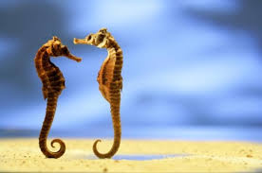
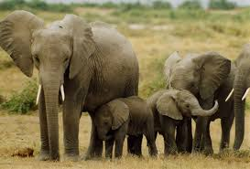
Reproduction Strategies of Seahorses and Elephants

Slide 2

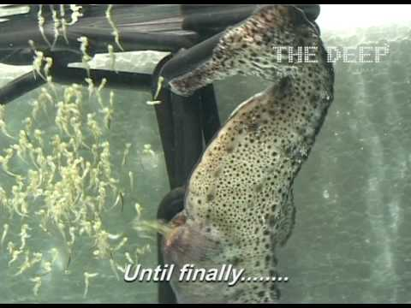
Seahorse Reproduction
Males carry the offspring in a pouch for 25-45 days
Seahorses use sexual reproduction to create offspring
Males will commonly fight with their tales during mating season
They can reproduce up to 2,000 fry (babies) at a time
Less than 1% of fry survive after birth, parents do not protect or take care of offspring
During the mating process, both the female and the male engage in a dance that can last up to eight hours, then the female places her eggs into the male seahorse
Some seahorses mate together for life, but some switch mates or only mate with one another for one season
Seahorses reach sexual maturity at the age of 6 months
Seahorses live up to 5 years

Slide 3
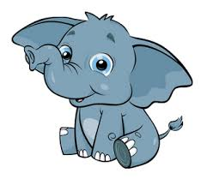
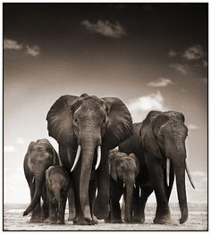
Elephant Reproduction
Elephants are the largest mammals on earth
Elephants use Sexual reproduction to create offspring
Age of sexual maturity for females is ages 11-20 and for males is ages 14-19
Competition for potential mates is settled by bulls through a trial of strength, usually pushing, tusking, wrestling, and ramming, the winner selects a female from the herd and after a brief courtship they mate.
Mating lasts 20 seconds and continues periodically for 2 days.
Length of gestation is 20-22 months (The longest gestation period of all mammals)
On average produce only 4 calves in a 50 year reproductive life span
Elephant calves are dependent on their mothers for 3-4 years after birth

Slide 4
Comparing and Contrasting The Reproductive Strategies Of Elephants and Seahorses
Similarities:
Differences:
Both use sexual reproduction to produce offspring
Both animals court their significant other before mating
Males of both species often fight for the right to reproduce with a female
Male seahorses give birth whereas male elephants do not
Seahorse gestation period is significantly shorter than elephant gestation period
Elephant calves depend on their mothers for survival but fry are on their own after birth
Seahorses reach sexual maturity at an earlier age than Elephants

Slide 5
