Slide 1
Lizards and frogs

Slide 2
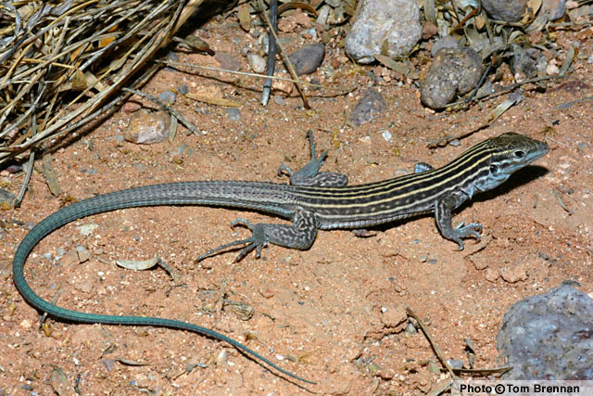
Name and description
Whiptail lizard (Cnemidophorus uniparens)
Lives in the southern western united states
This species of lizard is made up of only female, all the lizards are one gender
Even though all the lizards are female some act like males because of different levels of sex hormones

Slide 3
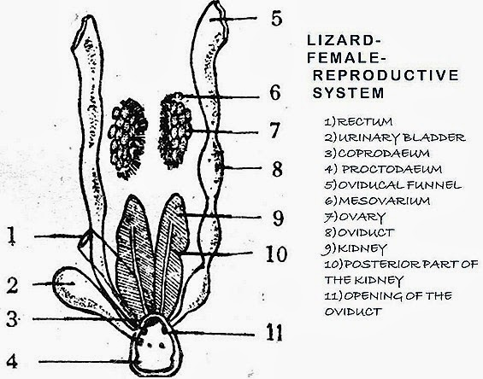
Reproductive Lizards
-These all female whiptails reproduce by laying eggs that are not fertilized
Mainly because there are no males to have sex with the females

Slide 4
Description of reproductive strategy
-it all happens in the lizards ovaries, the ovaries start out small but get bigger as the eggs inside them mature
- the eggs are then released into the oviduct where the eggs develop hard shells
- the eggs develop inside the shell while the lizards ovaries prepare another round of egg production
-in a couple of weeks the eggs that have been developing finally leave the lizard and lay eggs
- the lizards have different times for when these cycles happen letting the male/female behavior happen

Slide 5
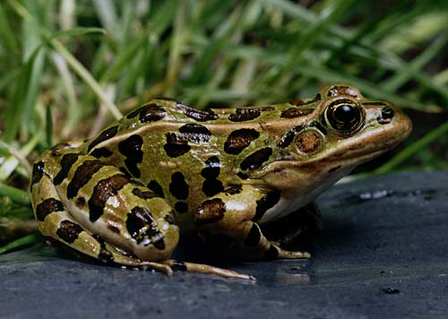
Name and description
Leopard Frog (Rana Pipiens), The frog is an an amphibian and they are predominantly aquatic which means they aren't always in the water
They have smooth,moist skin and its strong
They have webbed hind feet they have adapted for swimming and leaping
They eat worms and insects
Adults are 5 to 9 centimeters long
These frogs breed in freshwater ponds once a year
The male has a special call to call females over

Slide 6
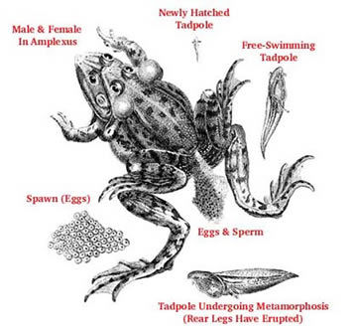
Reproductive category for frogs
Female frogs lay hundreds of eggs
The male expels sperm over the eggs as the female ejects them
The fertilized eggs float off in duster and become attached to water plants
Eggs lay occurs at night or early dawn in the springtakes about ten minutes

Slide 7
Description of reproductive strategy frogs
The female lays the eggs and the male puts the sperm on the eggs and the eggs leave and doesit by themselfs.

Slide 8
Comparison between two organisms
Frogs
Frogs have eggs and sperm to reproduce
Needed one male and one female to happen
Lizards
Lizards only are made up of females
Male sperm is not used unlike the frogs
Theres no male

Slide 9
similar
They both have eggs
They both like to get ontop of each other and have sex
Both eat insects

