Slide 1
Moss Vs. El Lobo

Slide 2
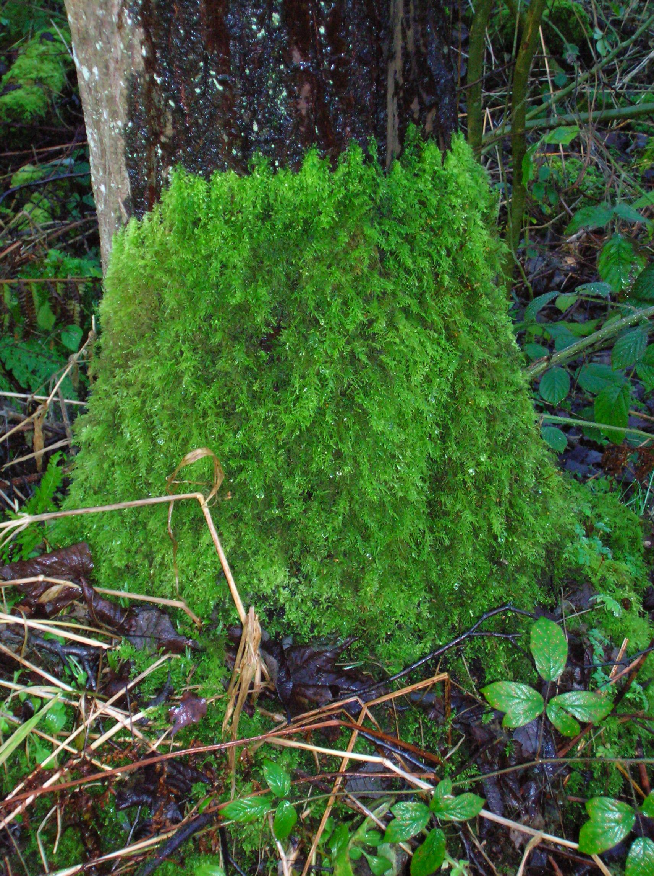
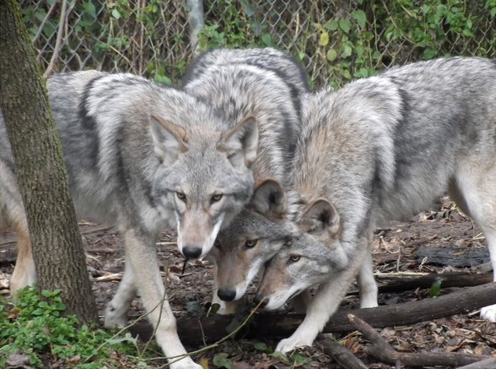
Facts

Slide 3
Moss
One thing is that Moss is an alternation for reproduction (Has both Reproductive properties, Asexual and Sexual)
It produces spores in the life cycle
The cell divides and produces long green threads
Gamete producing moss plants develop from these threads
The haploid is the major stage for moss in their life
Their lifespan consists of a couple years to 10 depending on the species

Slide 4
Wolf
They are sexaul reproducing animals
They may life to 13 years but average lifespan is 5 to 6
Female wolves usually have a litter of 1-11 pups the average however is 5-6
Wolves are sexually mature at the age of 2 or 3
Gestation consists of 63 days
Pups are born blind and deaf

Slide 5
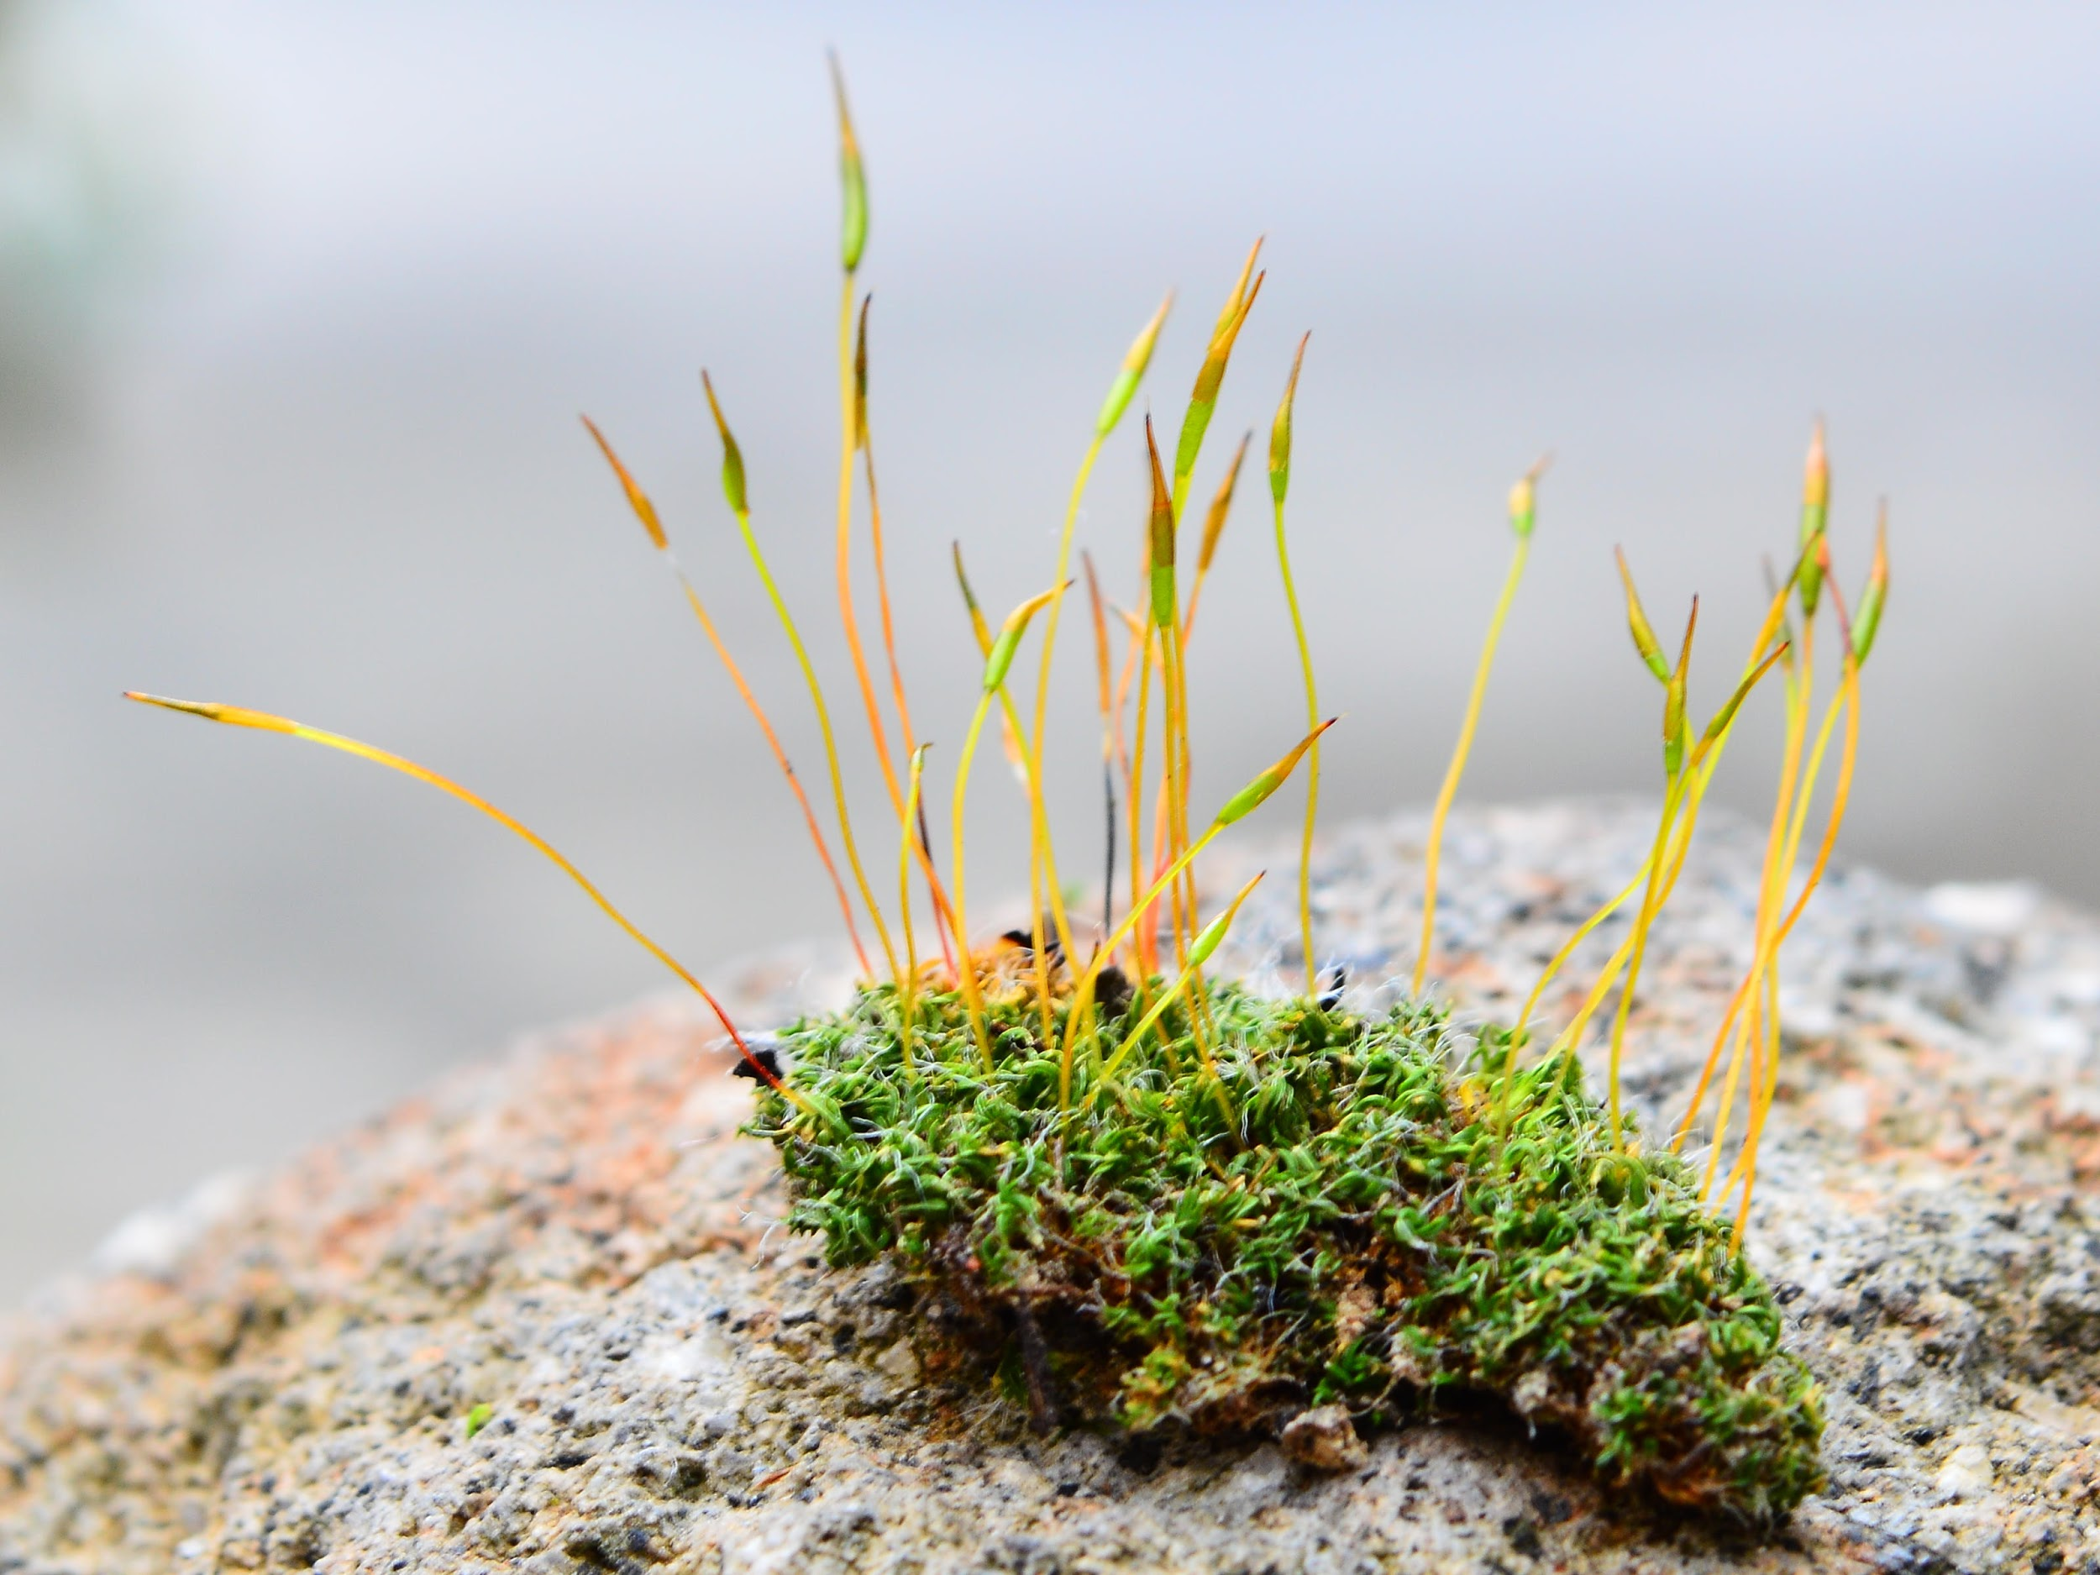
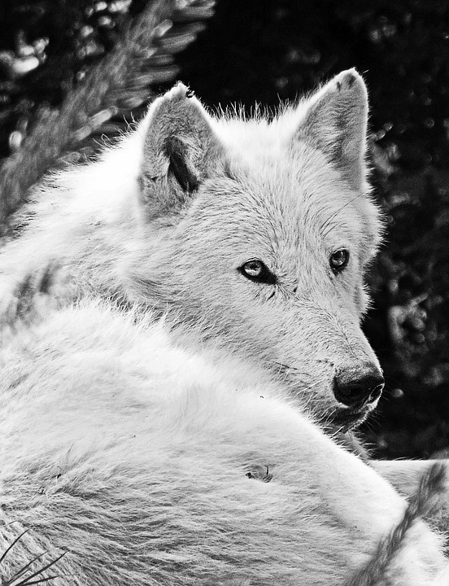
Similarities and Differencs

Slide 6
Wolf
Both can have a sexual reproductive attribute
Both average lifespan consists between 10 years
Wolves are mammals
Wolfs are always on the move
Mate between January and March
Moss
Both can have a sexual reproductive attribute
Both average lifespan consists between 10 years
Moss is a plant
Moss stays in one spot and grows
Is also asexual
Reproduce in many ways

Slide 7
Wolf
Advantages Disadvantages
Helps natural selection remove mutations in the population
Offspring become better than the parents
Helps keep the pack strong
Reproduction is much slower than asexual
Sometimes reproduction cannot happen depending on the outcomes that might occur
Can be a bad thing if predators are around, pups can’t see or hear for 63 days

Slide 8
Moss
Advantages Disadvantages
Rapid population, can always produce more
Does not need a mate in order to reproduce
They do not need to carry their offspring for a long time
If there is no mate then the offspring will only carry one trait
More percentage of extinction
They cannot adapt

Slide 9
Overall
Both species are very healthy in their reproduction process and can excel at very good lengths

Slide 10
Sources
Thenextgalaxy.com
Occupytheory.org
greengarageblog.org

