Slide 1
Reproduction

Slide 2
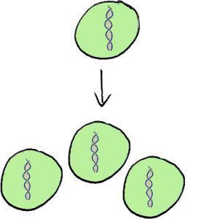
Asexual Reproduction
Process of reproduction with no gender involved where a single gggggg organism duplicates itself.

Slide 3
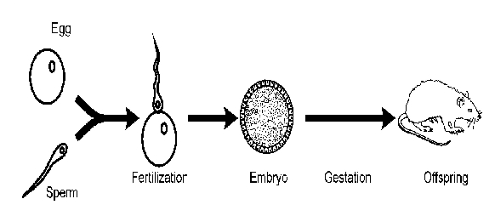
Sexual Reproduction
Process of reproduction where two sexes combine their genetic information to produce offspring.

Slide 4
Seahorses
Reproduces sexually between a male and female
Sexual
Female inserts eggs in male’s pouch
Male raises eggs
Male gives birth
Bread Mold
Reproduces both asexually and sexually
Asexual
Spore germinates
Reproductive parts form and eventually break apart, producing new spores
Sexual
Nuclei from different “genders” fuse
Zygotes form
Zygotes develop into zygospores
Zygospores mature and produce sporangia, which release more spores
The Two Organisms

Slide 5
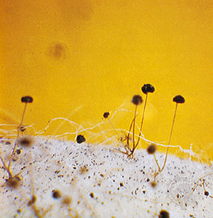
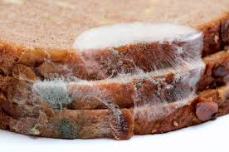
Bread Mold
Zygospore originates from the Greek word, zygos, which means joining (Olbrantz)
The scientific name of bread mold is Rhizopus stolonifer
Instead of having “sexes” or “genders,” they have mating types, which are categorized as “+” and “-”

Slide 6
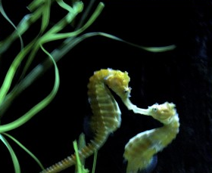

Seahorses
When males compete for a mate, they will tend to fight
Female and male seahorses will engage in daily dances (National Geographic)
During one dance, the female will insert her eggs into the male’s pouch
The female visits every day
Males give birth at the end of a 21 day span

Slide 7
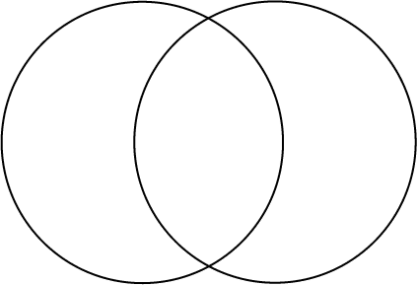
Bread Mold vs. Seahorse
Reproduces both asexually and sexually
Only reproduces sexually
Female inserts eggs into male’s pouch
Doesn’t have genders, instead has “mating types”
Can carry up to 2,000 seahorse babies at a time
Can reproduce sexually
Bread mold forms in around one to six days
Pregnancy can last 10-25 days
Age of sexual maturity is undefined
Males give birth
Reach sexual maturity at 6 months

Slide 8
Sources
http://news.nationalgeographic.com/news/2002/06/0614_seahorse_recov.html
http://www.springer.com/cda/content/document/cda_downloaddocument/3001.swf
http://bioweb.uwlax.edu/bio203/2011/olbrantz_chri/reproduction.htm
http://www.naturefoundationsxm.org/education/sea_horse/seahorses.htm
https://prezi.com/tj5csuk5wfxe/chapter-10-project/

