Slide 1
Hydra and Moss

Slide 2
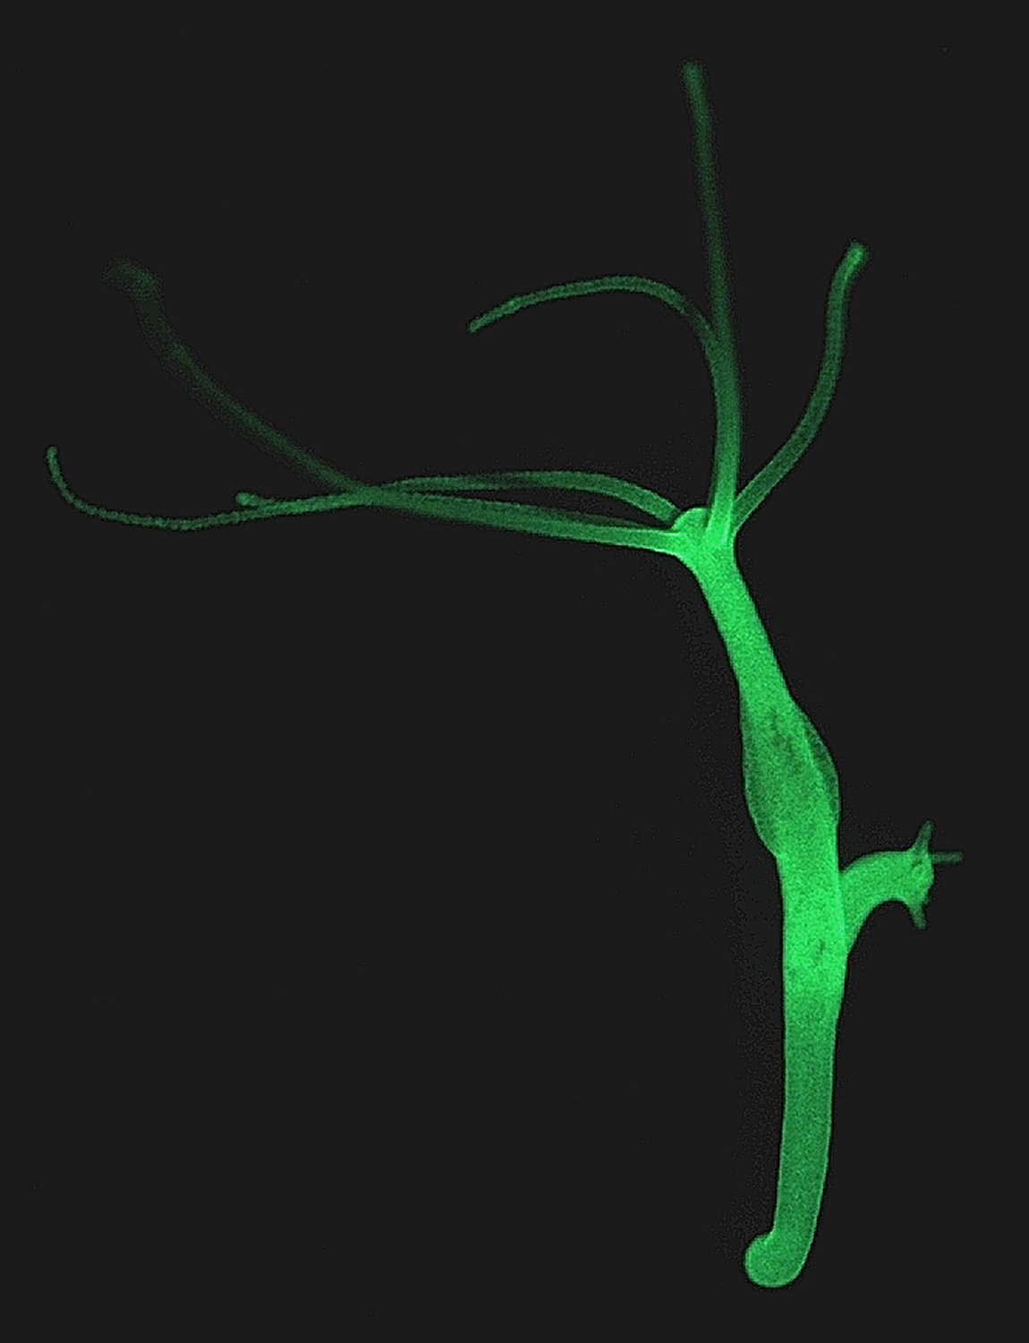
Hydra
Hydra are small invertebrate freshwater animals that have many limbs. They are native to temperate and tropical locations.
Reproduction:
Hydra reproduce asexually by ‘budding’. In budding, the offspring form as a lump on the parent, and eventually become big enough to break off and live on it’s own.

Slide 3
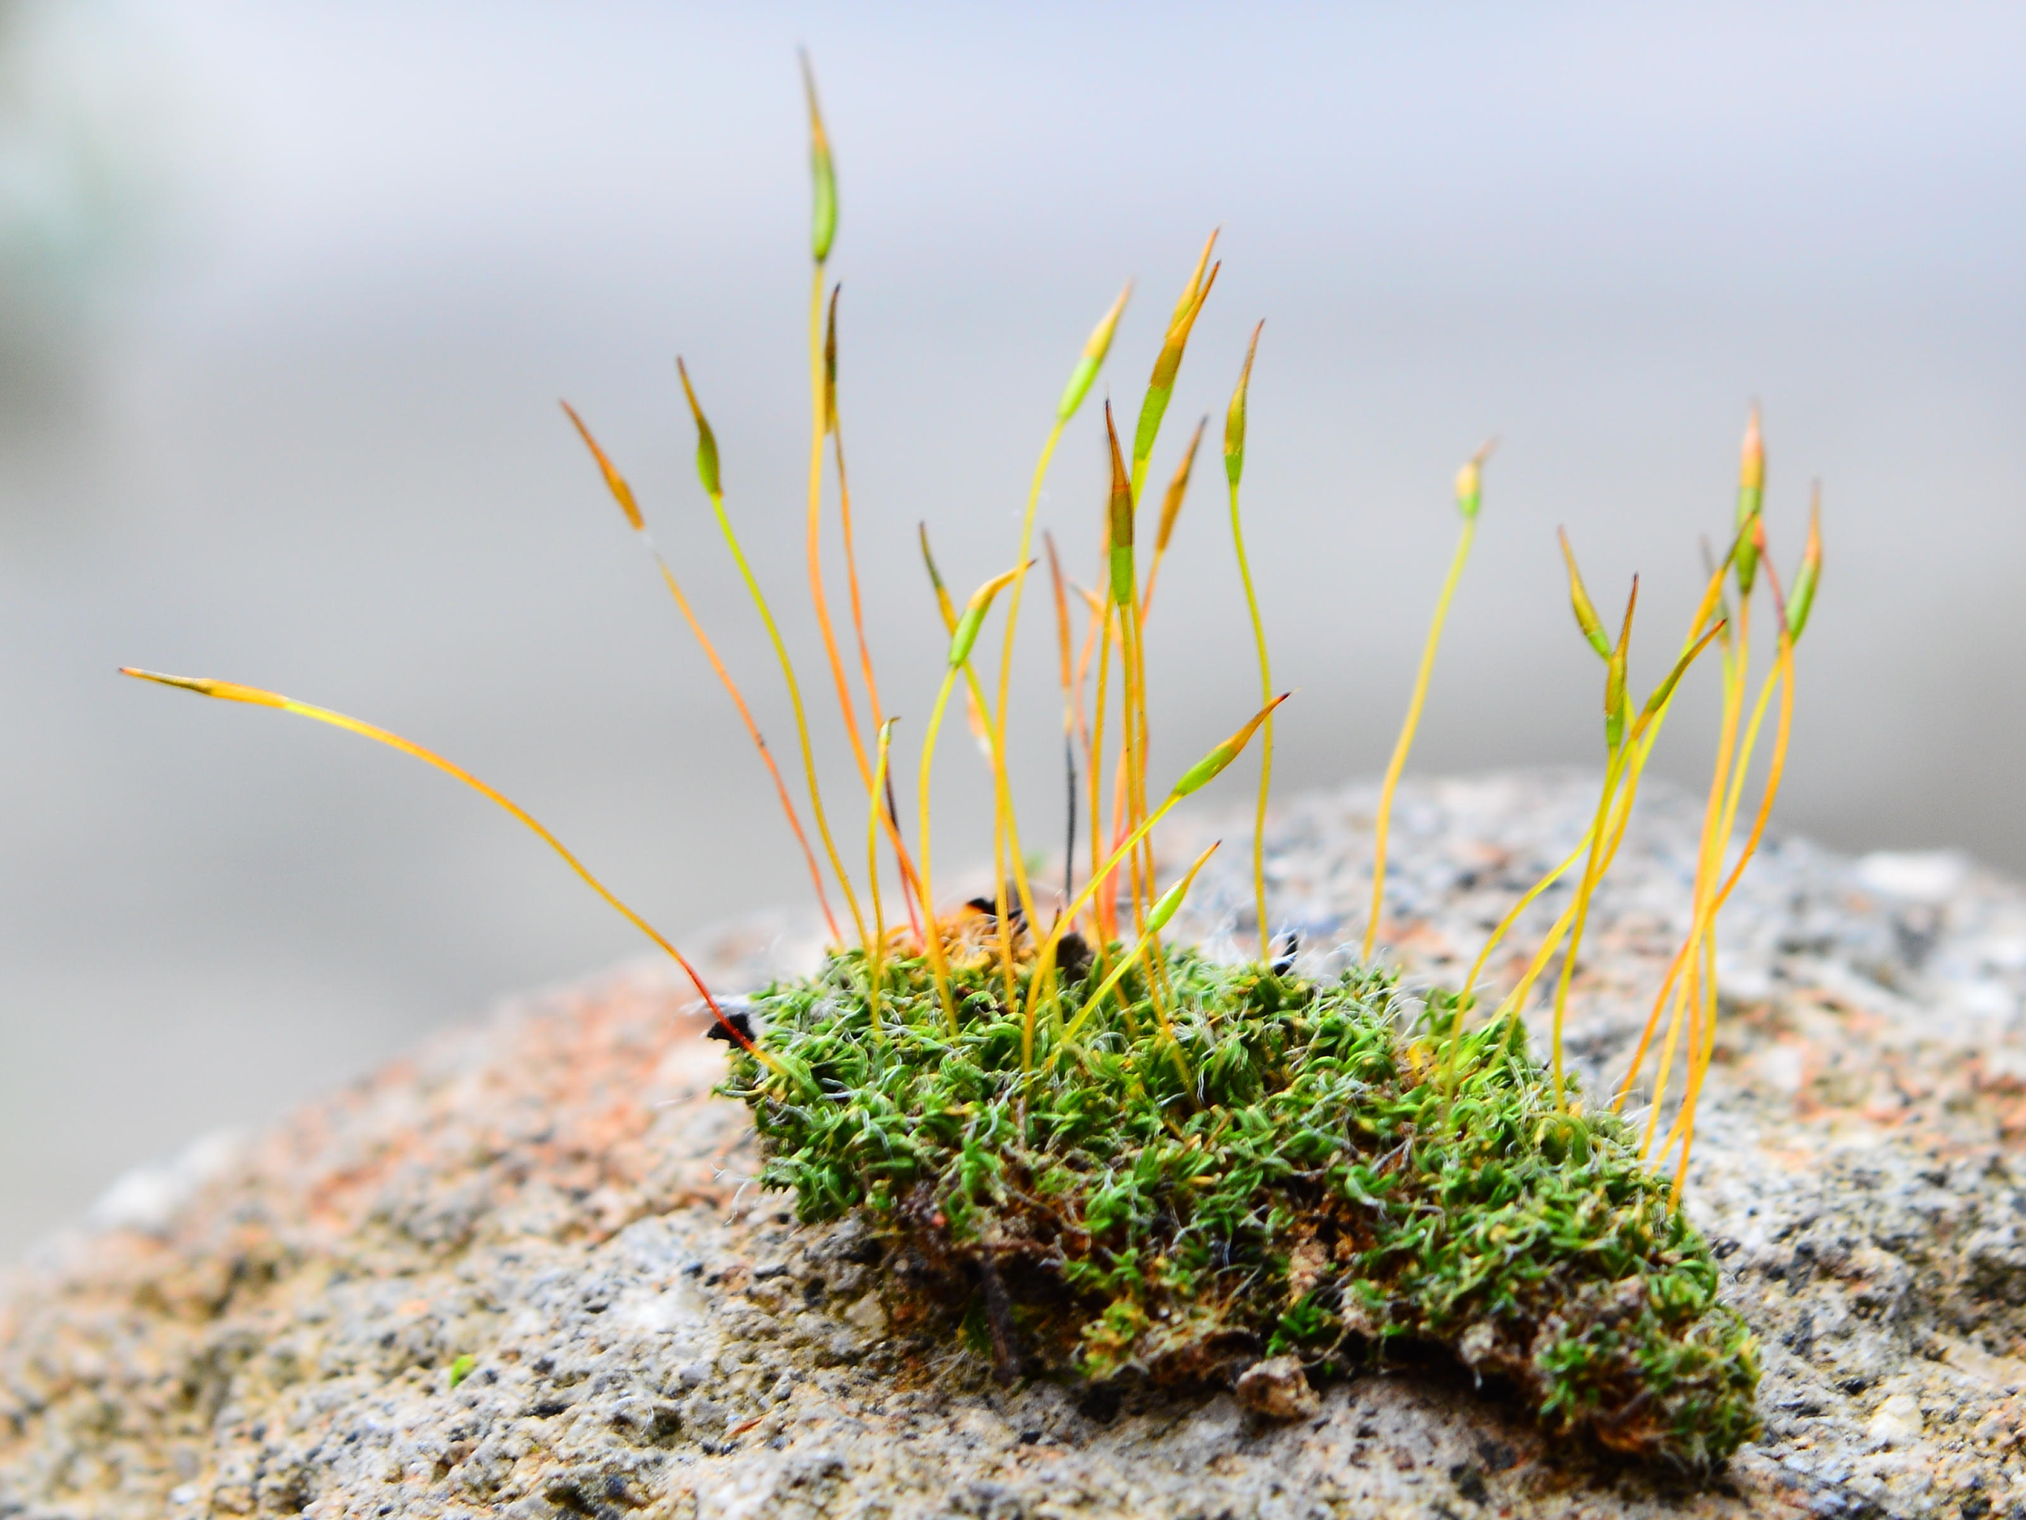
Moss
Moss are small flowerless plants that typically grow in small dense clumps, often in shady or damp locations. The individual plants are composed of simple single-cell leaves, connected to a branched or unbranched stem.
Reproduction:
Moss reproduces sexually by using spores. Male moss leaves will release sperm to swim to female leaves on another plant to fertilize it. It is important to note that this can only occur when the moss plants are damp and wet. After the female egg is fertilized it will create a spore, which will mature in 6 months.

