Slide 1
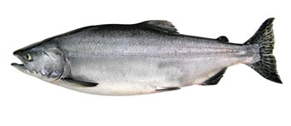
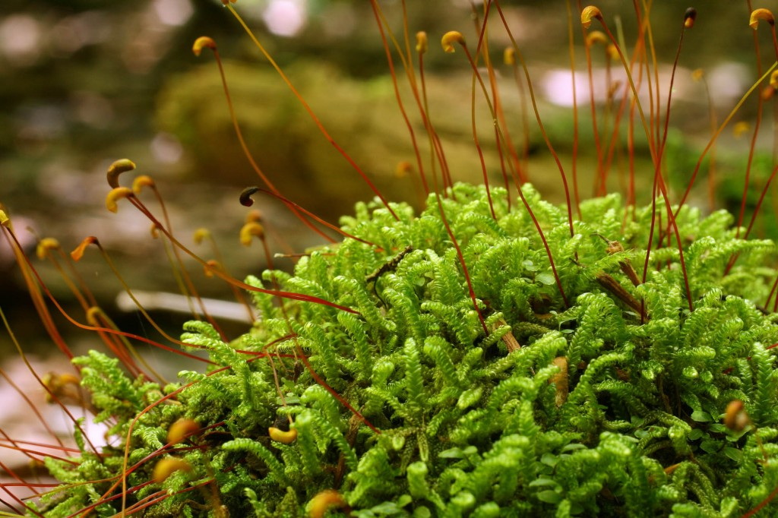
Organism Reproductive Strategies

Slide 2
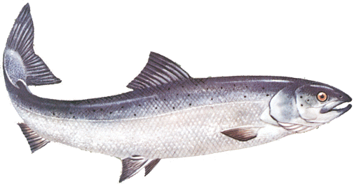
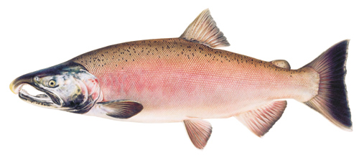
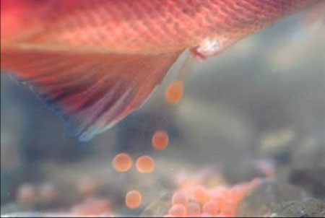
salmon
-Salmons have an average of 2,500 eggs, but can have up to 7,000.
-They do not eat while migrating up stream.
-They are called “fry” when emerging from their eggs.
-can travel up to 3,500 miles to spawn.
-The lightest salmon is the pink salmon (8.2 lbs) Can grow up to 20 inches.
-Spawning occurs in the fall(Pink salmons spawn in september & November).
-once they spawn, they die afterwards.
-sexual maturity age of 2 sea years.
Atlantic salmon
Pink Salmon
Salmon spawning

Slide 3
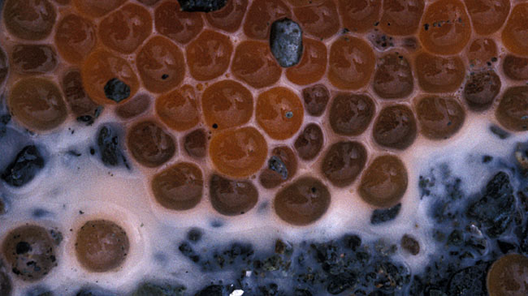
Salmon(Continued)
-Length of gestation is from december to february.
-sexual maturity age of 2 sea years.
-. The lifespan of the salmon is 3 to 8 years.
-They can live in both fresh and saltwater.
-The male salmon bite each other and display their kype.(The hook on the lower jaw of a mature male salmon)
-milt squeezed from male to fertilize eggs.
-The winning male joins the female salmon side by side to release their gametes above the redd.
Salmon gametes mixing

Slide 4
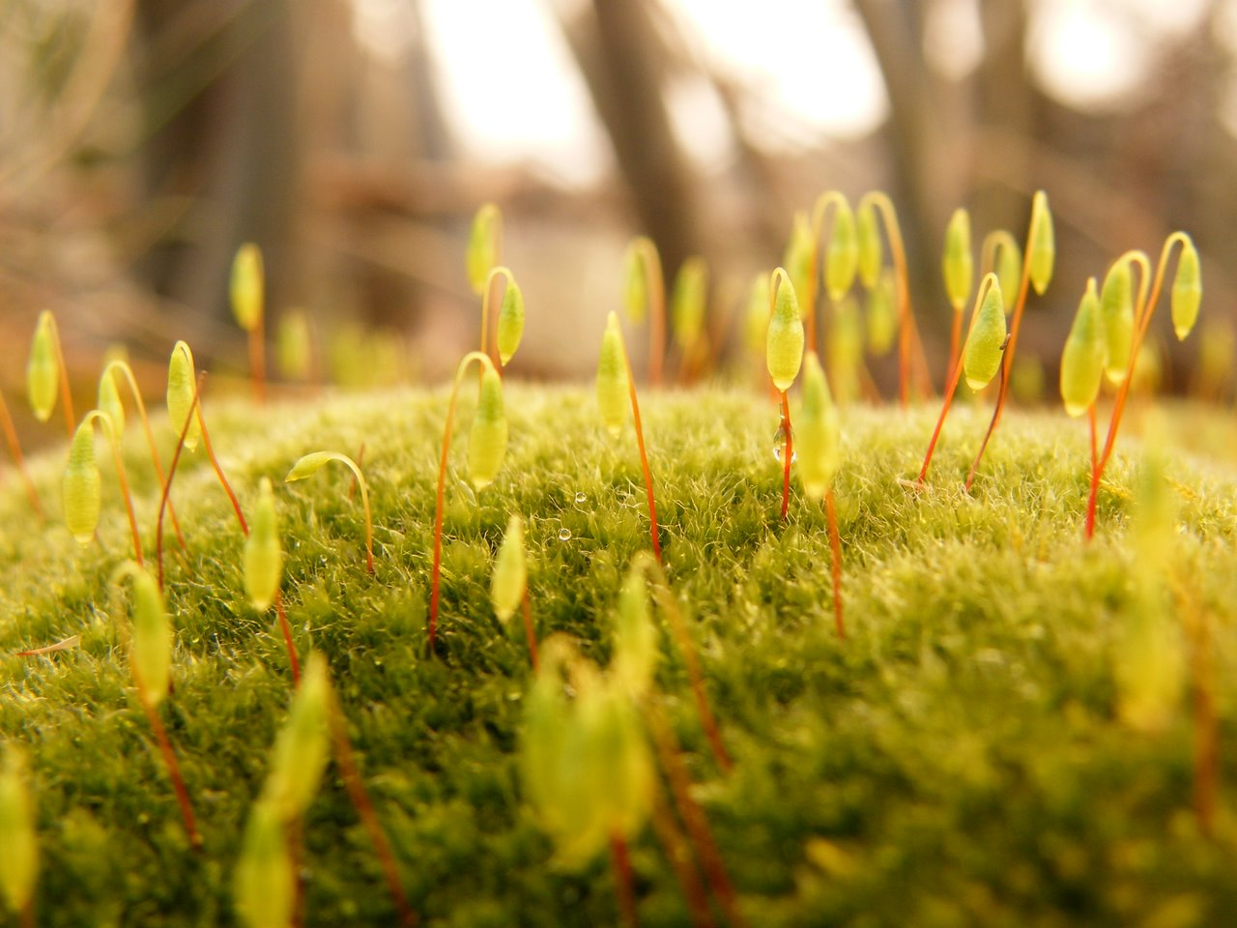
Moss
-Moss does not have a certain number of offspring.
-It produces in wet periods like spring.
-The structures used for reproduction are the capsule that contains spores, the spores, and the egg.
-The maturity is not based on age but size.
-There is no gestation period.
-There is no offspring dependency.
-The life span is usually 3-5 years but it can reach to ten years.
-There are no mating behaviors since it is a plant.

Slide 5
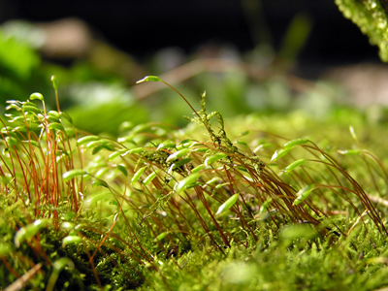
Moss Differences
-Moss produces in wet periods like spring. Salmon Reproduce in November
-The structures used for reproduction are the capsule that contains spores, the spores, and the egg. Salmon don’t have capsules.
-The maturity is not based on age but size. Salmon gain sexual maturity in two sea years.
-There is no gestation period. Salmon have a three month gestation period.
Moss Similarities
-Moss does not have a certain number of offspring. Salmon can produce 2,500 to 7,000 eggs.
-There is no offspring dependency. Salmon die after spawning.
-The life span is usually 3-5 years but it can reach to ten years. Salmon live to three to eight years.
There are no mating behaviors since it is a plant. There are none with salmon.

Slide 6
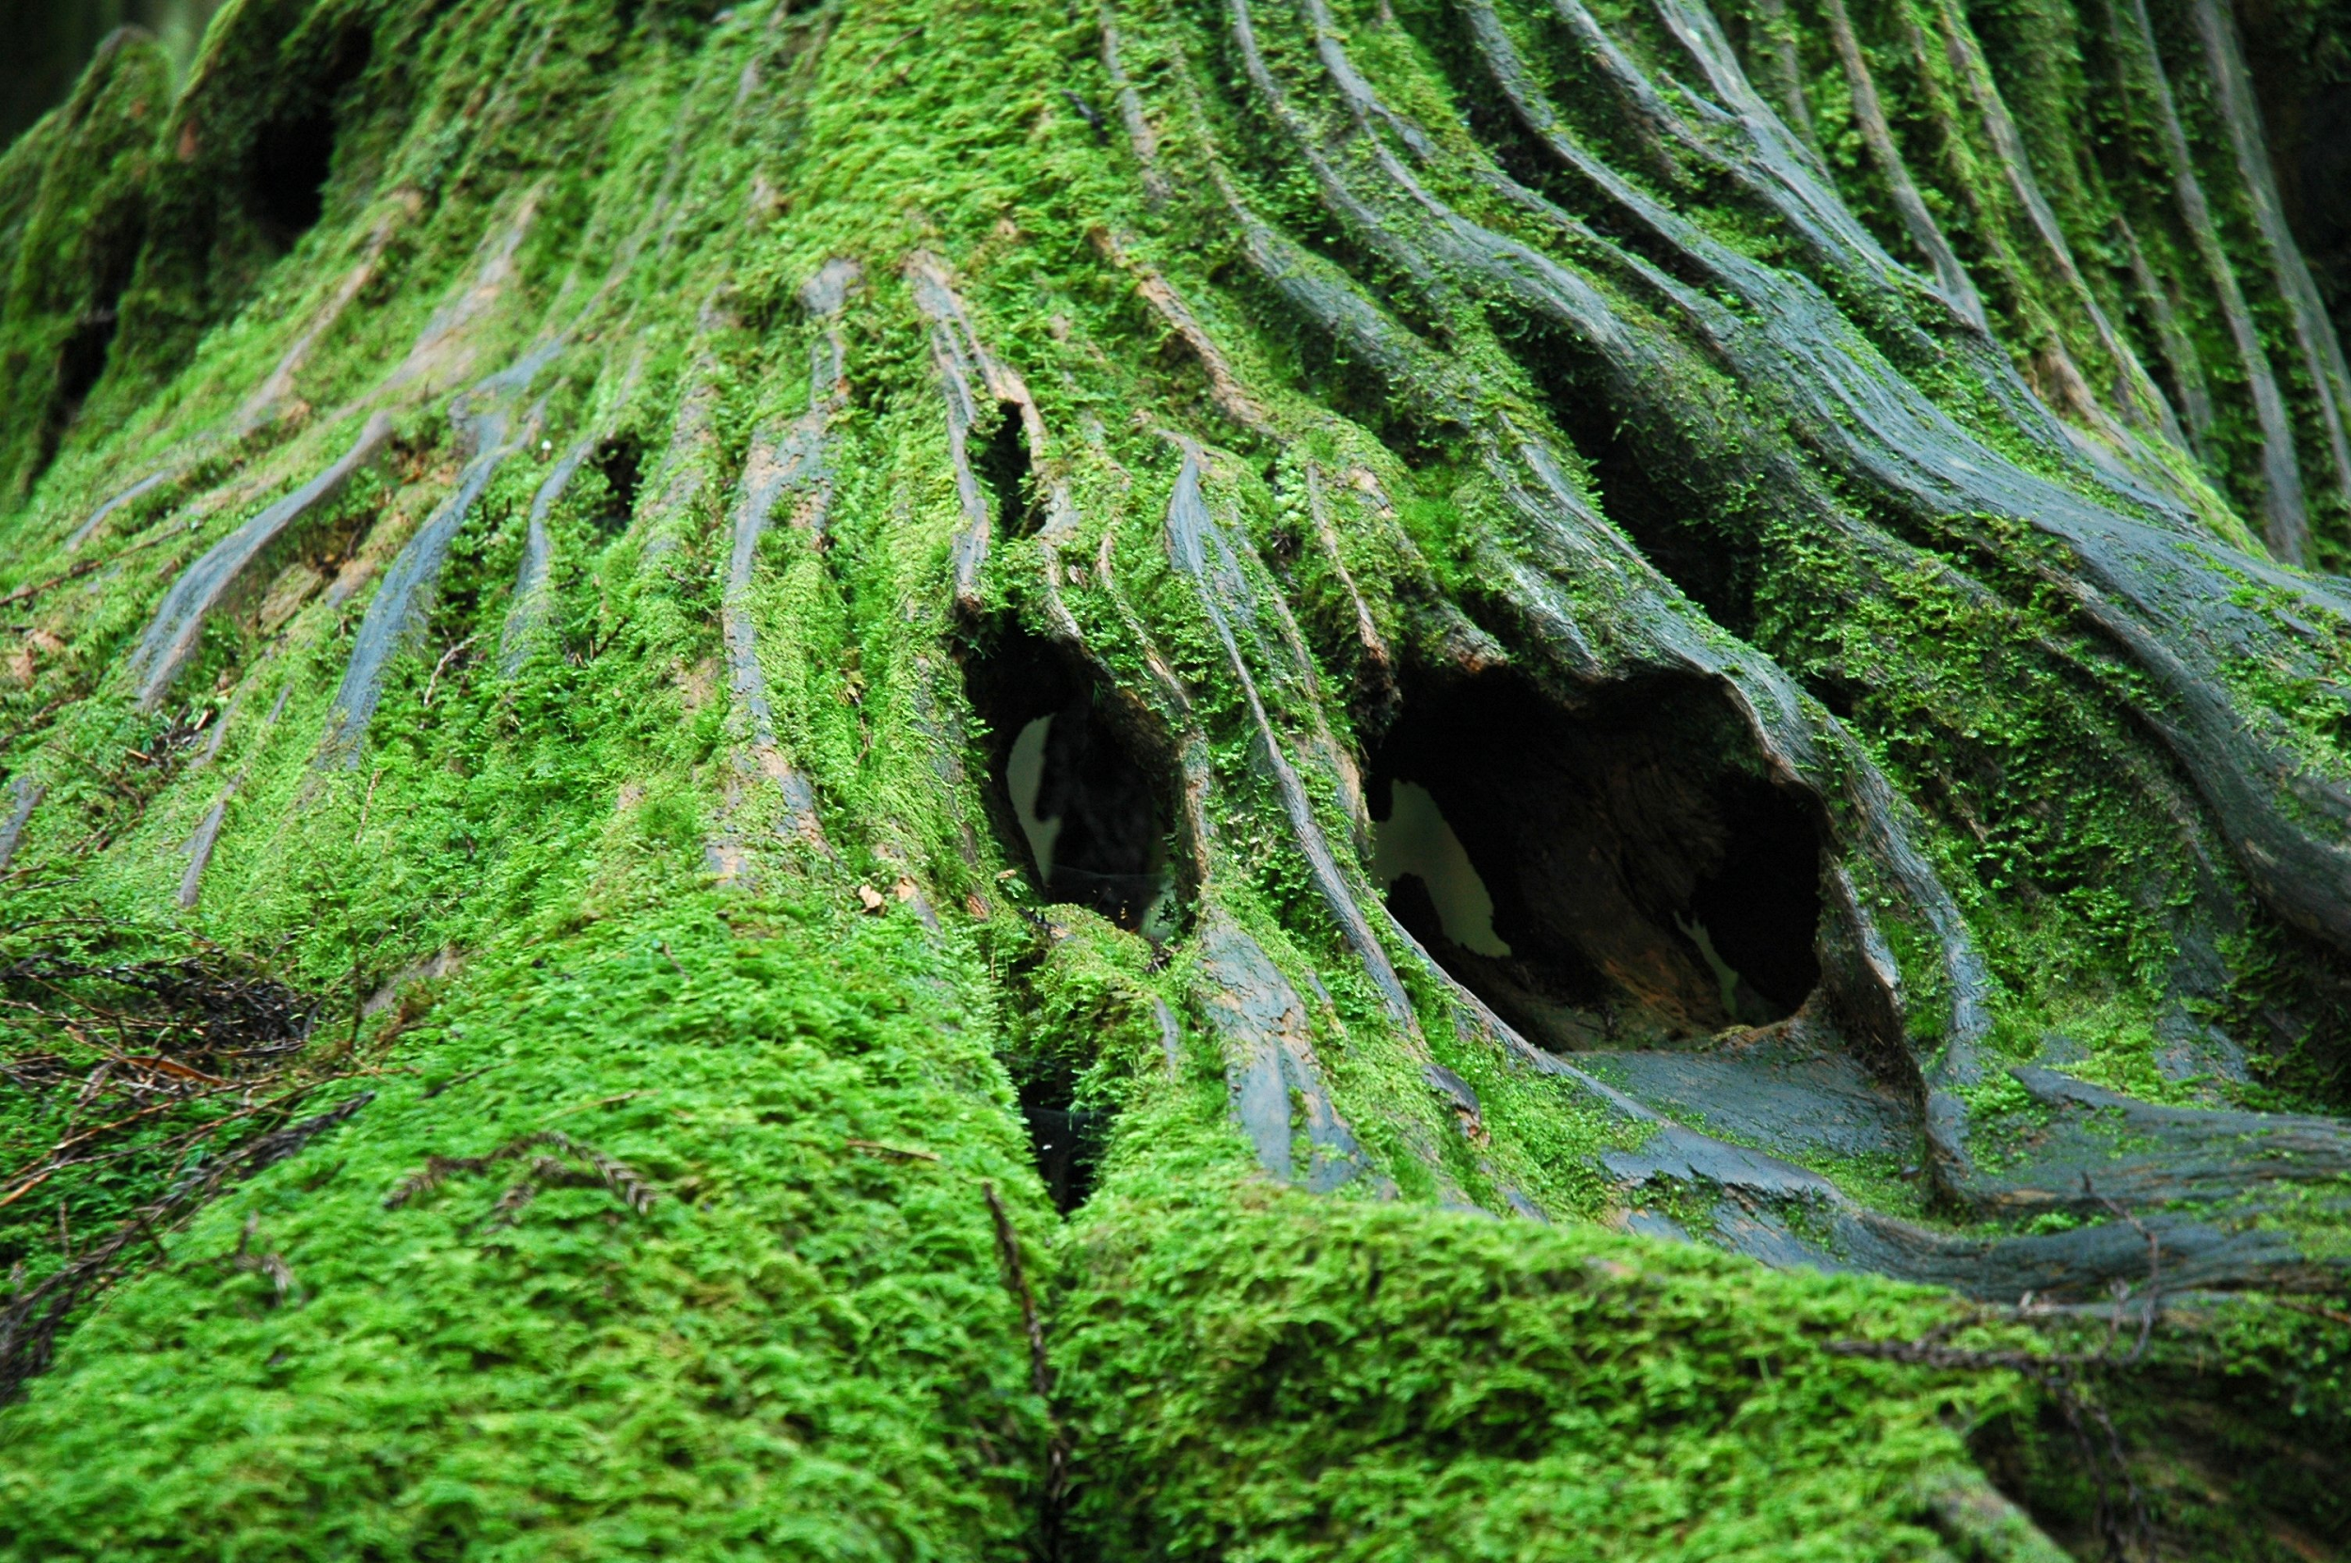
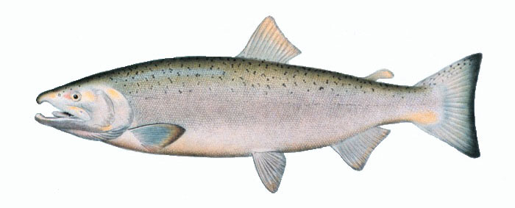
Advantages and Disadvantages
-Disadvantage - Salmon have a dangerous environment to live and spawn in.
-Advantage - Salmon can make sure the eggs and sperm are where they want them and that they contact each other.
-Disadvantage - Moss can’t control where their spores go.
-Advantage - Moss spores can go everywhere and spread quickly.
Moss
Coho Salmon

Slide 7
Moss Sources
-Smith, T. (n.d.). Moss Reproduction. Retrieved March 31, 2016, from http://serendip.brynmawr.edu/biology/b103/f00/web1/smith.html
-The picture source’s link was bad.

Slide 8
Salmon sources
-http://www.marinebio.net/marinescience/05nekton/sarepro.htm
-http://home.utah.edu/~u0027332/funsalmonfacts.html
-https://en.wikipedia.org/wiki/Salmon
-http://www.defenders.org/salmon/basic-facts

