Slide 1
Chimpanzee and Elephants

Slide 2
Reproduction
Reproduction (breeding, procreation) is the biological process by which new individual organisms (offspring) are produced from their parents. Reproduction is a fundamental feature of all known life; each individual organism exists as the result of reproduction. There are two forms of reproduction: asexual and sexual. In asexualreproduction, an organism can reproduce without the involvement of another organism. Asexual reproduction is not limited to single-celled organisms. The cloning of an organism is a form of asexual reproduction.
sexual reproduction: In animals, sexually-reproducing adults form haploid gametes from diploid germ cells. Fusion of the gametes gives rise to a fertilized egg cell, or zygote. The zygote will undergo multiple rounds of mitosis to produce a multicellular offspring.
asexual reproduction:Organisms, both prokaryotes (archaea and bacteria), and eukaryotes (protists and unicellular fungi)

Slide 3
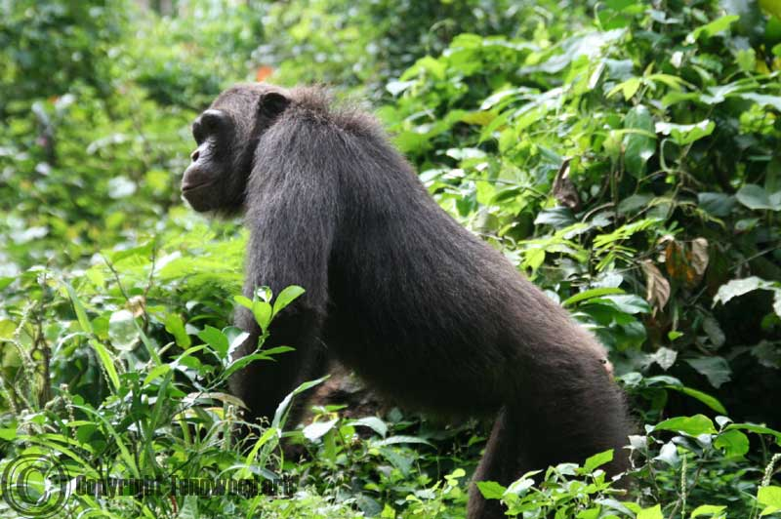
Chimpanzee
Inhabits Africa
Female Chimps are important to their loose community
A female estrous cycle can last for more than 30 days
Chimps reproduce by sexual reproduction
In certain types of chimps, female are the dominant animal
Chimpanzee are smart.

Slide 4
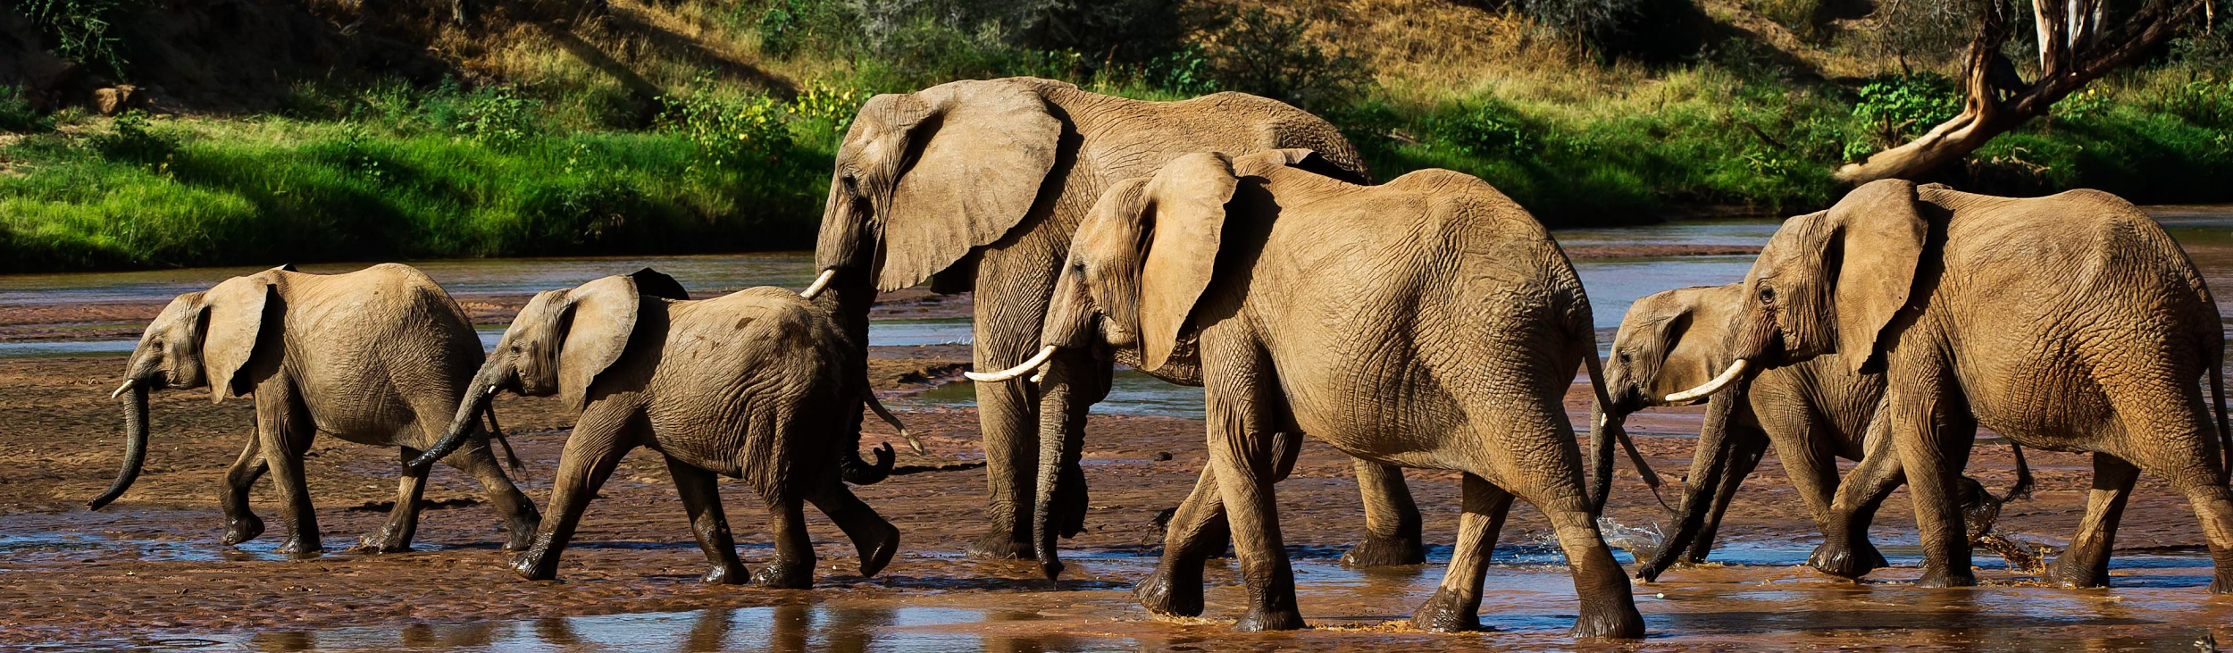
Elephant
A Elephant are the largest Mammals living today.
Adults Bulls may reach up to 3.3 meters (10.8 ft)
old) Africans Can live up to 60-70 yrs old)Elephants can weigh up to 6,000 pounds to 13,000
There are multiple types of Elephants like Asian Elephants , African bush elephants and African forest Elephants
These types of elephants can only live to only a certain age. (Asian can live up to 48 yrs

Slide 5
Compare/Contrast
Similarities:
Lives in same kind of environment
Both produce sexualy
Differences:
DIfferent education class. Chimps are smarter than elephants
Chimps have opposable thumbs like humans

