Slide 1
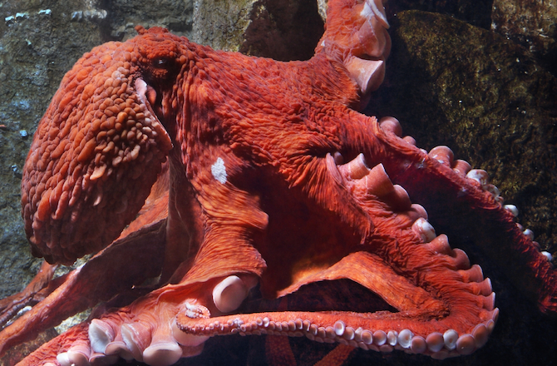
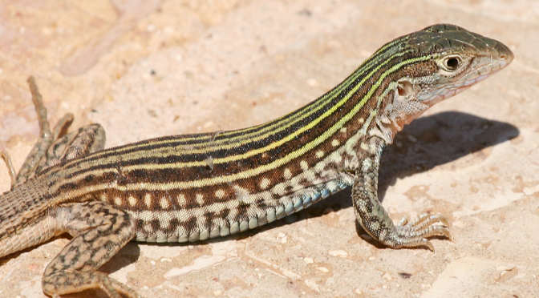
Reproduction of octopi & whiptail lizards

Slide 2
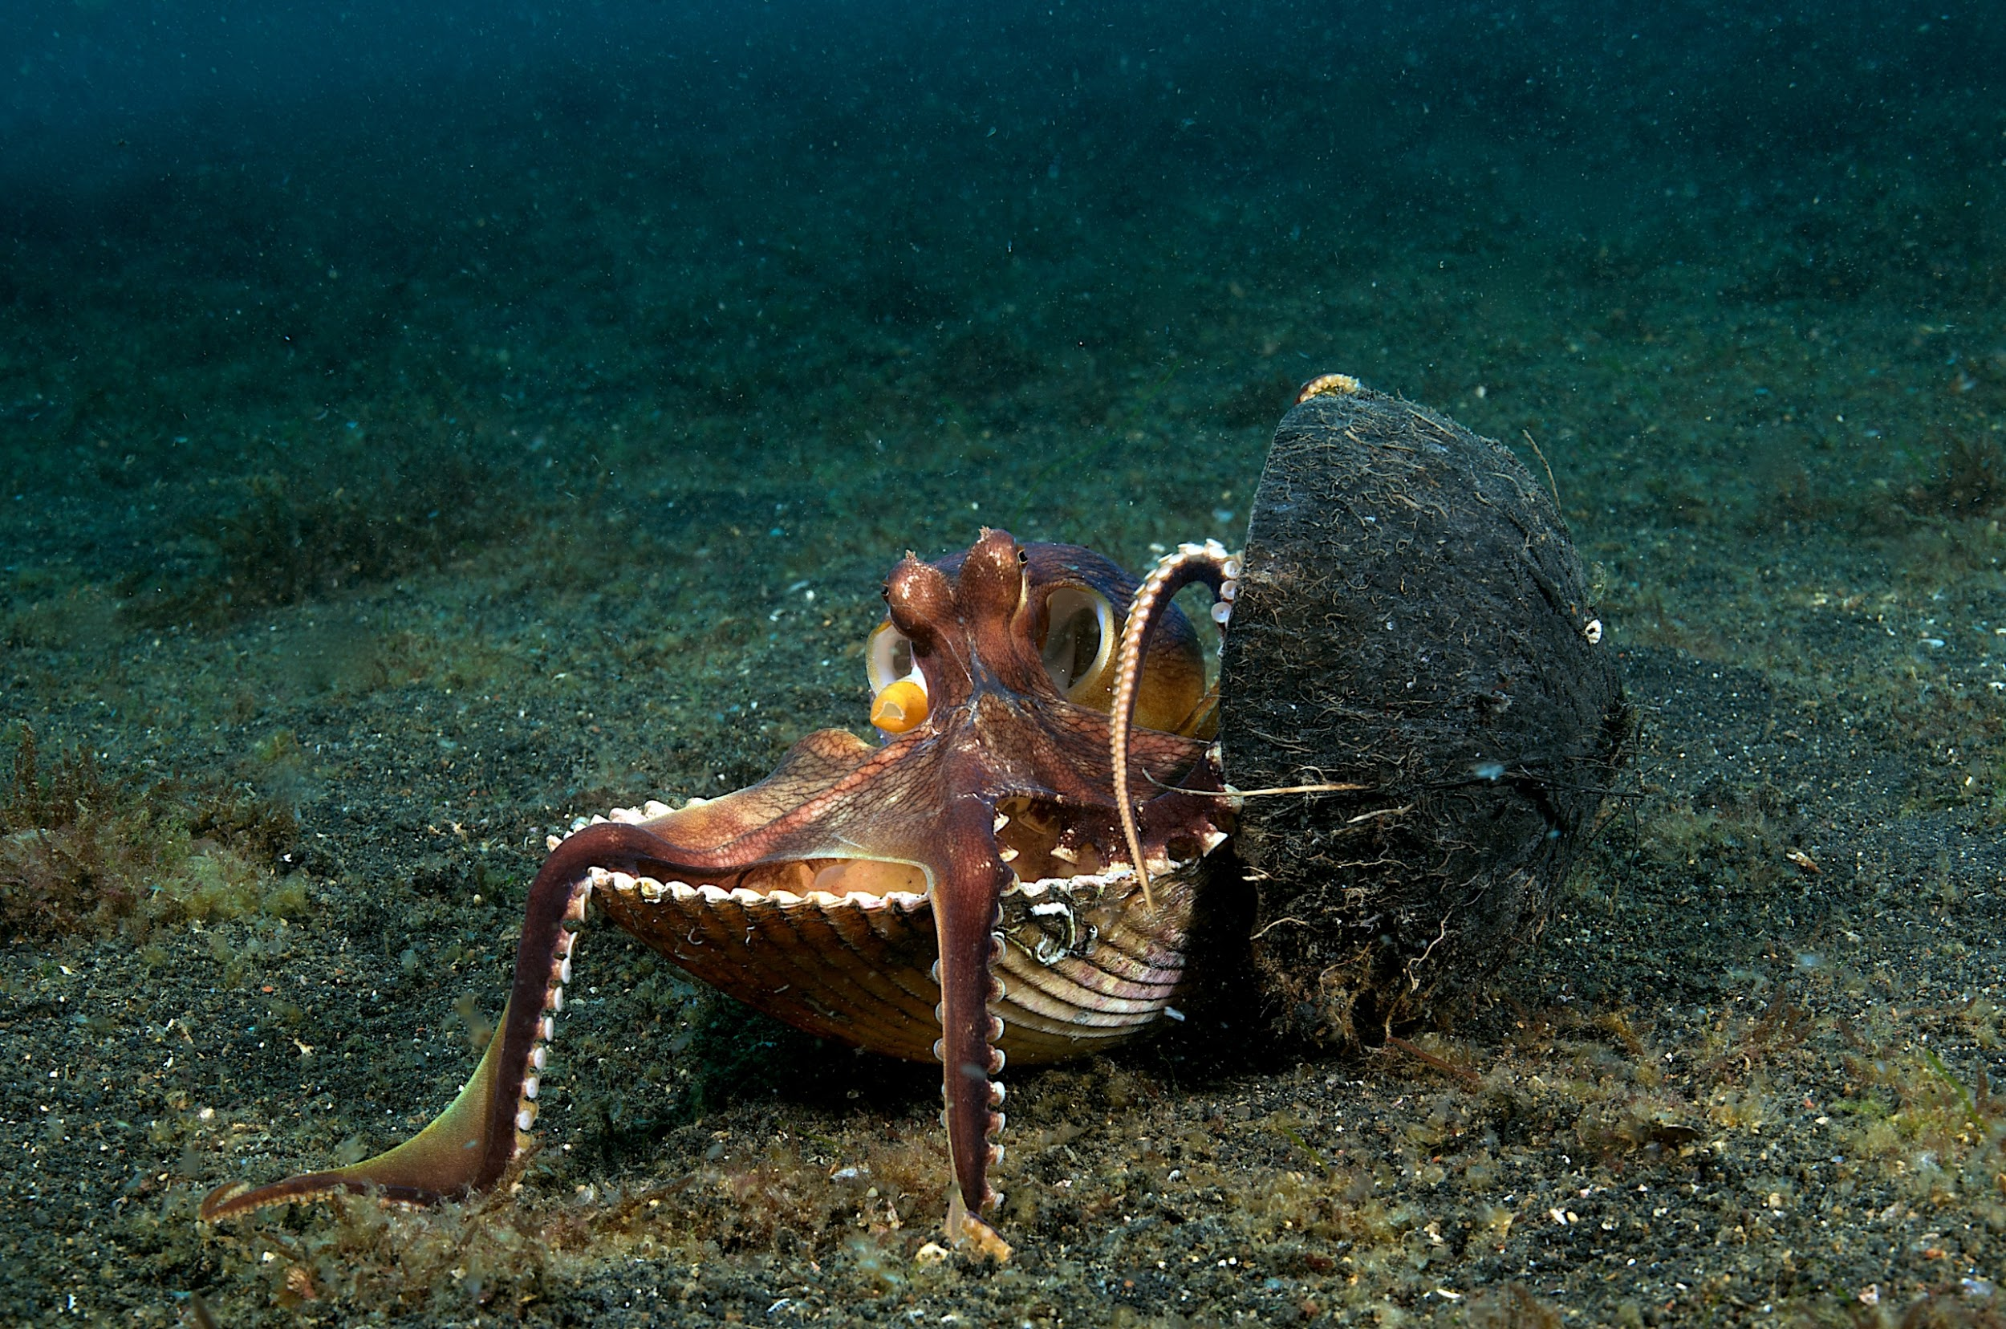
Octopi reproduce by a male and a female mating, the male transfers spermatophores to the female. The female can then hold the sperm in a sac and fertilize them when the eggs are mature.

Slide 3
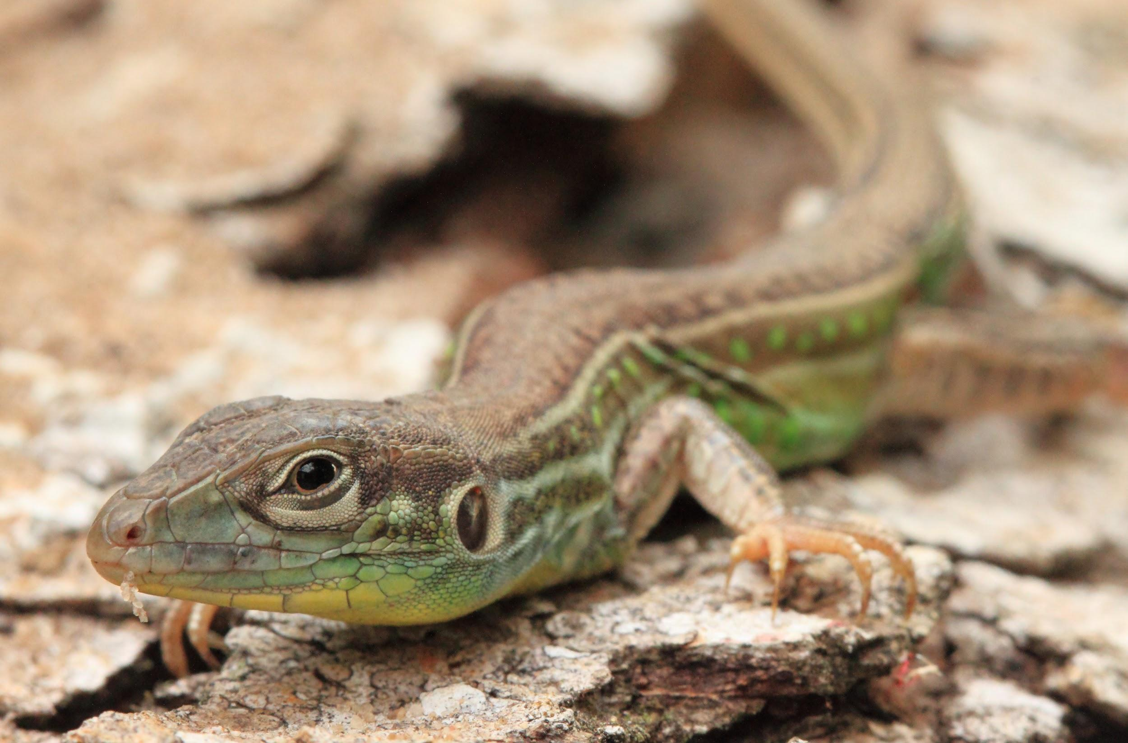
Whiptail lizards reproduce by apomictic parthenogenesis. This is where mature egg cells are produced by a series of mitotic cell divisions that directly begins to form an embryo.

Slide 4
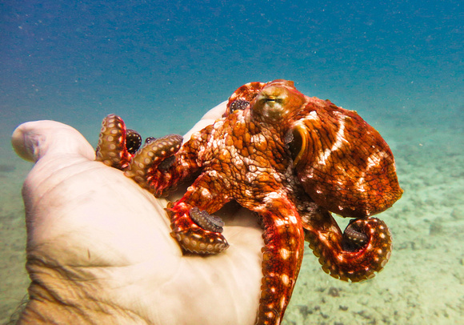
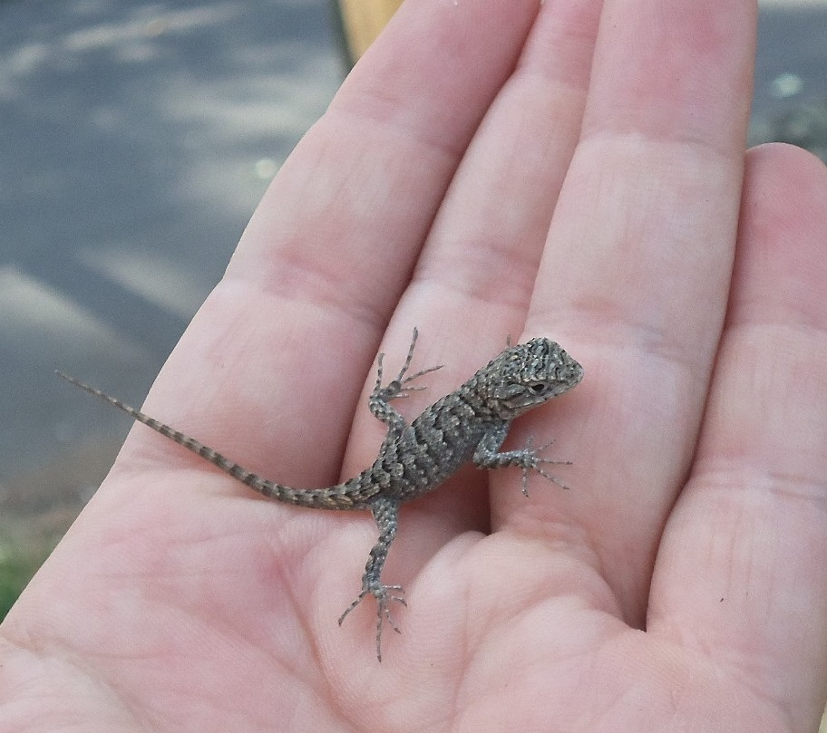
While the lizards reproduce by meiosis, octopi reproduce by mitosis.

Slide 5
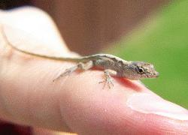
Whiptail lizards can reproduce asexually because they have twice the amount of chromosomes compared to other animals.

Slide 6
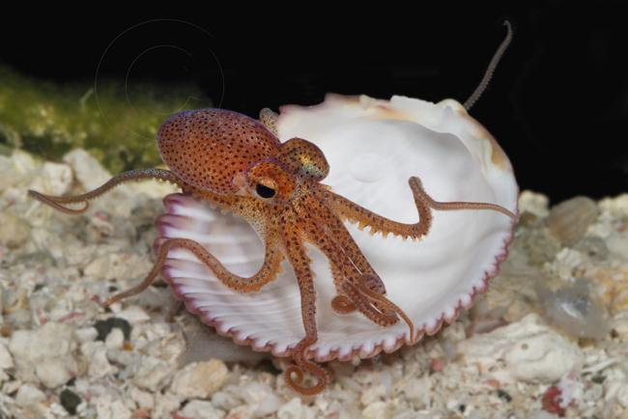
Father octopi die about a month after mating. The mothers often die after the eggs are laid due to starvation, the mother octopus refuses to leave her babies and stays to squirt oxygenated water on the eggs, cleaning them, and fending off predators.

Slide 7
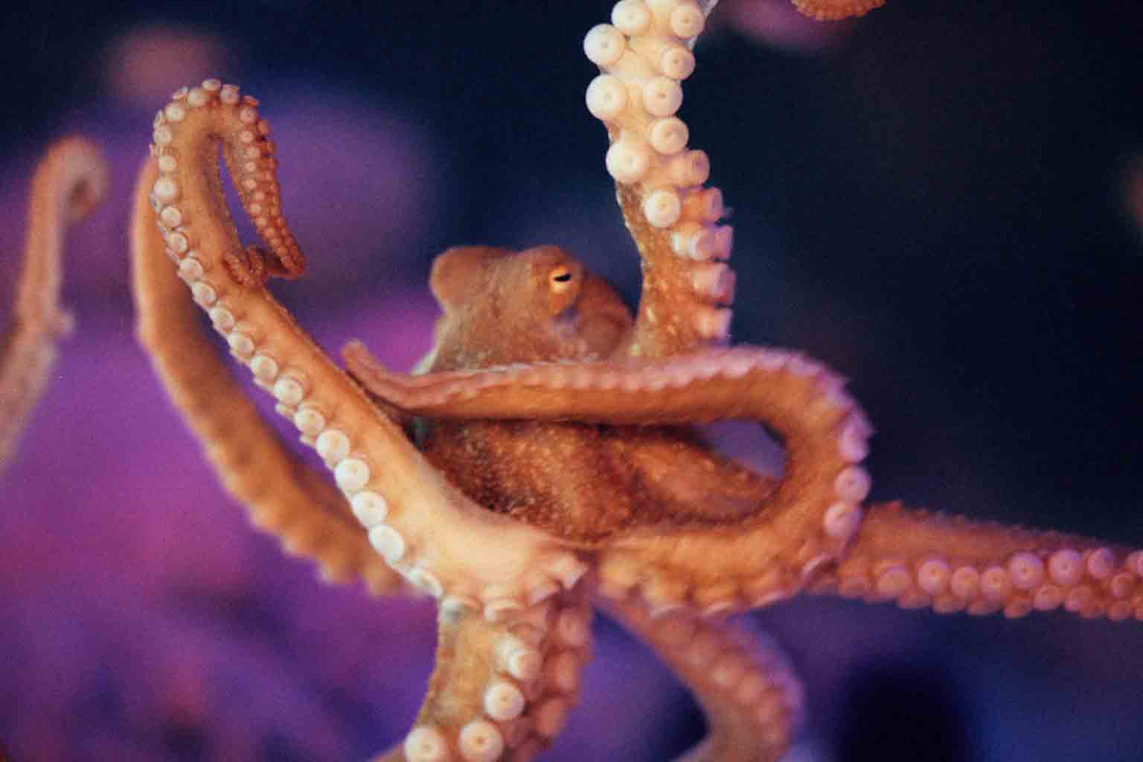
While survival rates for baby octopi are slim, octopus are not endangered.

