Slide 1
The comparison of how a seahorse and bread mold reproduce

Slide 2

Seahorse
Seahorses are pregnant for about 10-25 days at a time and can carry about 2,000 eggs in there pouch. In Seahorses however it is the male that gives birth.
When seahorses mate they are very aggressive in attaining a female. Male seahorses will beat each other until one succumbs and turns a dark color. The male and female seahorse connect and the male opens its pouch where the female pours its eggs into. The eggs embed themselves into the soft tissue inside the pouch. These eggs become fertilized and 21 days later the seahorses are born.
During the pregnancy the female will leave and return everyday until the baby seahorses are born. The female and the male link tails and twirl for roughly ten minutes during this period.

Slide 3
Bread mold
Bread mold reproduces by both asexual reproduction and sexual reproduction.
Asexual reproduction occurs when a spore germinates on bread. Filaments go into the air and make reproductive structures. These will soon break and release a bunch of spores. These spores can germinate and repeat the process.
Sexual reproduction happens in bread mold when nuclei from two different filament like structures combine. Zygotes which result from this form into zygospores. After certain conditions are reached the zygospores go through meiosis to create spores which will be released by the fungus.

Slide 4
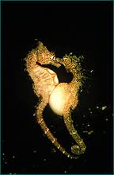
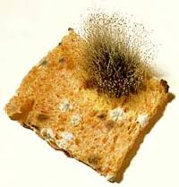
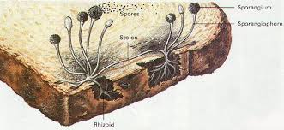
Comparison
Seahorses are similar in that they both can reproduce sexually. However there are more differences. Bread mold unlike seahorses can reproduce asexually. Bread mold doesn’t use eggs and sperm to recreate itself whereas seahorses do. Bread mold also has to wait for the right conditions to reproduce sexually whereas seahorses do not.

