Slide 1
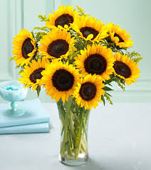
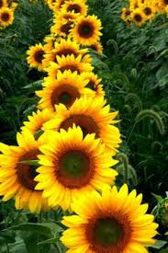
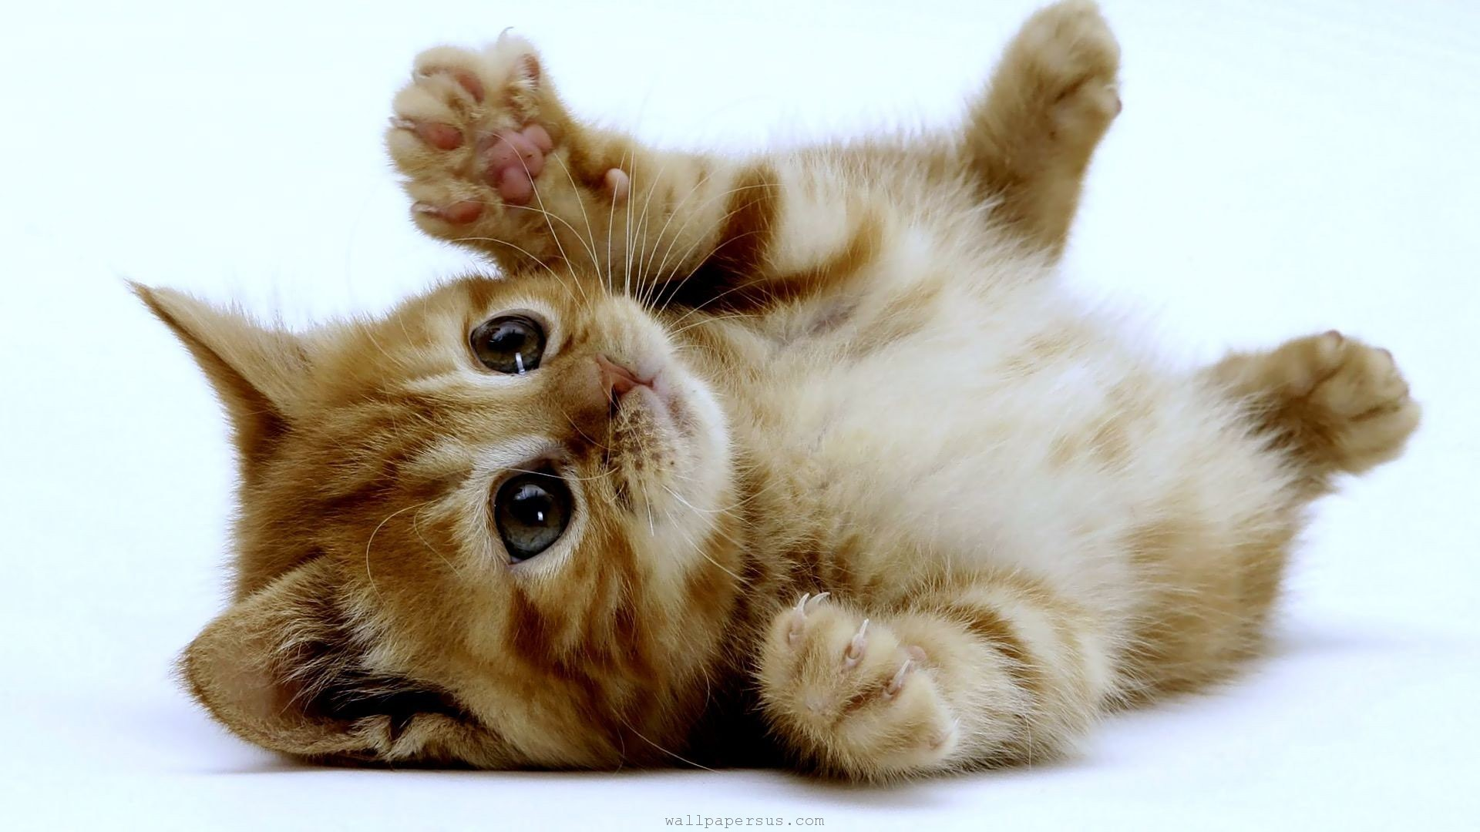
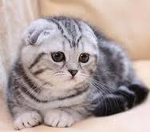
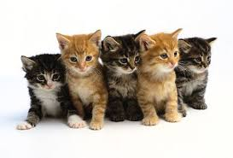
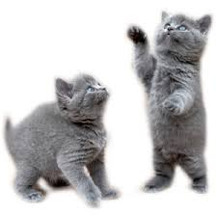
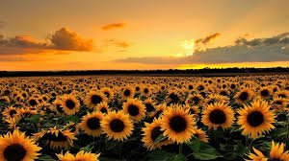
Sunflowers & Cats

Slide 2
SUnflowers(Helianthus)
One plant can create dozen of others
They bloom in the spring
Relies on bees and other insects for reproduction
They live for three weeks to a month, because they are just plants

Slide 3
Cats (Felis catus)
They can have from 1-8 kittens per litter. Generally 4-6 is the average.
Can have well over 100 kittens in a lifetime
They usually get pregnant September-December.
They reach sexual maturity when they are 5 or 6 months old.
Length of gestation is around 9 weeks
They stay with their mothers until they are 8 weeks.
They live for about 10-15 years.
The female begins to be very vocal to attract males. If 2 are present they will fight and the winner will get to ferilize her.

Slide 4
How are the similar/Different
Cats and sunflowers both reproduce sexually.
Cats have mating behaviors, meanwhile with sunflowers the bees do all the work.
They both dont reproduce year round

Slide 5
Advantages and Disadvantages
Sunflowers only last up to a month, so reproduction has to happen they are young so the plot can survive.
Cats have a short gestation period compared to other animals so they can have more litter and kittens.
Cats need to be with their mother for 8 weeks unlike sunflowers when they can just be by themsleves

