Slide 1
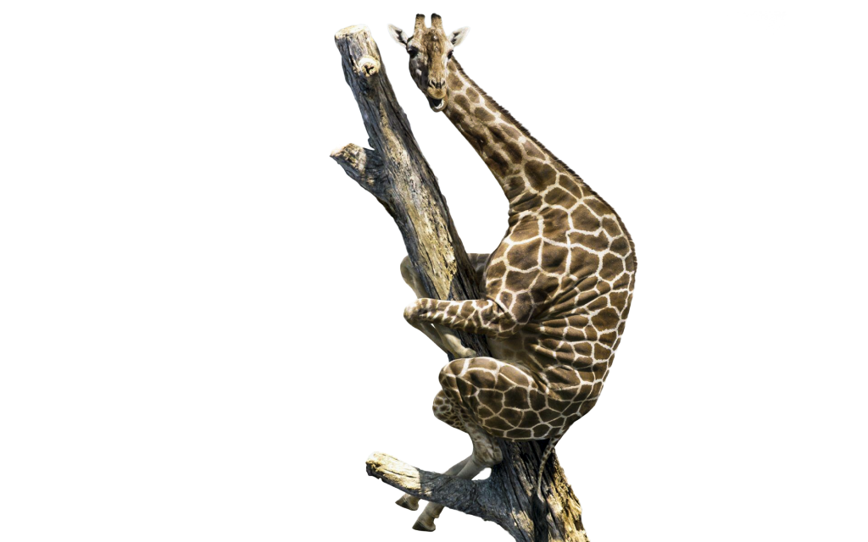

Cacti and Giraffes

Slide 2
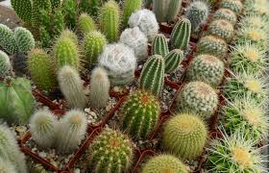
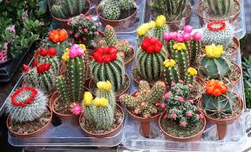
Cacti (Cactaceae)
Location: Mainly in dry environments (deserts)
Reproductive category: Some both sexually and asexually
Reproductive Strategies: Cacti are flowering plants and with the process of fertilization, they produce millions of seed which only 1 or 2 live long enough to create a new cactus (sexual) ; Sometimes, one of the stem of a cactus will break off and fall to the ground. With the right conditions, it can develop roots and create a new cactus (asexual)
Extras: Most cacti (in their natural environment) can live up to 50 to 200 years. The time span for a cactus to grow really depends on the type of cactus but in general, cacti grows very slowly.

Slide 3
Giraffes (Giraffa camelopardalis)
What do they eat? Their long necks help them eat leaves from tall trees, typically acacia trees. They can eat hundreds of pounds of leaves per week and can go for several days without water because the leaves provide moisture.
How long do they live? Healthy giraffes live about 25 years in the wild.
What is their status on the species list? Giraffes are hunted for their meat, coat and tails. Habitat destruction and fragmentation are also threats to giraffe populations. Although the giraffe is “Least Concerned” which means they are not on the endangered list yet

Slide 4
Giraffes (continued)
Location: Giraffes live in the savannas of Africa among the tall trees, arid land, dense forests and open plains.
Reproductive category: Sexual
Reproductive Strategies: A male giraffe mates with a female giraffe and in 15 months the female will give birth to a calf While mothers feed, the young are kept in small nursery groups.

Slide 5
Compare and contrast
Compare:
Giraffes and cacti can reproduce sexually (under different circumstances)
Both are located in usually warmer climate
Contrast:
Giraffes fall under animals and cacti are plants
Cacti can reproduce asexually
Cacti can reproduce thousands of times throughout their lives, while giraffes cannot reproduce until they are 4-7 which limits them

Slide 6
(Continue)
G: Only about 25% of young giraffes make it to adulthood
C: only 1-2 out of 1,000 seeds survive ( one cactus will produce only 1-2 successful offspring)
G: giraffes have no set mating season it will usually take place during the rainy season. This is because they are less stressed out and because they have plenty of food to consume
C: Can live up to 50-200 years in natural habit, and can reproduce when it is pollinated (have an opportunity throughout their life) they do not have a designated mating seasons compared to giraffes
G: males will taste the urine of the females to help him to discover which ones are ready to mate. (They will be the ones with more estrogen in their urine)
C: Bats, birds, bees and the wind pollinate the cacti (there is no strategy to know who and when to reproduce)

Slide 7
Sources
Giraffes:
http://www.kidsplanet.org/factsheets/giraffe.html
http://www.livescience.com/27336-giraffes.html
http://www.giraffeworlds.com/giraffe-reproduction/
Cacti:
https://en.wikipedia.org/wiki/Cactus
http://eduscapes.com/nature/cactus/index1.htm
http://homeguides.sfgate.com/many-times-cactus-reproduce-lifetime-94658.html

