Slide 1
Reproductive System
Elephant
Sea horse

Slide 2
Elephant
African elephant - The African elephant is bigger than the Indian elephant. It has larger ears, too. Both the males and females have tusks. The African elephant has wrinkly gray skin, and two tips at the end of its trunk that it can use like fingers to pick stuff up.
Indian elephant - The Asian elephant is smaller than the African elephant and has smaller ears. They have more of a humped back and only one finger like tip at the end of their trunk. Also, their skin is less wrinkly than the African elephant.
Elephants are sexual
Elephants are examples of K-selected animals. Female elephants have babies about three years apart, and they have only one each time. The whole group looks after them, and protects them through childhood and adolescence. By reproducing at a rate that holds their numbers close to constant, elephants are able to survive in their ecosystem.

Slide 3
Sea Horses
The male has a pouch on one side of the body. When it is time to mate the female will deposit as many as 1,500 eggs into that pouch. The pouch isn’t very big but they eggs are amazingly small. The larger the species though the larger the eggs are going to be. The male will carry the eggs up to 45 days and then the young will emerge fully developed.
They will be released into the water and the male will leave them alone. It is possible that the female will deposit more eggs into his sack the next day if they mate early in the season the first time. The males will puff up very large as they are getting closer and closer to the young being born.
Seahorses are sexual.

Slide 4
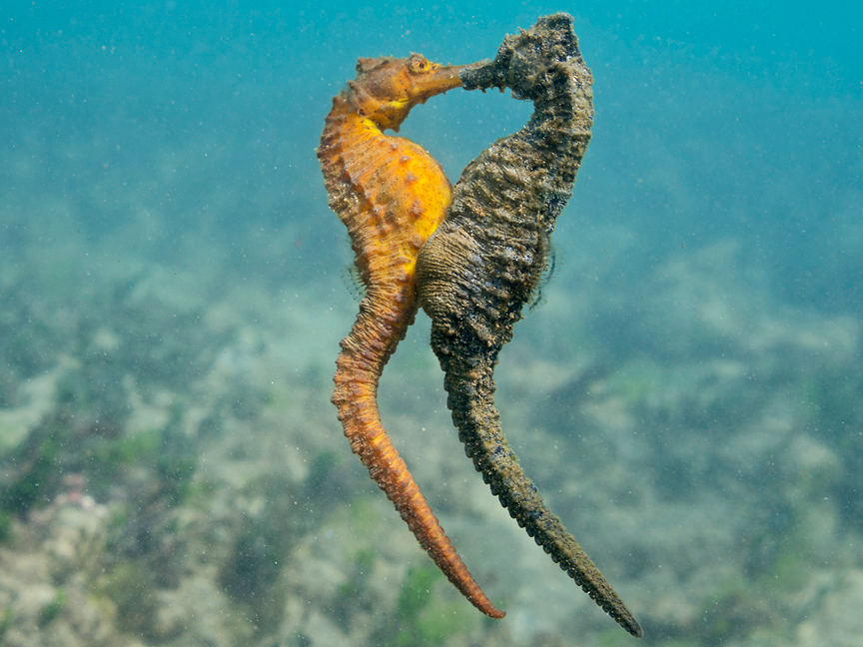
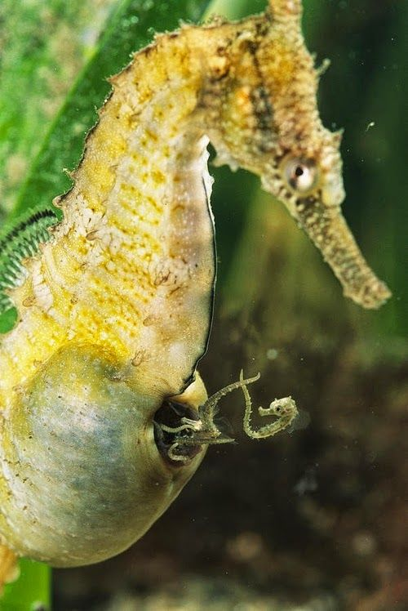
Sea Horse’s Reproductive System
- 2,000 babies
- 1-5 years
- 60 days from birth
- They rub stomachs
- They’re monogamous
- Males fight
- 21 days
- Males are pregnant

Slide 5
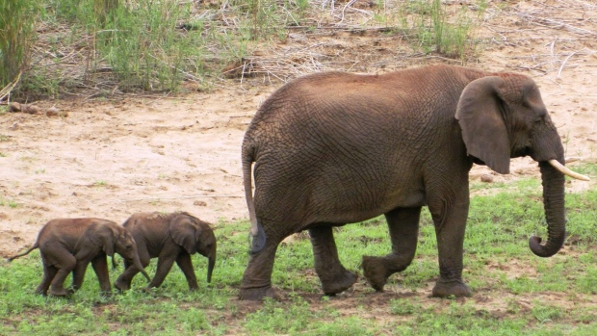
Elephant’s reproductive system
- 6 babies in a lifetime
- 11-20 years for F, 14.5-19.5.
- Reproductive strategies are similar to humans
- 3-9 years to reproduce again.
- Menstruate only when they’re in heat (Covert Mensturate)
- Numbers of elephants increase slowly.
- Mating lasts for 20 seconds
- Pregnant for 18-22 months.

Slide 6
Comparison
Both organisms are sexual
Males will fight for the female
Mating doesn’t last long
They have a specific mating season
Both organisms are monogamous

Slide 7
SOURCES
http://www.seahorseworlds.com/seahorse-reproduction/
http://www.world-builders.org/lessons/less/biomes/breeding.html

