Slide 1
Reproductive Strategies of Chimpanzees Compared to Moss

Slide 2
Chimpanzee Reproductive Strategies (sexual)
Estrous ( reproductive cycle in females ) Cycle:
- This cycle lasts in females for about 36 days. In this time the female chimpanzees will mate for 6 - 7 days.
Gestation ( fetal development ) Period:
- This time is when usually one offspring is born. Average weight of birth is 4 pounds. The first 3 months the child is held by its mother. Around 6 months the child starts to hold onto its mother then climb to the backs of the mother. The child may continue with its mother until it is 10 years old.

Slide 3
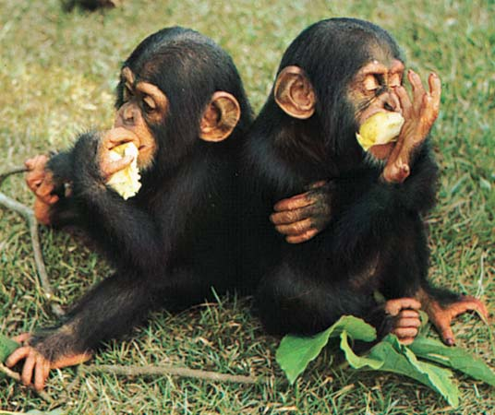
Continued:
Puberty:
- For both sexes it occurs at around 7 years. The female chimpanzees do not give birth until they are 13 or 14 and are able to give birth until they are about 40. Maximum life span for both sexes are 60 years.

Slide 4
Moss Reproductive Strategies (sexual)
Gametes:
- The carpet of moss produce gametes in the reproductive structures which are near the tips of the individual leaflike structures. In wet environments the male plants produce sperm which swim to the eggs in a female plant. Fertilization ends up in the form of “zygote” ( a fertilized ovum ) which later turn into an embryo. Similar to that of human reproduction.

Slide 5
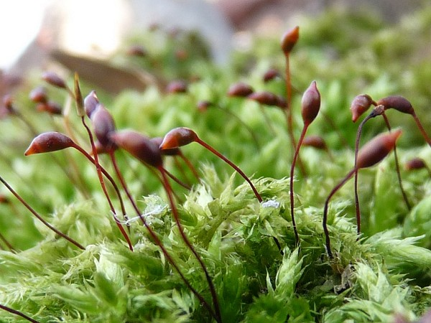
Continued:
Embryo:
- After this embryo is formed it grows out of the female plant in a stalklike structure with a capsule at the end. Inside the capsules are where spores are formed. These spores get released when the capsules open. The spores get blown away by winds and if they find a healthy environment for themselves it will begin to divide, producing green threads.

Slide 6
Compare and contrast
Similarities:
- Chimpanzees and moss are very similar in reproduction strategies such as containing gametes ( sperm and eggs ) to produce offspring. Both species contain sperm that fertilize the female ovum ( egg ) which later forms a embryo.
Differences:
- Chimpanzees have offspring that they watch over until old enough to fend for themselves. Moss for obvious reasons don’t care for their offspring. Moss produce spores which form in capsules above their stems. When they open wind blows these and they begin to grow in environments that are healthy for them.

