Slide 1
Reproduction in Chimps and Salmon

Slide 2
Chimpanzee Reproduction (sexual)
Female estrous cycle lasts 36 days and females will amte 6-7 days during this period
Gestation period lasts about 230 days
One offspring produced normally. (sometimes more)
Young chimps nurse until 3-4 years old
Offspring can be dependent on mother for about 8-10 years
Puberty occurs at about 7 years, but females do not give birth until age 13-14
Maximum life span is about 60 years

Slide 3
Salmon Reproduction (sexual)
Salmon swim upstream to where they were born from the ocean and spawn eggs
Females tend to spawn eggs when 2-7 years old
Females lay about a few thousand eggs in the hole and will be fertilized by a male
They emerge after about 4-6 weeks and are born in freshwater
Right after birth they are all alone and must survive for themselves.

Slide 4
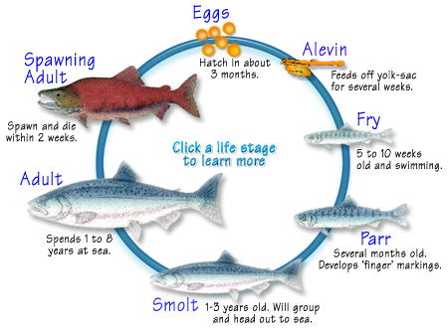
Salmon Reproduction Visual

Slide 5
Similarities & Differences
Females have eggs and males have sperm in both cases
Both reproduce Sexually
In salmon the female spawns eggs and male fertiles them on the outside.
Chimps are live bearing
Chimps have 230 days of gestation and salmon eggs hatch after 4-6 weeks

Slide 6
CITRATIONS
Reproduction Card
http://www.streamexplorers.org/fish-facts/salmon-life-cycle
Biology book

