Slide 1
Opossum vs. Chimpanzee

Slide 2
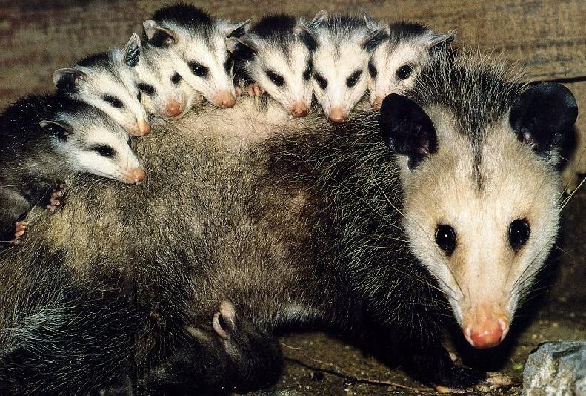
Opossum
Gestation: Process of being carried in the womb from conception to birth.
Estrus: Time where eggs are fertile.
Opossum Reproduction
Opossums breed between december and october, and give birth from february to june.
This usually happens once a year, but can happen as many as three times.
Male opossums make clicking sounds with their mouths to attract a mate.
The female opossums ovulation lasts 28 days and is and is only estrus for 36 hours.
Up to 20 baby opossums will emerge 11-13 days later and will then crawl up and latch onto one of their mother’s teats in her pouch, (like a kangaroo pouch).
At 2½ months they come out of the pouch, and at 5 months they’re on their own.
The opossum sexually reproduces, and ready to reproduce at 8 months, they can live to 3 years old.

Slide 3
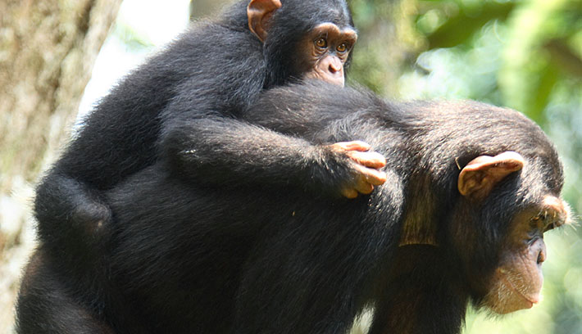
Chimpanzee
Chimpanzee Reproduction
Chimpanzee’s reproductive category is sexual.
Usually only one offsprings during each reproductive cycle.
Frequency of reproductive cycle really depends on if a female is ready to mate or not.
Puberty in both sexes occurs around the age of 7. But females don’t give birth until 13 or 14.
Gestation period averages about 230 days.
The length of offsprings dependency is 3 to 4 years old but some depend on their mother a lot longer than that.
The life span is about 60 years old.

Slide 4
Reproductions Similarities and Differences
Opossum
They live until they're about 3 years old.
Gestation period is 11-13 days.
Have a pouch.
Chimpanzee
Live until they’re about 60 years old
Gestation period is about 230 days
Usually only a single offspring
Both
Both sexually reproduce.
Live of of mother's milk for a time.

Slide 5
Sources
Opossum
http://opossumsocietyus.org/general-opossum-information/
http://www.smu.edu/Orgs/Cats/FAQs/Opossum
Chimpanzee
http://www.janegoodall.ca/about-chimp-so-like-us.php
http://pin.primate.wisc.edu/factsheets/entry/chimpanzee/behav

