Slide 1
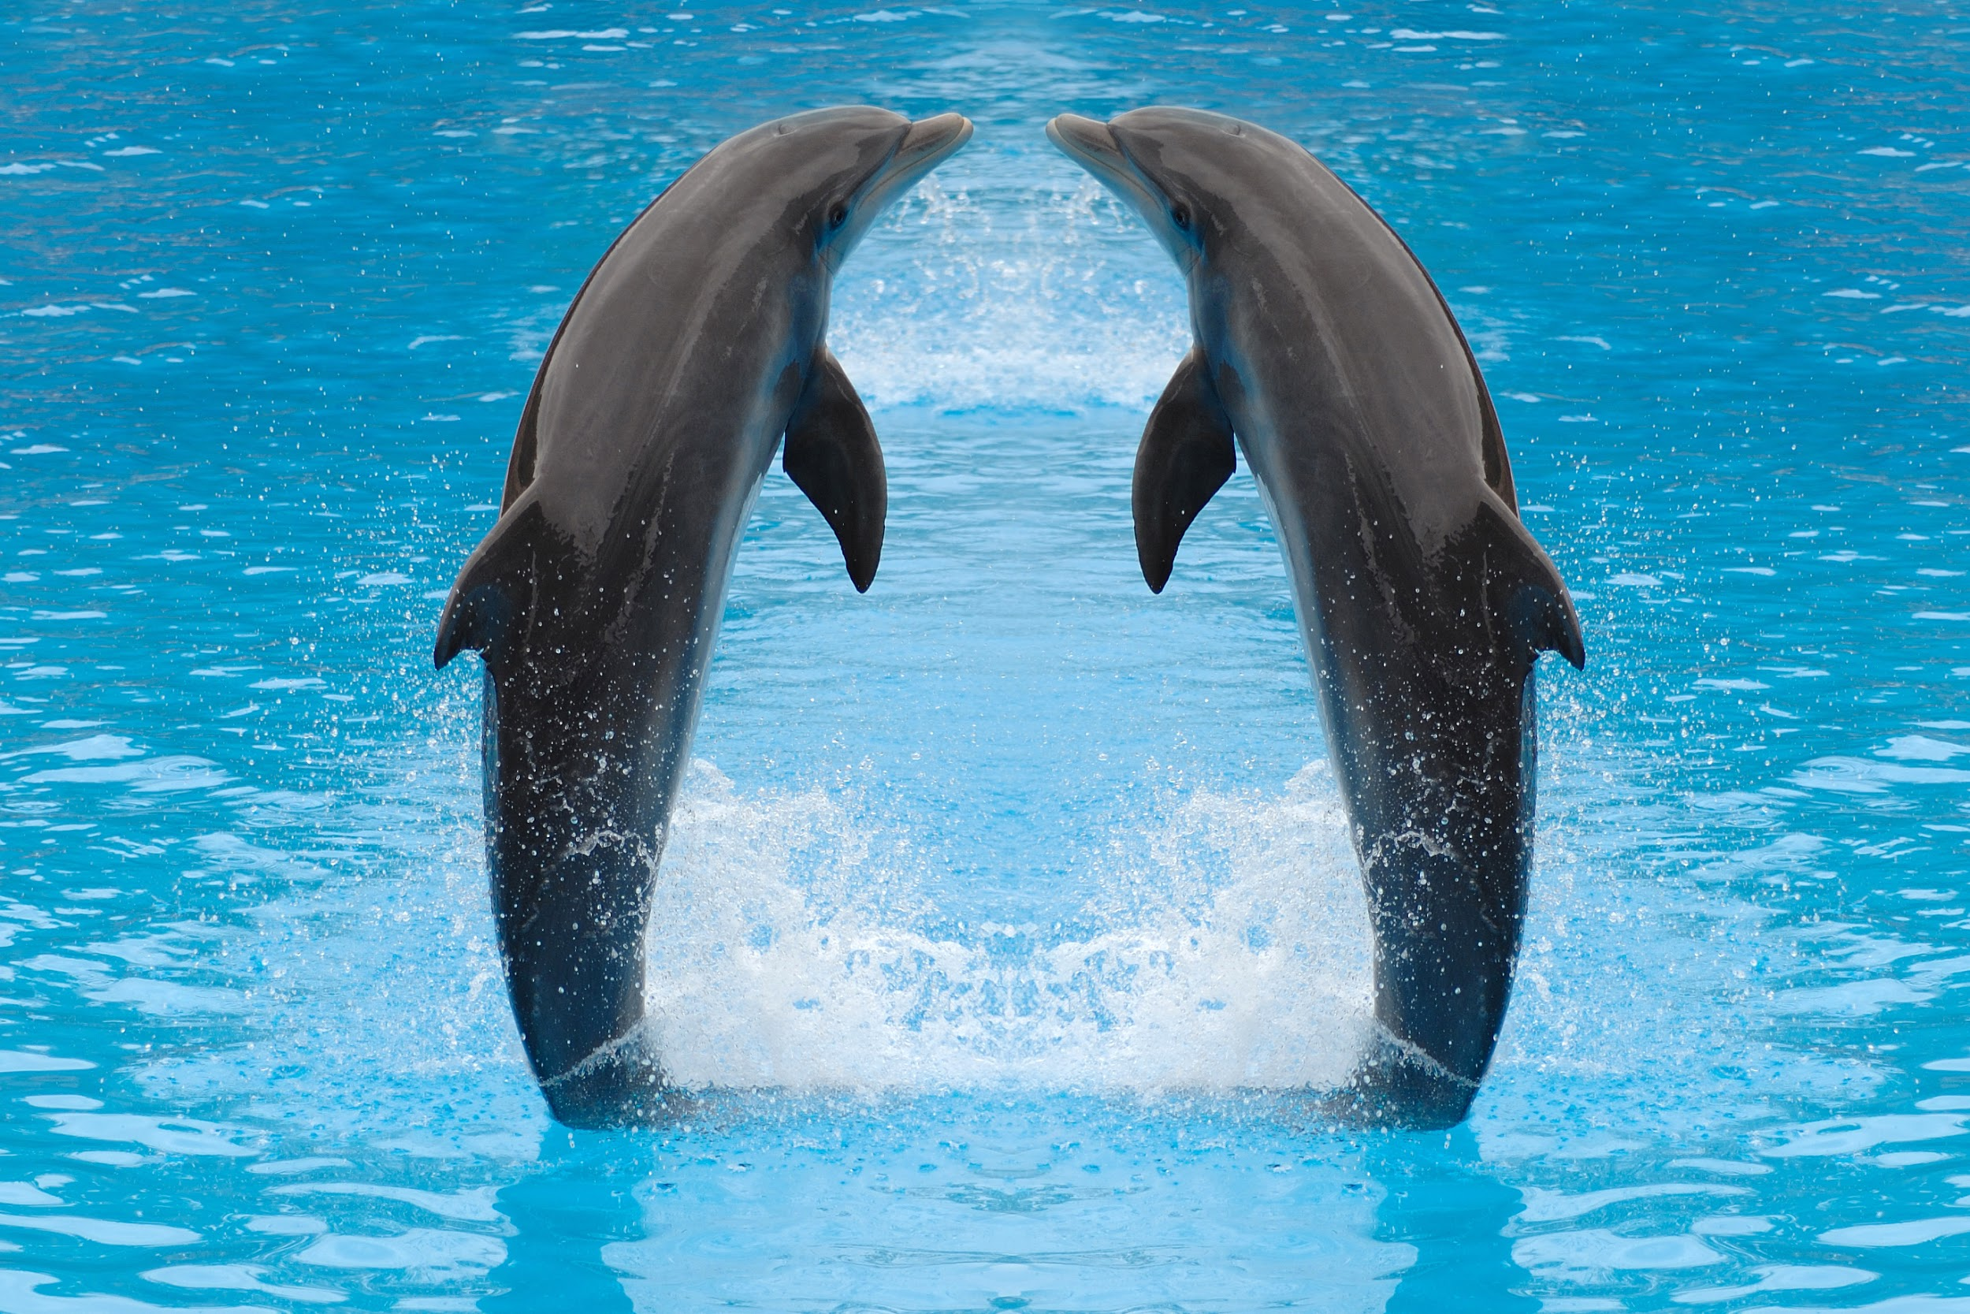
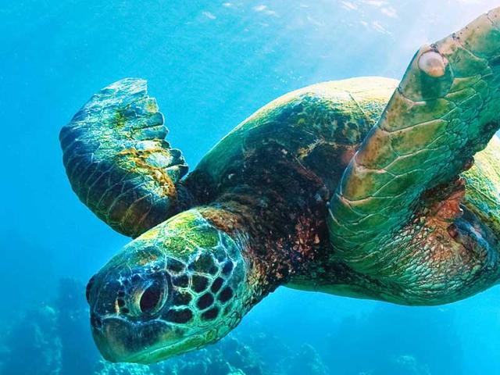
Dolphins & sea turtles

Slide 2
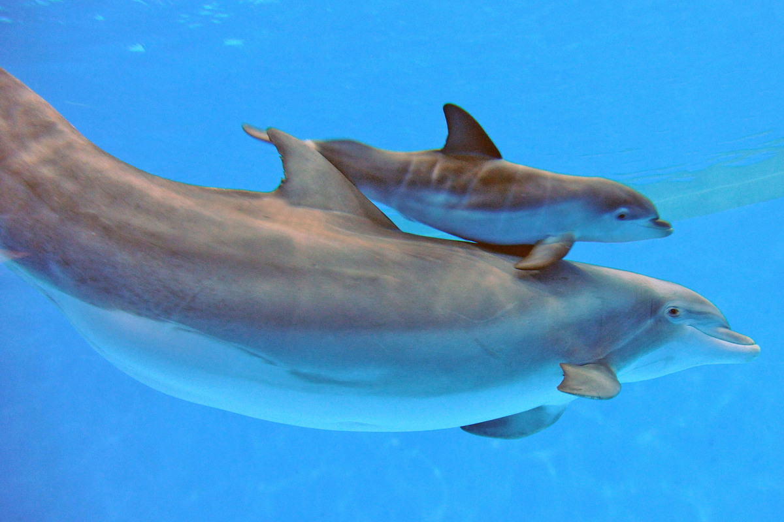
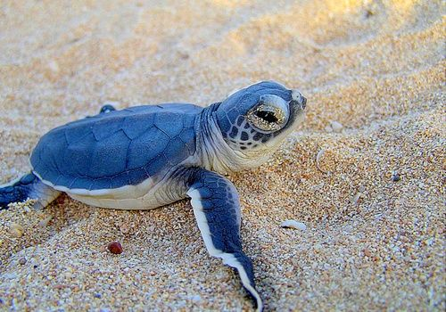
Dolphins ; sea turtles;
Dolphins are a small gregarious toothed whale that typically has a beaklike snout and a curved finnon the back
Sea turtles are a slow moving reptile enclosed in a scaly or leathery domed shell into which it can retract its head and thick legs

Slide 3
Reproductive category;
Both of the organisms have a mother and father/meaning they are sexually reproduced
Both dolphins and sea turtles are both sexual reproductive

Slide 4
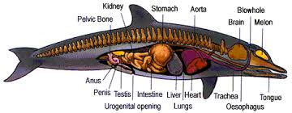
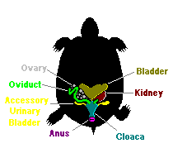
Reproductive strategies;
Dolphins reproduce because they have an emotional bond, the female will mate with the one that is the strongest and most dominant.
Sea turtles reproduce by a male and a female having connection and reproducing baby sea turtles.Like other turtles, sea turtles lay eggs.Females come ashore on a sandy beach to nest a few weeks after mating and lay ther eggs in the sand and covers them with san and gos back to the ocean

Slide 5
comparison ;
Turtles & dolphins;
-They are both mammals.
-There are both sea animals.
-They have fins instead of legs and fingers.

