Slide 1
Living By Chemistry
SECOND EDITION
Unit 3: WEATHER
Phase Changes and Behavior of Gases

Slide 2
Lesson 61: What Goes Up
Combined Gas Law

Slide 3
ChemCatalyst
A weather balloon is inflated with helium to a volume of 125,000 L. When it is released, it rises high into the atmosphere, where both the pressure and the temperature are lower.
  Explain why the balloon rises.
  Will the balloon pop at a high altitude? Explain your thinking.

Slide 4
Key Question
What is the relationship among pressure, volume, and temperature for a sample of gas?

Slide 5
You will be able to:
define the combined gas law
solve gas law problems that involve changes in all three of the variables, P, V, and T

Slide 6
Prepare for the Activity
Work in pairs.

Slide 7
Discussion Notes
The relationship among the pressure, temperature, and volume of a gas is described by the combined gas law.
Combined Gas Law
P1V1
T1
P2V2
T2
K = PV
T
or
=

Slide 8
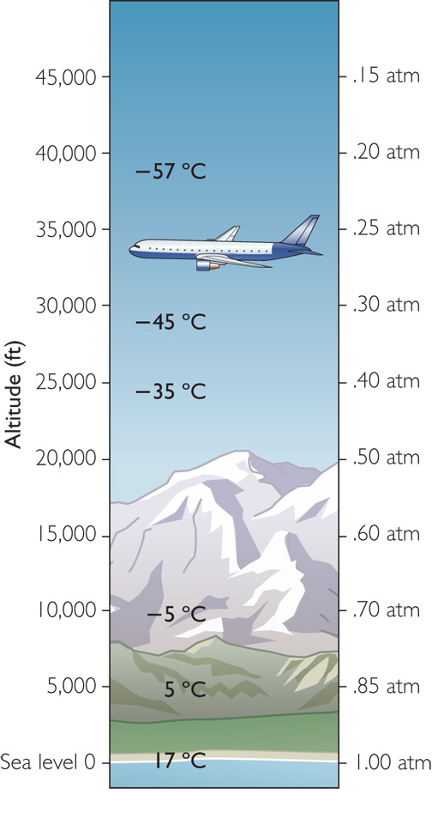
Discussion Notes
(cont.)
Altitude | Temperature (°C) | Temperature (K) | Pressure (atm) | Volume (L)
40,000 ft | –57°C | 216 K | 0.20 atm | 47,000 L
30,000 ft | –45°C | 228 K | 0.30 atm | 33,000 L
25,000 ft | –35°C | 238 K | 0.40 atm | 26,000 L
10,000 ft | –5°C | 268 K | 0.70 atm | 17,000 L
5,000 ft | 5°C | 278 K | 0.80 atm | 15,000 L
0 ft | 17°C | 290 K | 1.0 atm | 12,500 L

Slide 9
Discussion Notes (cont.)
The weather balloon rises no matter what the outside conditions because the balloon is full of helium, and helium is less dense than air.

Slide 10
Wrap Up
What is the relationship among pressure, volume, and temperature for a sample of gas?
  If volume, temperature, and pressure all vary, then you can use the combined gas law to determine the effects of changing two variables on the third. (Amount of gas remains the same.)
    k =
  Air temperature and air pressure both decrease with increases in altitude.
  Ultimately, for a weather balloon, gas pressure has a greater effect on gas volume than does gas temperature.
PV
T

Slide 11
Check-In
A sample of neon gas occupies a volume of 1.0 L at 300 K and 1.0 atm.
  Calculate the value of the proportionality constant, k.
  Suppose you increase the temperature to 600 K and decrease the pressure to 0.50 atm. Does the volume of the gas increase or decrease? Explain your answer.

