Slide 1
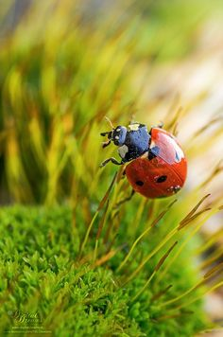
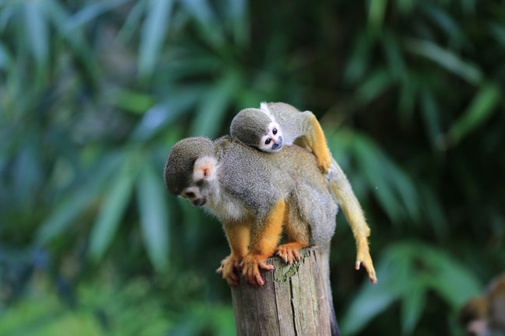
Ladybugs & Squirrel Monkeys

Slide 2
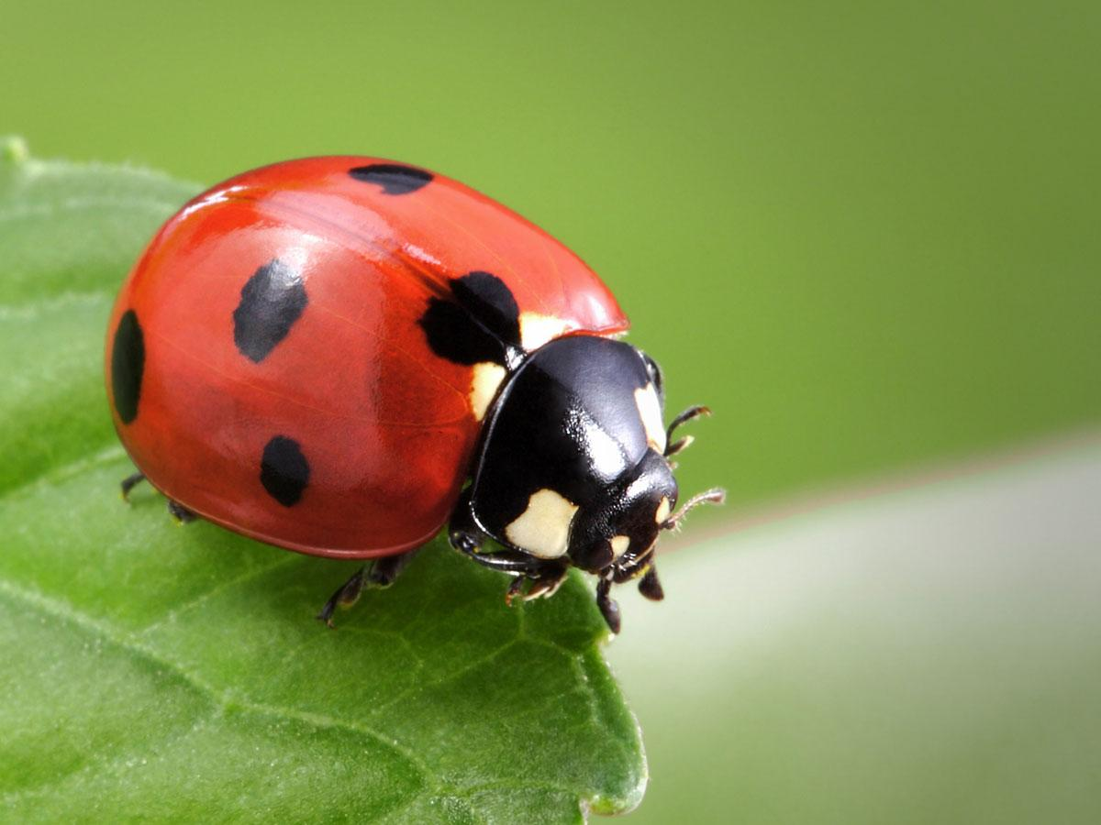
Ladybug Description:
A ladybug is a bug, it is smaller than half an inch, they are generally red, yellow or orange with black dots.

Slide 3
Ladybugs Reproduction:
Ladybugs are sexual. When a female and a male ladybug find each other, the male grips the female from behind and holds on tight. They can stay together for more than 2 hours at a time. Female ladybugs can store a male's sperm for 2-3 months before laying eggs

Slide 4
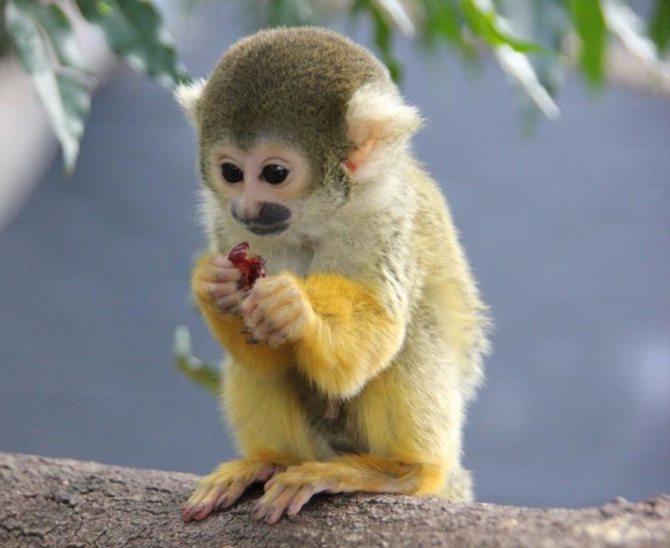
Squirrel Monkey Description:
Squirrel monkey is one of the smallest members of the primate group. Measuring as little as 25 cm from the top of the head to the base of their tail, these tiny primates are more than double that size when including their long tail.

Slide 5
Squirrel Monkeys Reproduction:
Squirrel Monkeys are sexual. Females prefer the sexually mature males that gain the most weight during the two months prior to the breeding season, which lasts from early August to early October. In order to determine sexual receptivity, groups of males chase and grab a female, holding her down to inspect her genitalia. Gestation (pregnancy) lasts 145 days and the birth season lasts from February to early April.

Slide 6
Comparisons between Ladybugs & Squirrel Monkeys:
Ladybugs and Squirrel Monkeys are both very small and they both reproduce similar, sexually. However ladybugs lay eggs and squirrel monkeys do not. Squirrel Monkeys are usually pregnant for about 145 days and ladybug eggs hatch in about 3 to 4 weeks.

