Slide 1
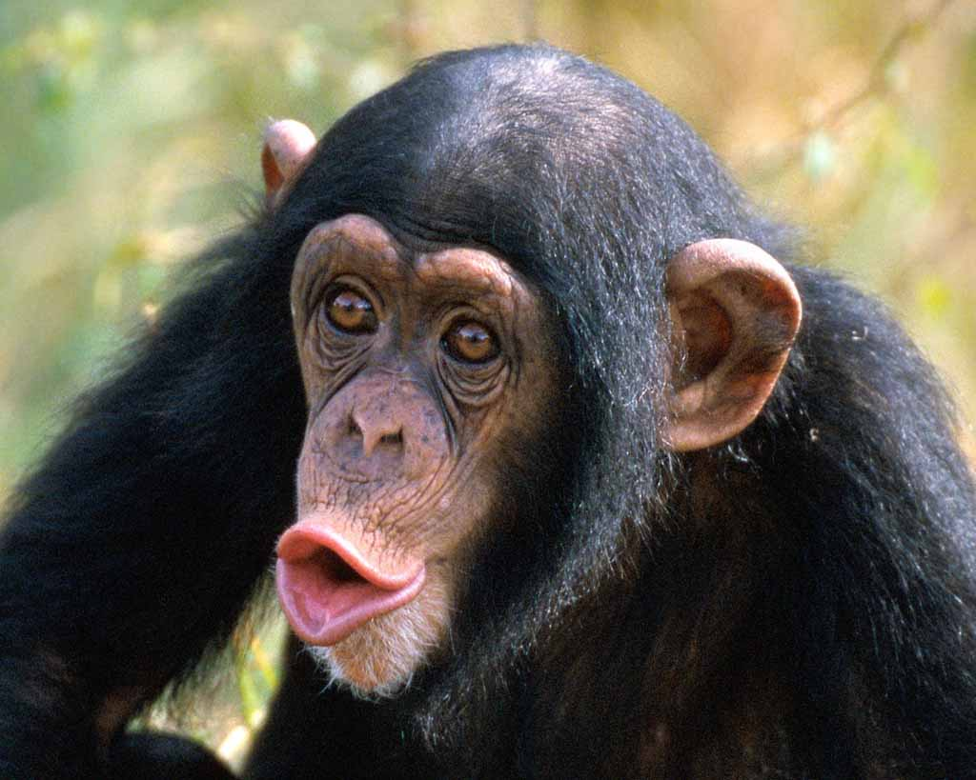
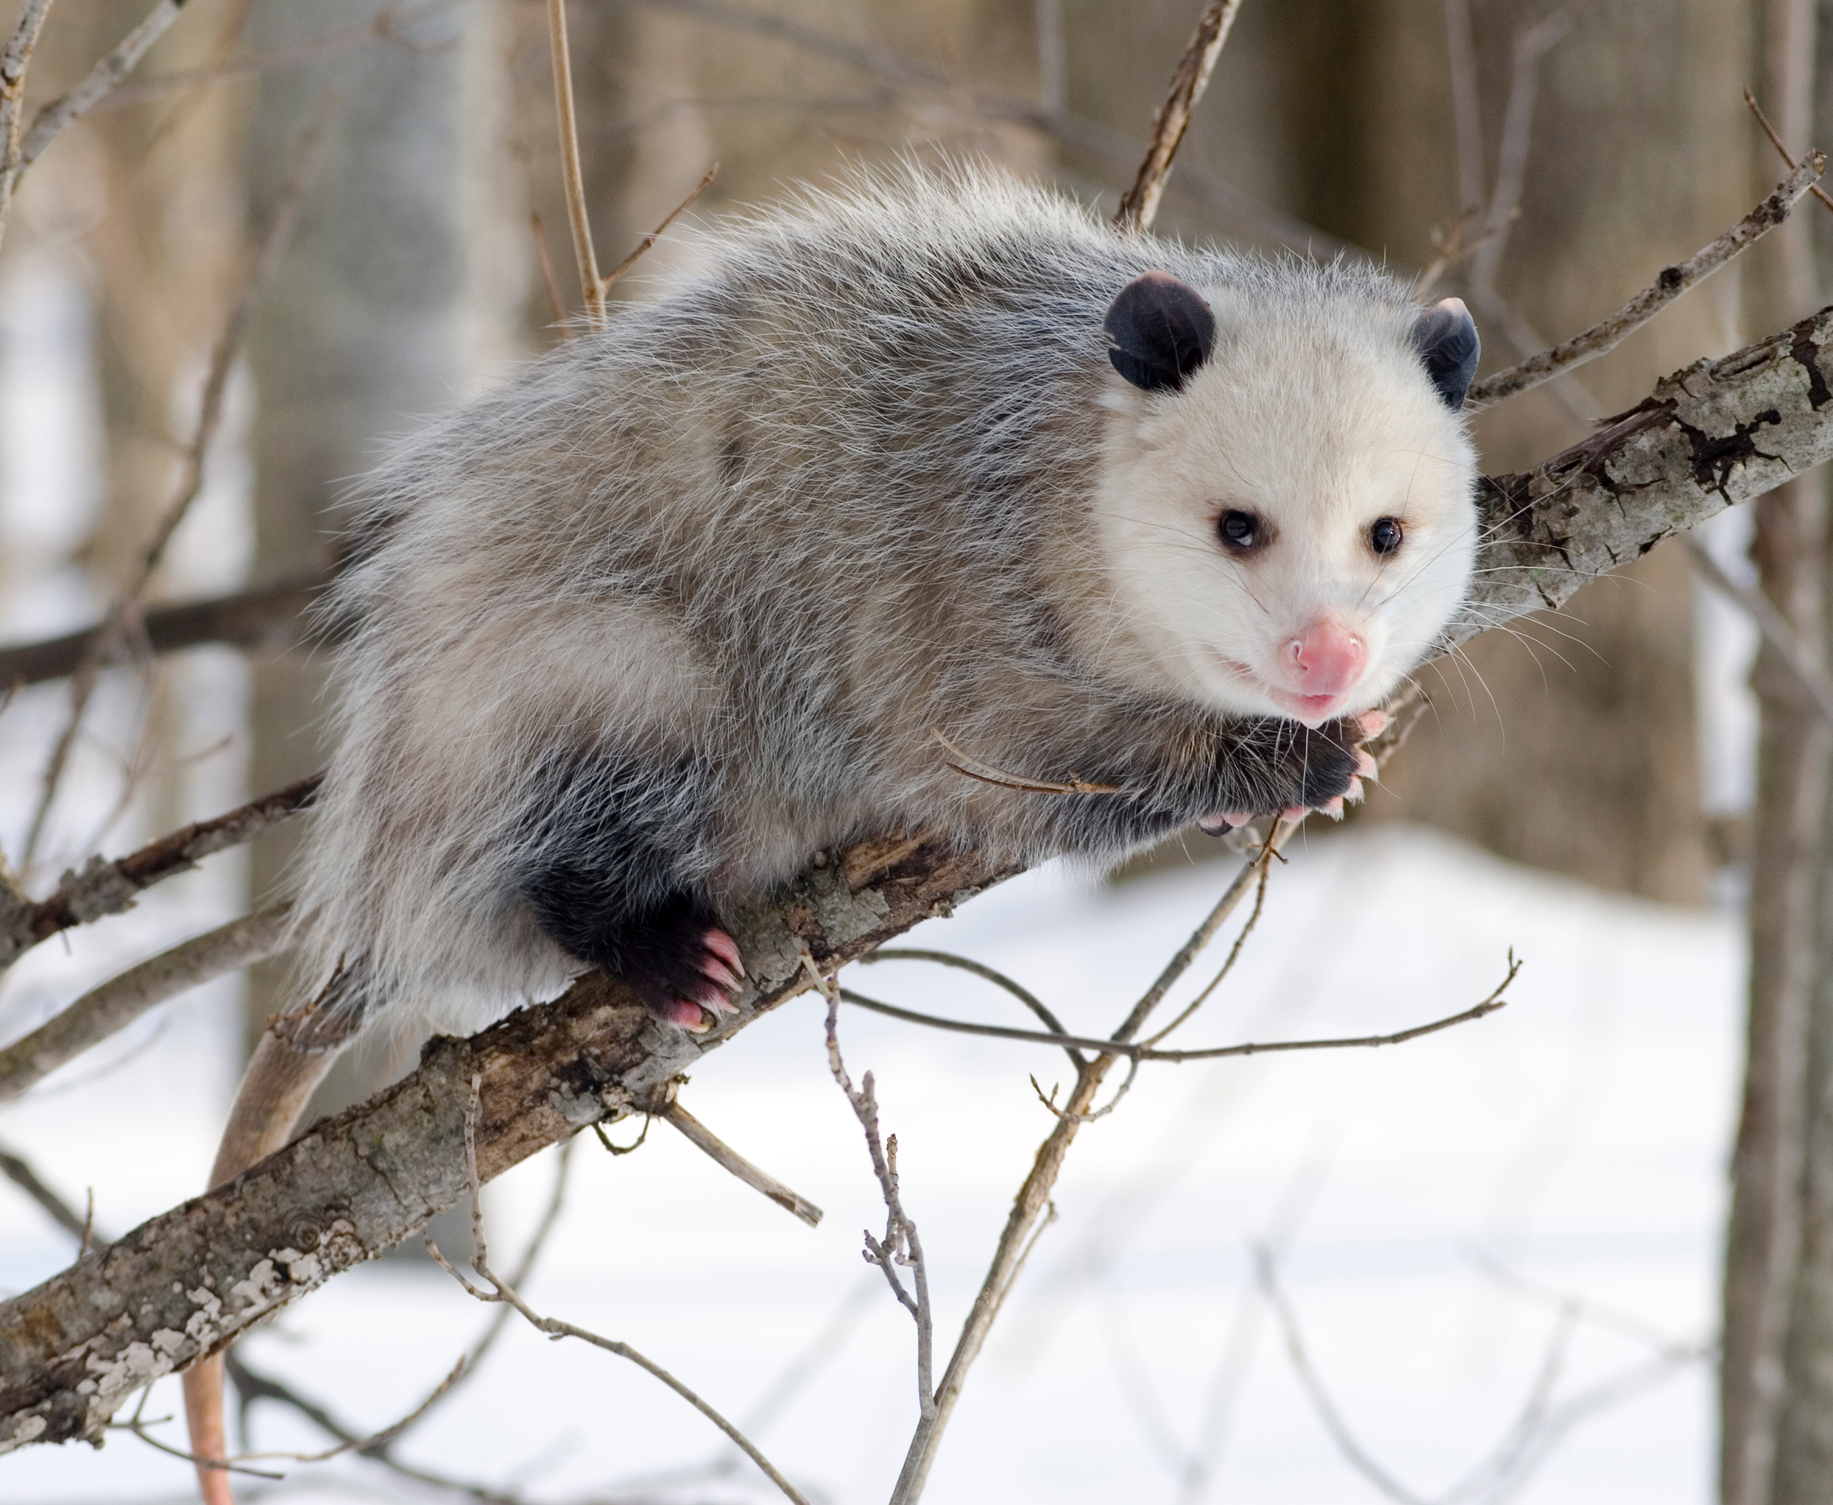
Chimpanzees VS Opossum
Reproductive system

Slide 2
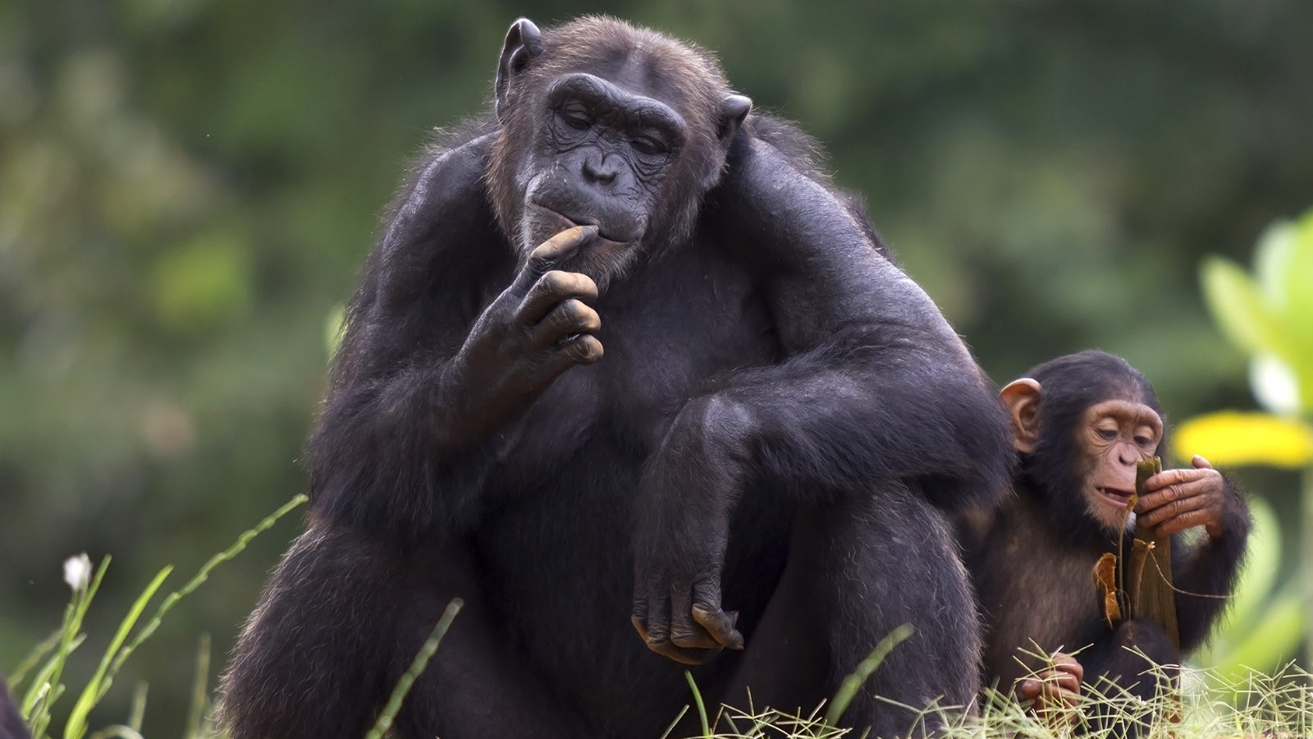
Chimpanzees
What is a chimpanzee? - A chimpanzee is a great ape with large ears, mainly black, and lighter
Only 1-2 offsprings are produced during each cycle
Only get their reproductive cycle 4-6 times in their entire life
13- 14 is when they usually mate
They are pregnant for 8.5 months
Life span is only 60 years
Only mate every 5 years so they can take time to raise their young

Slide 3
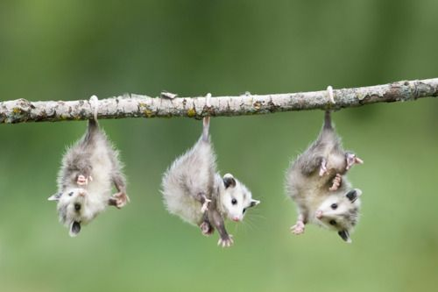
Opossum
What is an Opossum? - A opossum is an American marsupial that has a ratlike prehensile tail and hind feet with an opposable thumbl
8-9 offsprings occur during each cycle
Can have 1-3 littes each year
Sexual maturity can be at age 1
2 weeks maxs
60 days
2-4 year life span depending on what kind of opossum

Slide 4
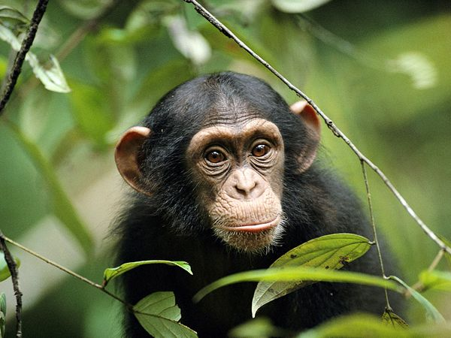
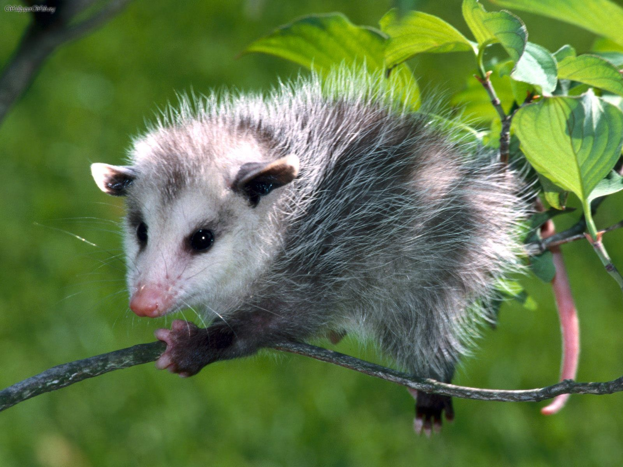
Similarities
They are both sexual creatures
They both feed their children with breast milk
They live on land
The children rely on their mother for a great deal of their life
They are more than one kind of each species
Are found all over the world
Both show their teeth as a sign of defense
Both are mammals

Slide 5
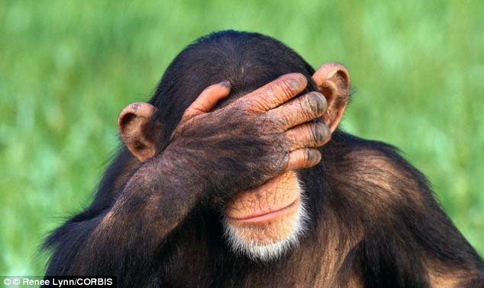
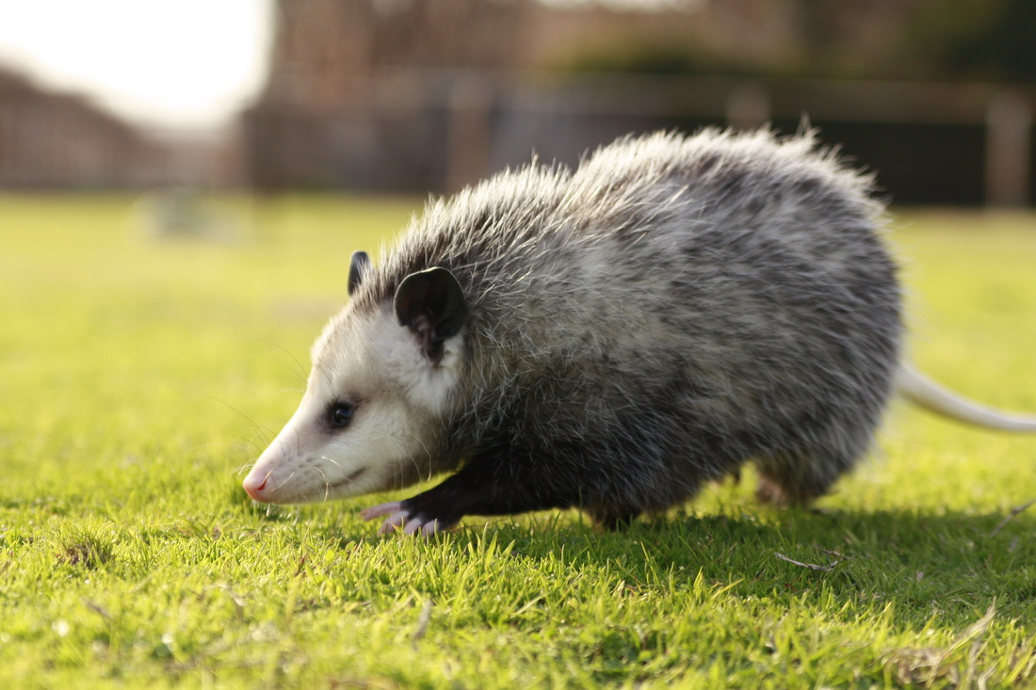
Reproductive Strategies
Chimps females are fertile for 36 days and often mate 6-8 times during that time when the females show the most swelling which is a sign of fertility, female chimps leave their families to go find a male to mate with and they attract to the males by the males making noises with their mouth
For opossums they don't really have a set fertile time but here pregnancy is very fast after 2 weeks after the opossums have mated the child is born.

Slide 6
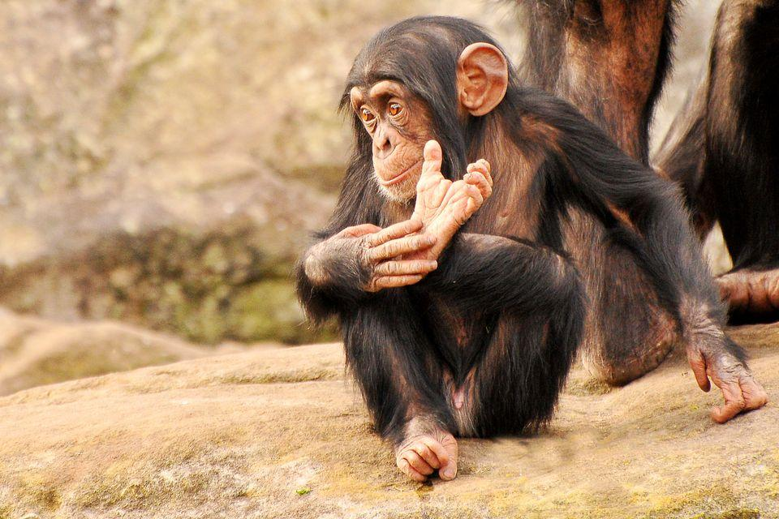
Sources
http://unisci24.com/300021.html http://animals.nationalgeographic.com/animals/mammals/chimpanzee/
http://theeagleonline.com.ng/ebola-island-with-infectious-monkeys-in-liberia-video/
http://kids.nationalgeographic.com/animals/chimpanzee/#chimpanzee-with-baby.jpg
http://animals.nationalgeographic.com/animals/photos/chimps/#/young-chimp_763_600x450.jpg
http://www.dailymail.co.uk/sciencetech/article-2649325/Could-outwit-chimp-Study-finds-apes-consistently-better-humans-competitions-hide-seek.html
http://www.wildliferescuerehab.com/all-about-opossums.html
http://www.itsnature.org/trees/mammals-trees/virginia-opossum/

