Slide 1
Organism Reproductive Strategies Project

Slide 2
Whiptail lizard reproductive strategies
Sexually (btw females)
One has male behaviors, other one has female behaviors
Lays eggs but does not fertilize
Eggs matured in ovary later develop hardshells in oviduct
7-14 days later, eggs are lays
Entire cycle lasts about 3-4 weeks

Slide 3
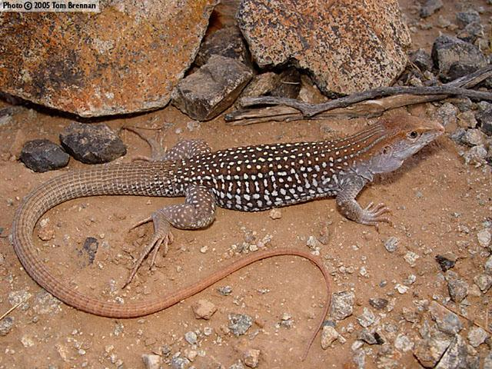
Whiptail lizard
Lives in southwestern US
Only females
Evolved from bisexual ancestors
Have both male and female mating behaviors
Reproduce by laying unfertilized eggs

Slide 4
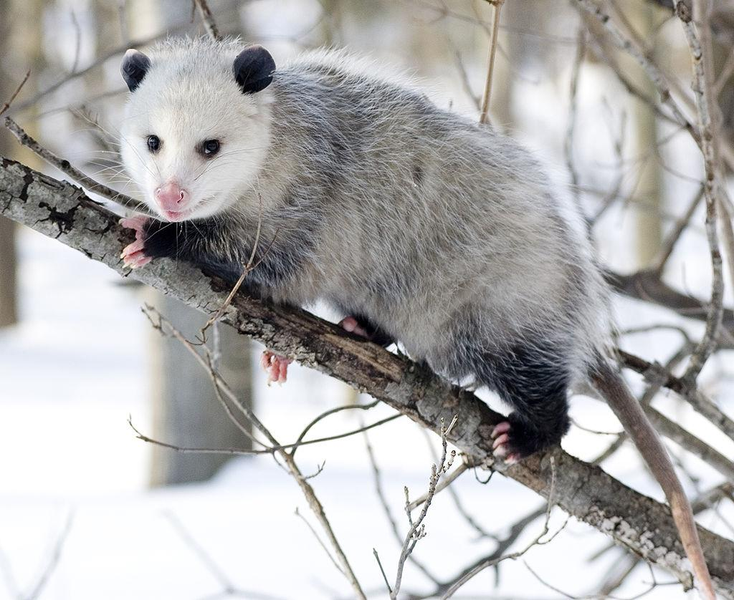
opossum
-Marsupial mammals
-Offsprings stays in mother’s pouch.
-Offsprings that are not able
to get into the pouch and attaching
to a nipple do not survive
-Have about 15 nipples.
-About 2 litters a year (North-1, South-more than 2)

Slide 5
opossum
Sexually (male-female)
Reach sexual maturity at 5 months
Sperms fertilizes eggs
Females will give birth 2 weeks later (litter about 3-13)
Young one need to get into pouch for nipples to survive
Continue to live in pouch for at least 80 days

Slide 6
Comparisions
Whiptail lizard
Female-female
Don’t fertilized eggs
Reptiles
Hatch eggs
Same
Reproduce sexually
Opossum
Male-female
Fertilized eggs
Mammals
Give birth

