Slide 1
The Reproduction of the Lizard and the Frog

Slide 2
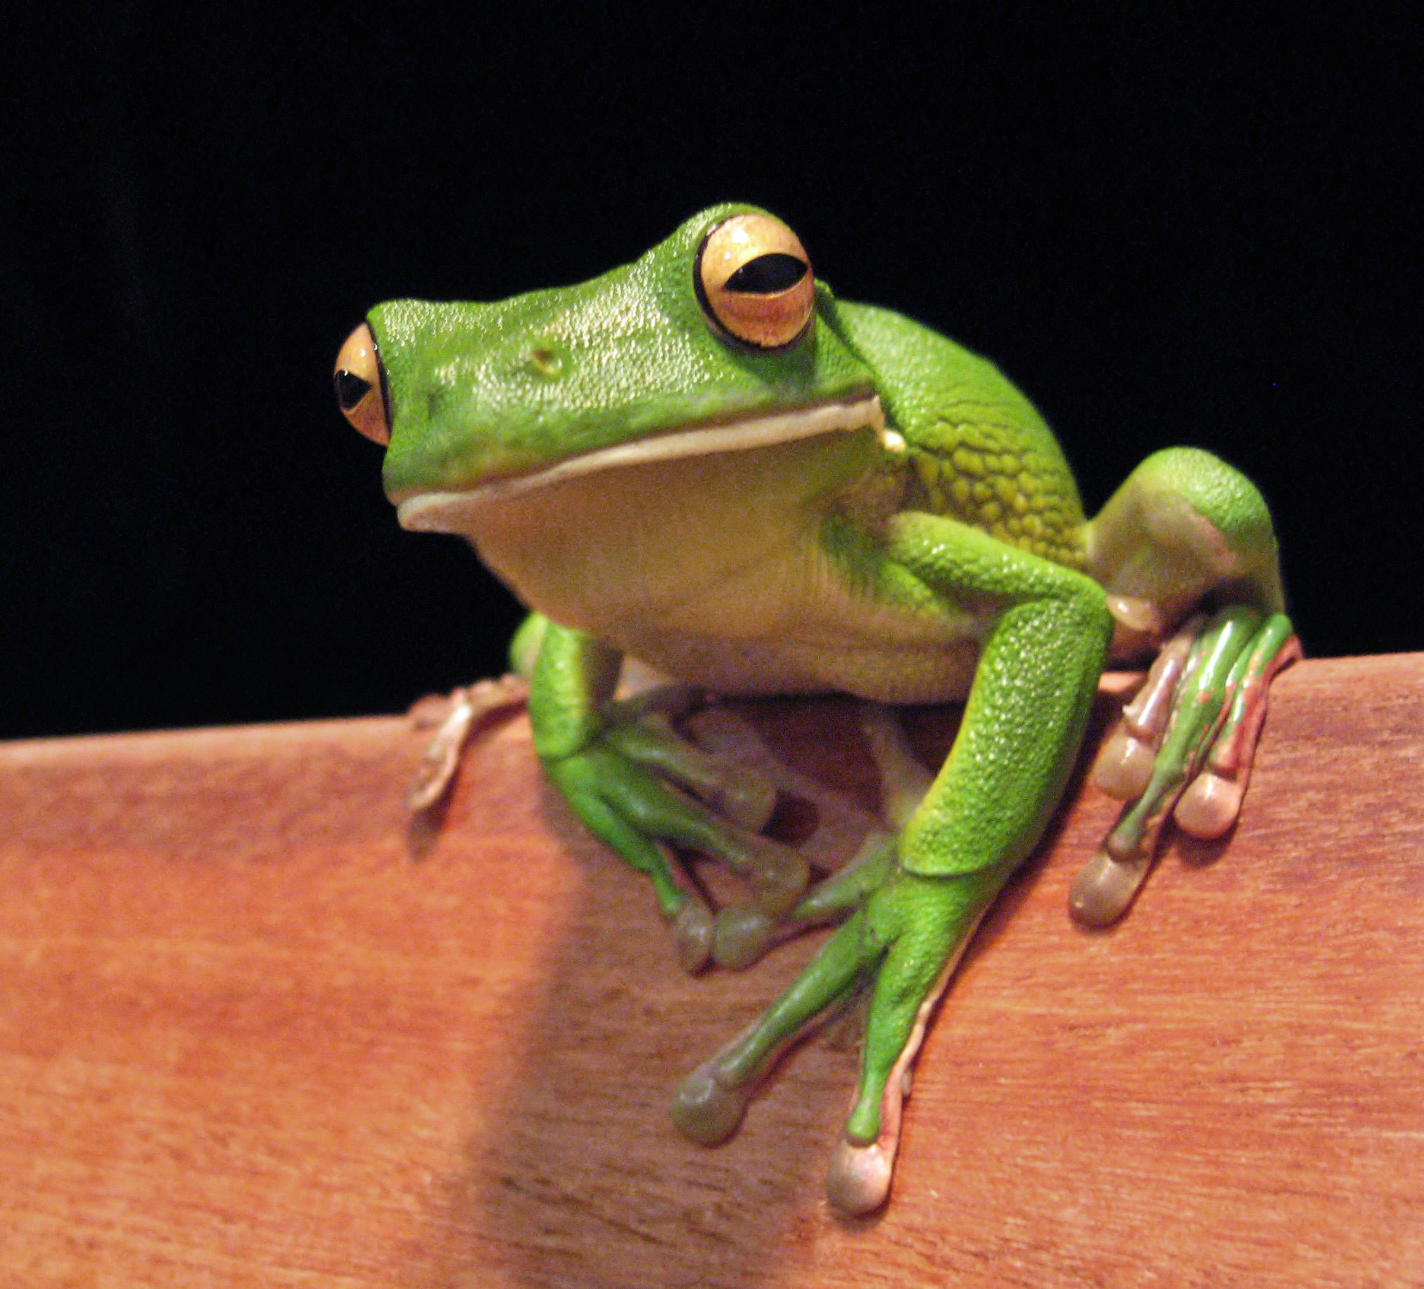
Frog

Slide 3
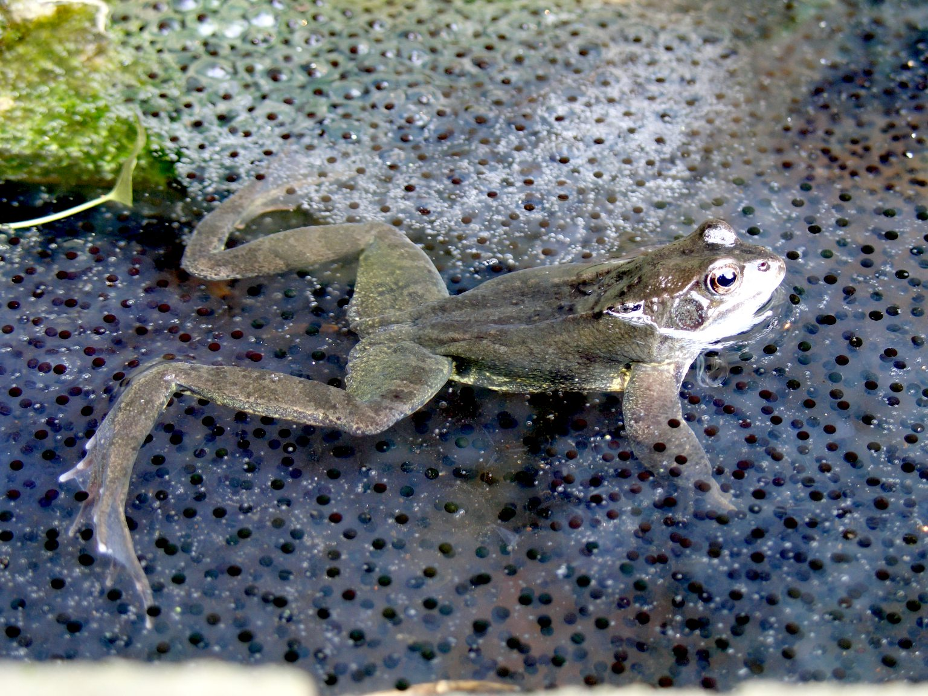
Number of Offspring
A female frog lays eggs under water, usually in the spring. She may lay as many as 20,000 eggs.

Slide 4
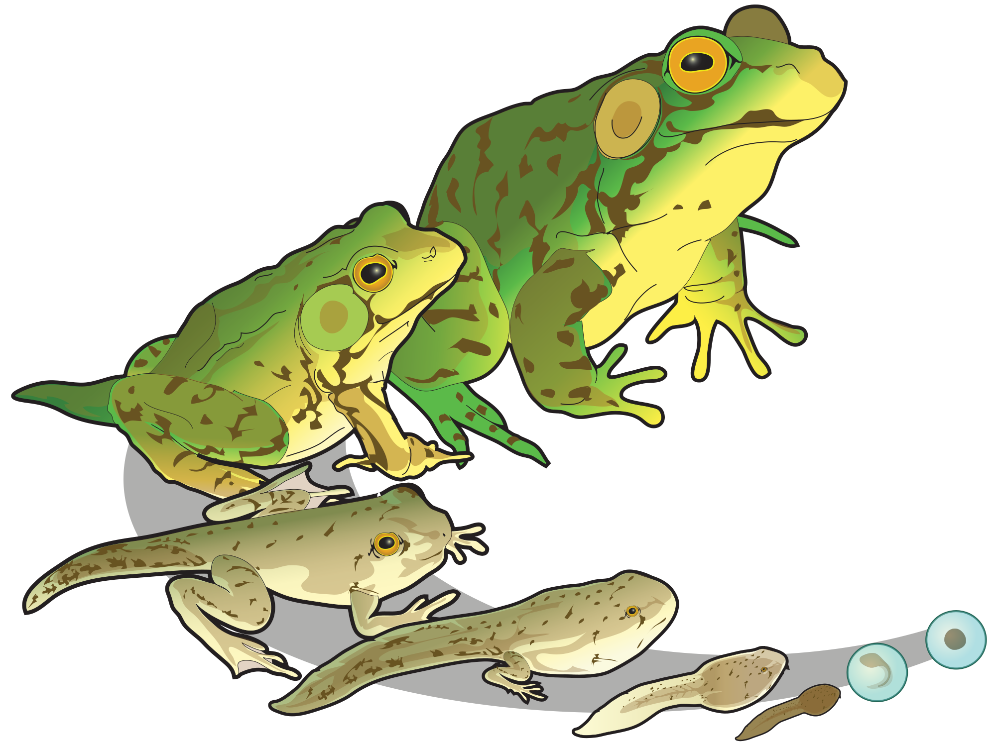
Frequency of Reproductive Cycle
There are variations on the basic frog reproductive cycle in species found in the Australian tropical rainforest. The Stony Creek Frog Litoria leseuri actually builds a nest separate but close to the creek to mate and lay her eggs. Some frogs have developed reproductive cycles that rely less directly on water. The Barred Frogs Mixophys spp. actually lay their eggs out of the water. They are, however, near the edge, so the tadpoles are eventually washed in. Some frogs have developed reproductive cycles that can occur even further from the water. The Microhylid family is often referred to as ‘nursery frogs’. This is because they have the unusual reproductive strategy of laying eggs that hatch directly into little frogs; they skip the usual larval stage of the tadpole, having no need for a complete aquatic environment in their moist rainforest habitat. Some species, such as Spheophryne fryi, have been observed guarding their nests of eggs.

Slide 5
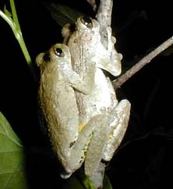
Structures that are Involved in Reproduction
At the right you see two mating treefrogs. They are Squirrel Treefrogs, Hyla squirella. The smaller male is on top. As you can see in the photograph, when frogs mate, the male grasps the female's trunk with his forelimbs. The technical name for this special kind of embrace is amplexus. A more general term for fertilization accomplished outside the female's body, and therefore including amplexus, is external fertilization. Frogs and toads don't have penises. During amplexus the female discharges eggs usually into water while the male sheds sperms over the eggs.

Slide 6
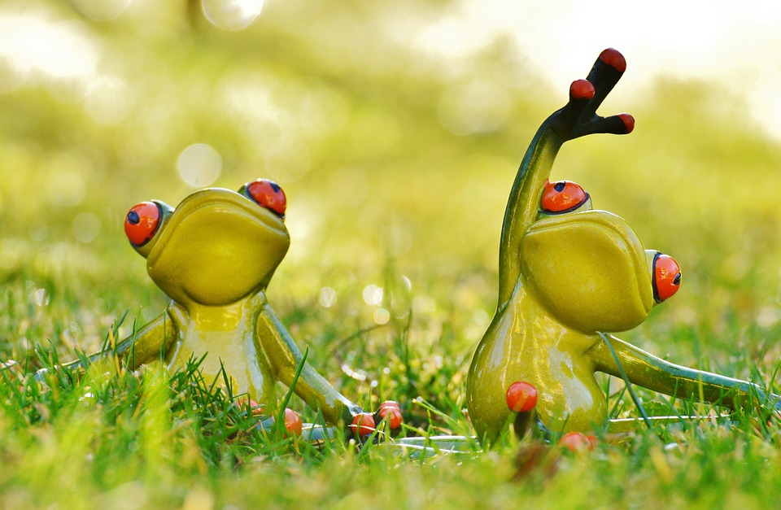

Age of Sexual Maturity
Males reached sexual maturity at two years of age, although sometimes they can reach it at only one year of age. Females reached sexual maturity at two years of age with an average.

Slide 7
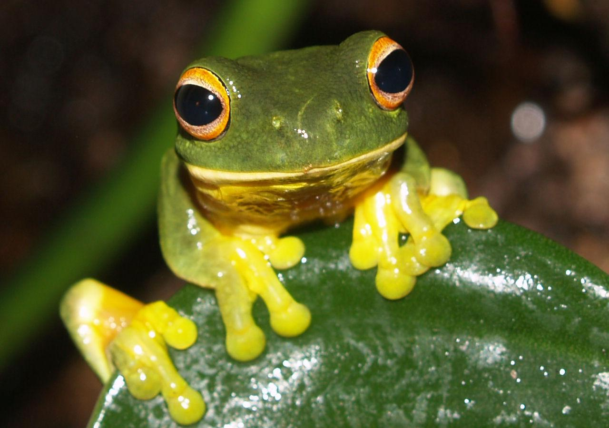
Length of Gestation
Female frogs have two ovaries and a pair of oviducts in their reproductive system, located beside the kidneys. The female frog creates 2,000 to 20,000 eggs that she retains inside her body from late summer until spring, preparing for breeding season. From late summer until the spring, the eggs mature inside the frog's body until mating season begins. If the mature eggs stay inside the ovaries beyond a normal breeding season, the eggs begin to deteriorate, or cytolize.

Slide 8
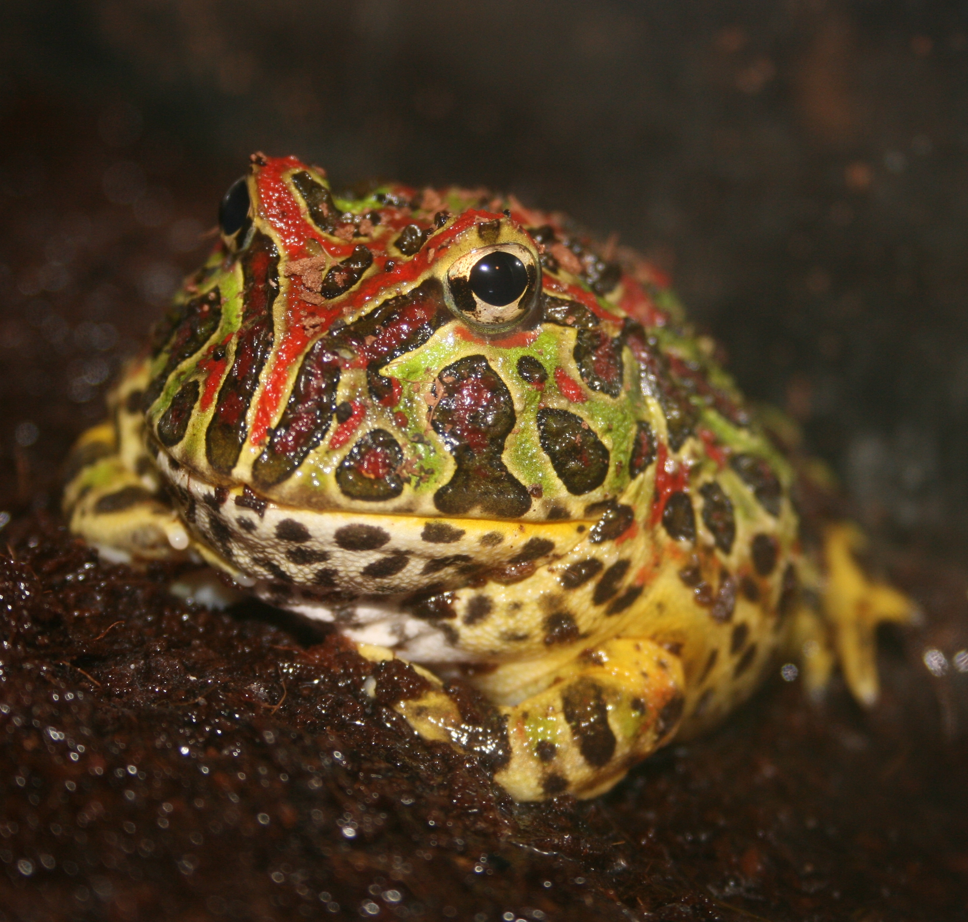
Length of the Period of Offspring Dependency
4 months of dependency.

Slide 9
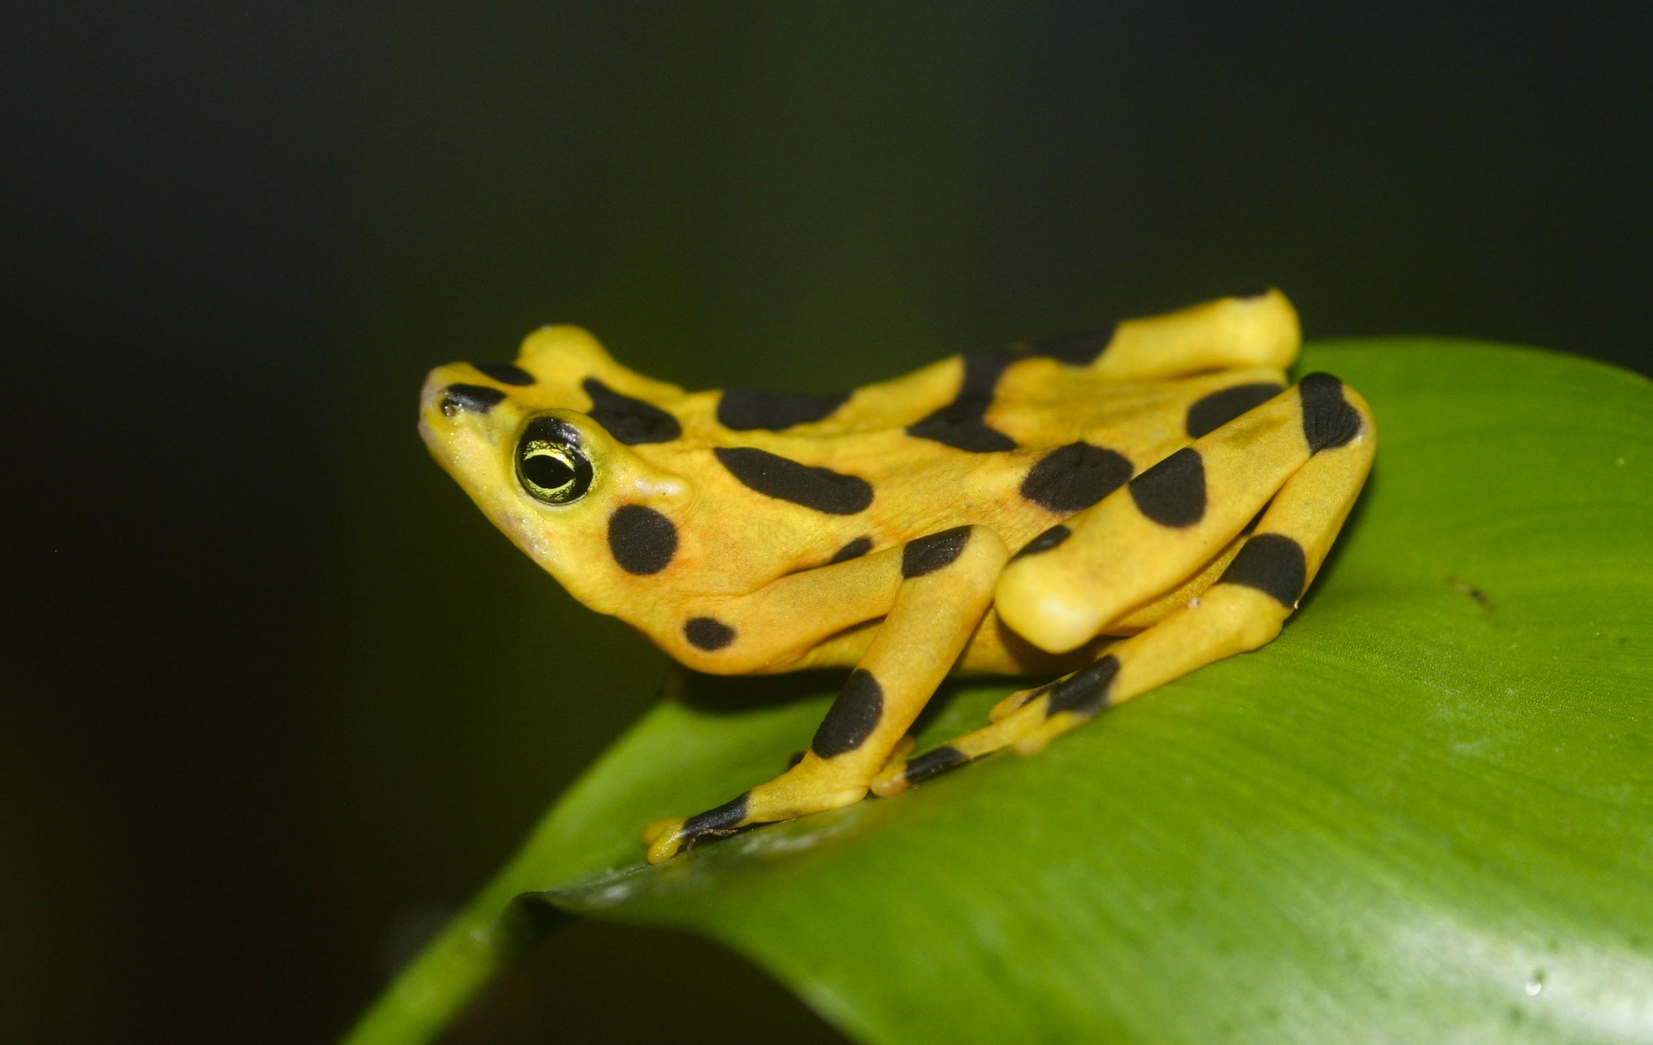
Life Span of Individuals
Range lifespan Status: captivity
10.0 (high) years
Range lifespan Status: wild
6 (high) years

Slide 10
Mating Behaviors
Most people learn about the basics of frog reproduction in elementary school. Frogs lay eggs in water, and the eggs hatch into tadpoles that grow into frogs. Only about half of all frogs follow these exact steps, but there are a few rules of thumb about frog reproduction. All frogs reproducesexually, and all hatch from eggs.
In almost all frogs, egg fertilization happens outside the female's body instead of inside. The female releases her eggs and the male releases his sperm at the same time. In order to make sure that the sperm reach the eggs, the male and female get into a mating posture called amplexus. The male climbs onto the female's back and clasps his forelegs around her middle. Frogs can stay in amplexus for hours or even days as the female releases as few as one or as many as several hundred eggs.

Slide 11
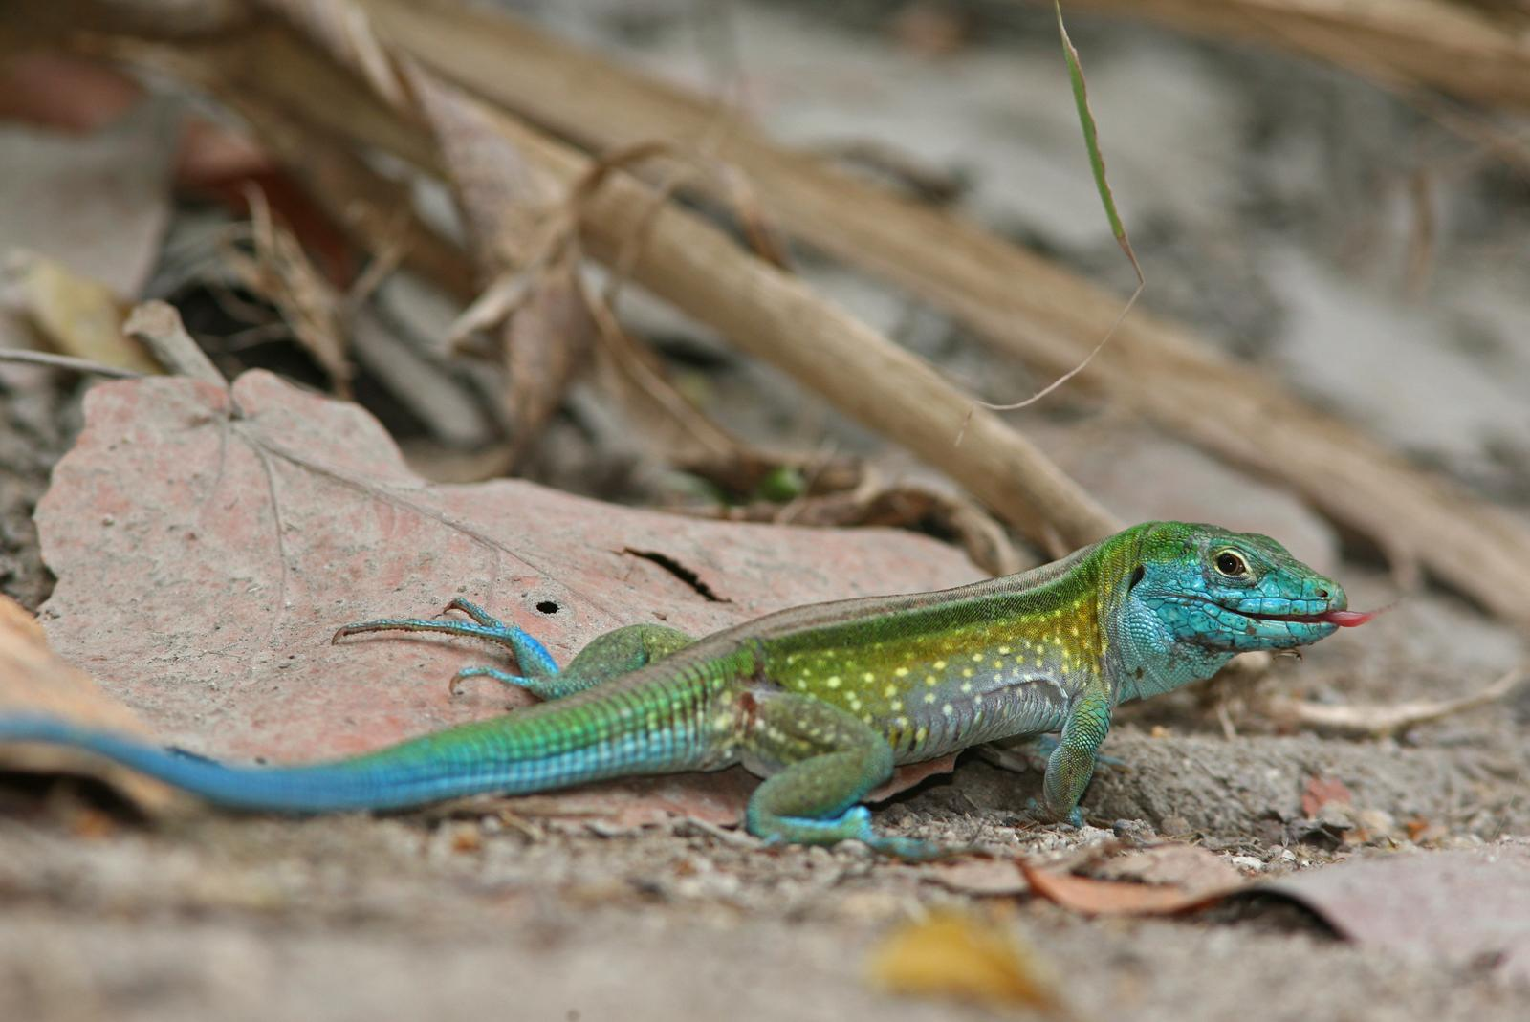
Whiptail Lizard

Slide 12
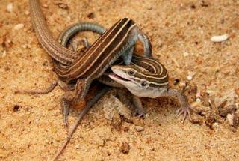
Number of Offspring

