Slide 1
Living By Chemistry
SECOND EDITION
Unit 3: WEATHER
Phase Changes and Behavior of Gases

Slide 2
Lesson 52: Hot Enough
Thermometers

Slide 3
ChemCatalyst
The weather forecast in Moscow, Russia, calls for a 60% chance of precipitation with highs reaching 30 °C, while in Washington, D.C., the weather forecast calls for a 70% chance of precipitation with highs reaching 50 °F.
  Which city will be warmer? Explain your thinking.
  Do you think it will rain or snow in either of the two cities? Explain your reasoning.

Slide 4
Key Question
How is temperature measured?

Slide 5
You will be able to:
create a thermometer and a temperature scale
describe how a thermometer works
explain the Fahrenheit and Celsius temperature scales

Slide 6
Prepare for the Lab
Work in groups of four.

Slide 7
Discussion Notes
The volume of matter changes in response to changes in temperature.

Slide 8
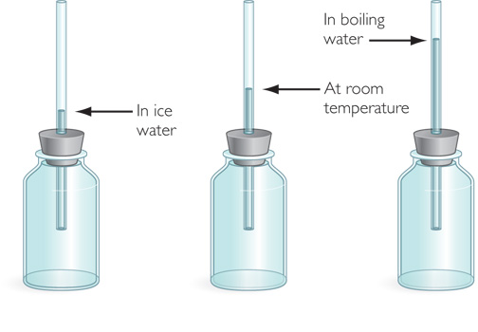
Discussion Notes (cont.)
Many thermometers contain a liquid, such as alcohol or mercury.

Slide 9
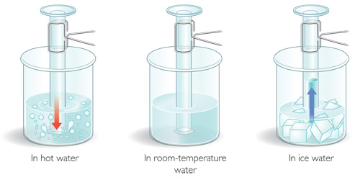
Discussion Notes (cont.)
Gases expand and contract as the temperature changes.

Slide 10
Discussion Notes (cont.)
To set a temperature scale, you need at least two measurements.
Melting point or melting temperature: The temperature at which a substance melts or freezes. At this temperature, both solid and liquid phases of the substance are present.
Boiling point or boiling temperature: The temperature at which a substance boils or condenses. At this temperature, both liquid and gas phases of the substance are present.

Slide 11
Discussion Notes (cont.)
Once you have set a scale with two points, you can determine other temperatures.
In 1724, German physicist Daniel G. Fahrenheit invented the first modern thermometer—the mercury thermometer.
Degree: The increment of temperature that corresponds to one unit on a thermometer. The size of a degree depends on the temperature scale used.

Slide 12
Discussion Notes (cont.)
In 1747, Anders Celsius, a Swedish astronomer, created a thermometer with a different scale.
Degrees Celsius and degrees Fahrenheit both measure the same thing (temperature).
9
5
°F = (°C)+32 or °F = 1.8(°C)+32

Slide 13
Wrap Up
How is temperature measured?
  The volume of matter changes in response to changes in temperature.
  Almost all substances expand on heating and contract on cooling.
  The change in volume of a liquid can be used to measure temperature changes.
  The relationship between the Fahrenheit scale and the Celsius scale is described by the formula °F = (°C) + 32.
9
5

Slide 14
Check-In
The temperature is 37 °C in Spain in July. How does this compare with body temperature, which is 98.6 °F?

