Slide 1
Living By Chemistry
SECOND EDITION
Unit 2: SMELLS
Molecular Structure and Properties

Slide 2
Lesson 46: Sniffing It Out
Phase, Size, Polarity, and Smell

Slide 3
ChemCatalyst
  1. If you place an open perfume bottle and a piece of paper in a sunny window, the aroma of the perfume will soon fill the air, but you won’t smell the paper at all. Explain what is going on.
  2. What is the heat from the Sun doing to the perfume to increase the smell?

Slide 4
Key Question
What generalizations can you make about smell and molecules?

Slide 5
You will be able to:
  explain the connections between smell and polarity, molecular size, phase, and type of bonding
  predict whether a molecule will have a smell based on its structure, composition, and phase

Slide 6
Prepare for the Activity
Work in pairs.

Slide 7
Discussion Notes
Phase and molecular size both play a role in smell properties.
Polarity determines the smell of small molecules.
Many solids do not evaporate into gases and therefore don’t have a smell.

Slide 8
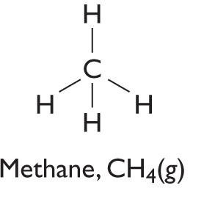
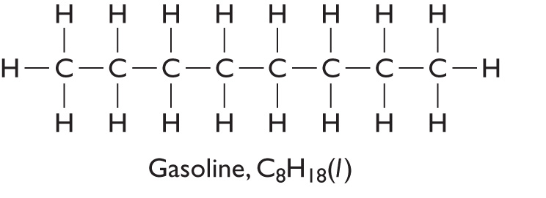
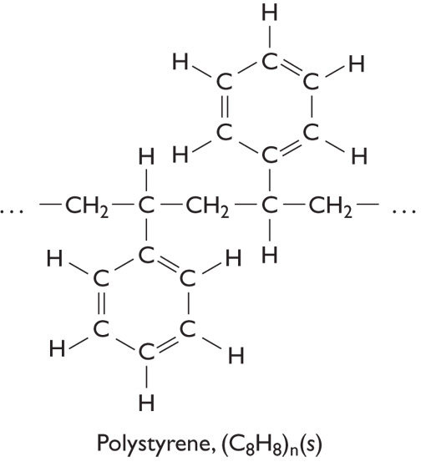
Discussion Notes (cont.)
Compound | Phase | Structural Formula
methane CH₄ | gas
Octane C₈H₁₈ | liquid
Polystyrene (C₈H₈)_{n} (repeating units) | solid

Slide 9
Discussion Notes (cont.)
Molecular substances tend to have a smell because it is easy for them to become airborne.
Substances that are liquids at ordinary temperatures tend to have a smell.

Slide 10
Discussion Notes (cont.)
Molecular solids are volatile and have a smell.

Slide 11
Wrap Up
What generalizations can you make about smell and molecules?
  Small molecules have a smell if they are polar.
  Medium-size molecules tend to have a smell whether or not they are polar.
  The smells of medium-size molecules can be predicted by looking at shape and functional group.
  Very large molecules do not have a smell because they do not evaporate and enter the nose.

Slide 12
Wrap Up (cont.)
  Nonmolecular solids (e.g., salts, metals) do not have a smell because they do not evaporate.

Slide 13
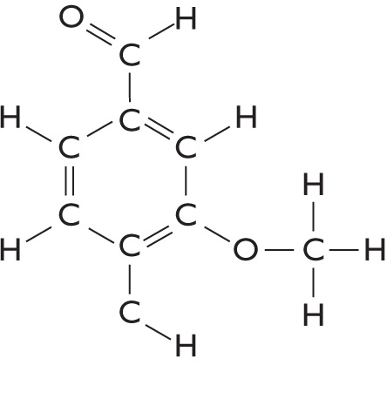

Check-In
Which of these will have a smell? Explain your reasoning.
Substance | Structure | Phase
CaCl₂, calcium chloride | Cl⁻ Ca²⁺ Cl⁻ (repeating throughout the solid in three dimensions) | solid
C₈H₈O₃, vanillin |  | liquid
HCN, hydrogen cyanide |  | gas

