Slide 1
Living By Chemistry
SECOND EDITION
Unit 2: SMELLS
Molecular Structure and Properties

Slide 2
Lesson 45: I Can Relate
Polar Molecules and Smell

Slide 3
ChemCatalyst
Hydrogen chloride, HCl, and ammonia, NH₃, have a smell, and large amounts of each dissolve in water. Oxygen, O₂, nitrogen, N₂, and methane, CH₄, do not have a smell, and only a small amount of each dissolves in water. How can you explain these differences?

Slide 4
Key Question
What does polarity have to do with smell?

Slide 5
You will be able to:
  assess a molecule for symmetry and determine whether it is likely to be polar
  use electronegativity values to locate the partial negative and partial positive portions of a molecule
  explain the connection between polarity and smell

Slide 6
Prepare for the Activity
Work in pairs.

Slide 7
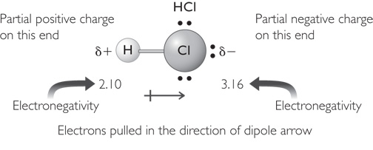
Discussion Notes
Polarity of diatomic molecules is fairly easy to determine.

Slide 8
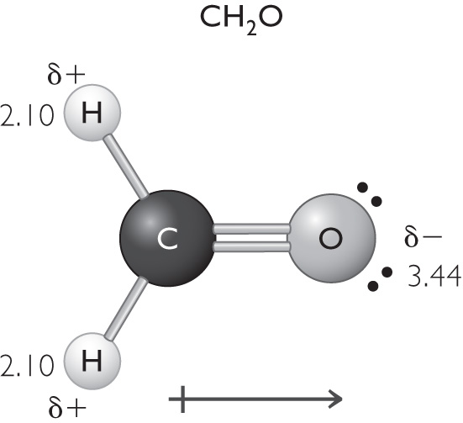
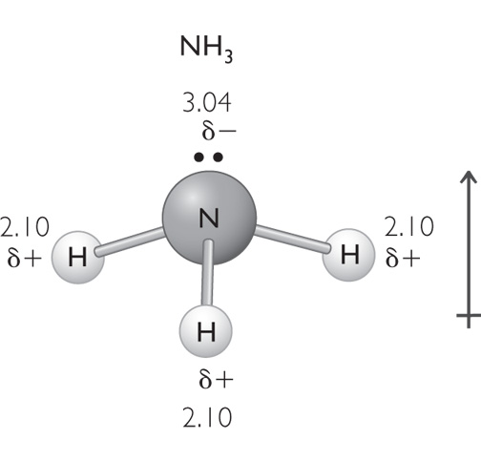
Discussion Notes (cont.)
Both electronegativity and the overall symmetry of the molecules help determine the polarity of molecules with more than two atoms.

Slide 9
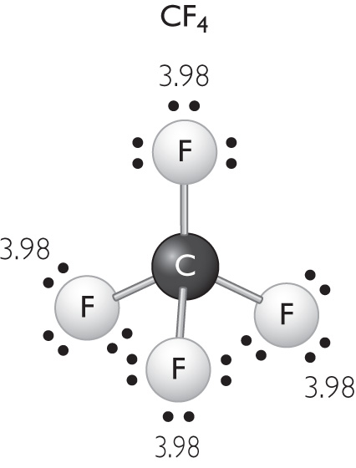
Discussion Notes (cont.)
Small nonpolar molecules do not have a smell.
Tetrafluoromethane is symmetrical and nonpolar.

Slide 10
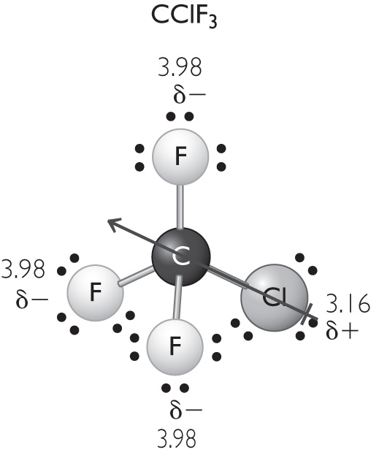
Discussion Notes (cont.)
If the overall shape of a molecule is asymmetrical and the molecule is made from more than one kind of atom, chances are it is a polar molecule.
Chlorotriflouromethane is polar because of the chlorine atom on one side.

Slide 11
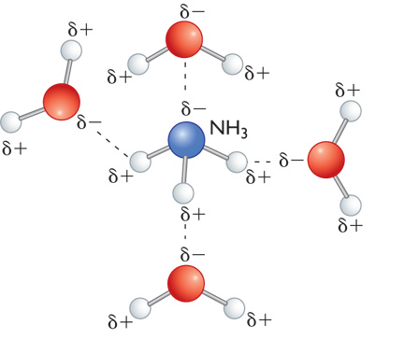
Discussion Notes (cont.)
Inside the nose is a watery mucous lining.
The intermolecular attractions of polar molecules cause them to dissolve easily in water.

Slide 12
Discussion Notes (cont.)
Molecules need to be attracted to receptor sites in order to be detected.
The small molecules that constitute our air do not have a smell.

Slide 13
Wrap Up
What does polarity have to do with smell?
  Differences in electronegativity values can be used to determine the direction of polarity of an entire molecule. (In other words, you can determine which part of the molecule has a partial negative charge and which part has a positive partial charge.)
  Molecules that are asymmetrical in shape and composition are usually polar and usually smell.

Slide 14
Wrap Up (cont.)
  Small polar molecules have a smell. Small nonpolar molecules do not have a smell.
  Polar molecules dissolve easily in other polar molecules. Nonpolar molecules do not dissolve easily in polar molecules.

Slide 15

Check-In
Is hydrogen cyanide, HCN, a polar molecule? Will it smell? Why or why not?

