Slide 1
Living By Chemistry
SECOND EDITION
Unit 2: SMELLS
Molecular Structure and Properties

Slide 2
Lesson 44: Thinking
(Electro)Negatively
Electronegativity Scale

Slide 3
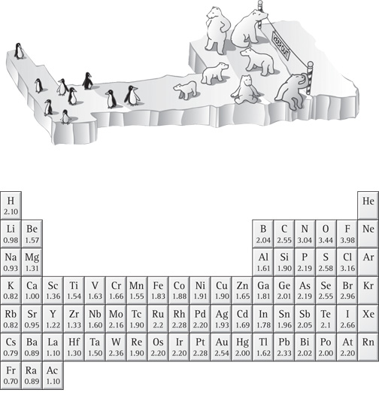
ChemCatalyst
1. Explain how the illustration and the table might be related to each other.
2. What patterns do you see in the numbers in the table?

Slide 4
Key Question
How can electronegativity be used to compare bonds?

Slide 5
You will be able to:
  use the electronegativity scale to compare atoms and to compare (calculate) the polarity of different bonds
  use the electronegativity scale to predict bond dipoles and bond type
  describe the continuum of nonpolar, polar, and ionic bonding in terms of electronegativity

Slide 6
Prepare for the Activity
Work individually.

Slide 7
Discussion Notes
In 1932, Linus Pauling created a scale for electronegativity and assigned numerical values for the electronegativities of the elements.

Slide 8
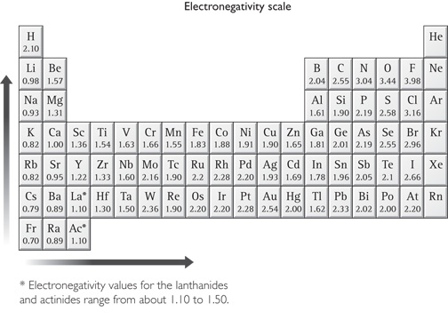
Discussion Notes (cont.)

Slide 9
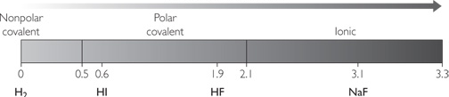
Discussion Notes (cont.)
By determining the numerical difference between electronegativities in a bond, you can compare the polarities of bonds.
Numerical differences in electronegativity can also help predict the type of bond that will be found.
Electronegativity difference
Bonding between atoms is on a continuum.

Slide 10
Discussion Notes (cont.)
The dividing line between polar covalent bonding and ionic bonding is not clear-cut.

Slide 11
Wrap Up
How can electronegativity be used to compare bonds?
  Electronegativity measures how strongly an atom will attract shared electrons.
  The greater the difference in electronegativity between two atoms, the more polar the bond will be.
  In ionic bonding, the electronegativities between two atoms are so different that we can think about the bond as one in which the electron(s) of one atom is (are) completely transferred to the other atom.

Slide 12
Check-In
  1. Is the bond in potassium chloride, KCl, nonpolar, polar, or ionic? Explain.
  2. To what degree do the K and Cl atoms in KCl, potassium chloride, share electrons?

