Slide 1
Living By Chemistry
SECOND EDITION
Unit 2: SMELLS
Molecular Structure and Properties

Slide 2
Lesson 35: Making Scents
Analyzing Ester Synthesis

Slide 3
ChemCatalyst
What do you think happened in the experiment in the previous class to transform an acid molecule and an alcohol molecule into a sweet-smelling molecule?

Slide 4
Key Question
What happened to the molecules during the creation of a new smell?

Slide 5
You will be able to:
  explain what happened at a molecular level during the ester synthesis lab
  predict the product of a reaction between an alcohol and a carboxylic acid
  generally define a chemical reaction
  define what a catalyst is

Slide 6
Prepare for the Follow-up Activity
  Work individually.
  Chemical equation: A chemical sentence that tracks what happens during a change in matter. Chemical equations are written with chemical formulas and keep track of the atoms involved in the changes.

Slide 7
Prepare for the Follow-up Activity
Test tube | Organic acid | Alcohol | Smell of mixture before heating | Smell of mixture after heating
1 | Acetic acid | isopentanol | putrid | Fruity, banana smell
2 | Acetic acid | butanol | strongly putrid | Fruity, pear smell
3 | Butyric acid | ethanol | putrid | Fruity, pineapple smell

Slide 8
Discussion Notes
The products of these reactions smell sweet, so they must all contain an ester functional group.
Many different acids and alcohols can be brought together to form an ester and water.

Slide 9
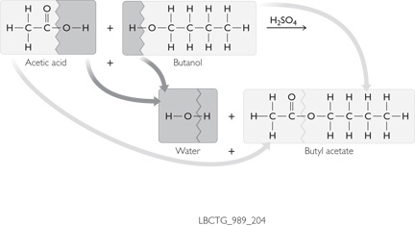
Discussion Notes (cont.)
H2SO4
Acetic acid
Butanol
Water
Butyl acetate

Slide 10
Discussion Notes (cont.)
The lab procedure you completed resulted in a chemical reaction.
It is possible to track the changes to the structure of the molecules through chemical equations.
Reactant: An element or compound that is a starting ingredient in a chemical reaction. Reactants are written to the left of the arrow in a chemical equation.

Slide 11
Discussion Notes (cont.)
Product: An element or compound that results from a chemical reaction. Products are written to the right of the arrow in a chemical equation.
Catalyst: A substance that accelerates a chemical reaction but is itself not permanently consumed or altered by the reaction. A catalyst is written above the arrow in a chemical equation.
When atoms are rearranged during chemical reactions, not all of the bonds must break.

Slide 12
Discussion Notes (cont.)
The naming of chemical compounds is not random.
Formic acid reacts with octanol to form octyl formate.

Slide 13
Wrap Up
What happened to the molecules during the creation of a new smell?
  The smell of the molecules in the ester lab changed because the reactant molecules combined to form different product molecules.
  In a chemical reaction, bonds are broken and new bonds are formed.
  A catalyst is a substance that accelerates a chemical reaction but is itself not permanently consumed or altered by the reaction.

Slide 14
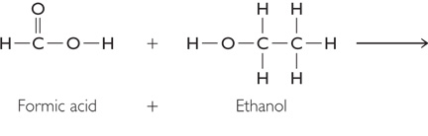
Check-In
Predict the structural formula of the product of this reaction.
What smell would you expect the product to have?
Formic acid
Ethanol

