Slide 1
Living By Chemistry
SECOND EDITION
Unit 1: ALCHEMY
Matter, Atomic Structure, and Bonding

Slide 2
Lesson 26: Electron Glue
Bonding

Slide 3
ChemCatalyst
A gold ring is made up of individual gold atoms.
  What keeps the atoms together? Why don’t they break apart from one another?
  What parts of the atom do you think are responsible for keeping the atoms together in a solid?

Slide 4
Key Question
How are atoms connected to one another?

Slide 5
You will be able to:
define a chemical bond and describe the four basic types of chemical bonds
use chemical formulas to sort substances into bonding categories
predict the properties of a substance based on its chemical formula and bonding type

Slide 6
Prepare for the Activity
Work in pairs.
Chemical bond: An attraction between atoms that holds them together in space.

Slide 7
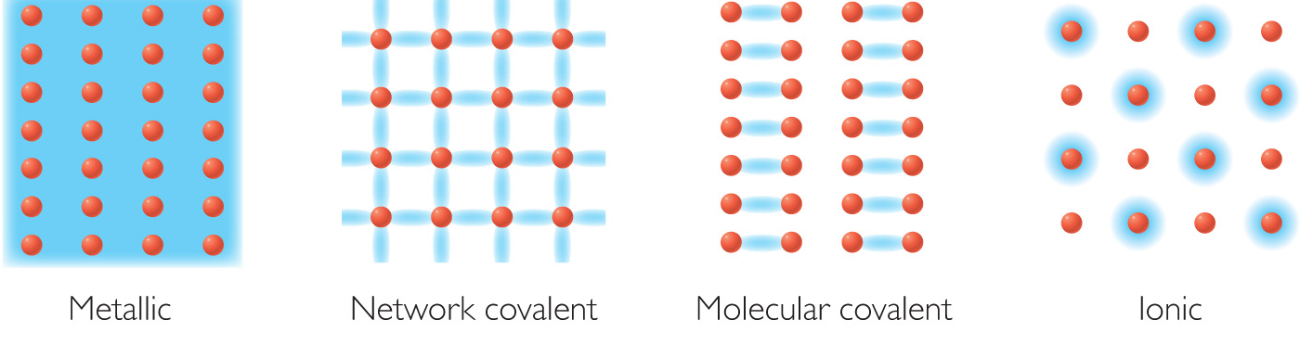
Prepare for the Activity (cont.)
Four Models of Bonding

Slide 8
Discussion Notes
The different locations of the electrons among atoms account for many different properties of substances.

Slide 9
Discussion Notes (cont.)
Ionic bonding: A type of chemical bonding that is the result of transfer of electrons from one atom to another.
Covalent bonding: A type of chemical bonding in which one or more pairs of valence electrons are shared between the atoms. Covalent bonding can be molecular covalent or network covalent.

Slide 10
Discussion Notes (cont.)
Metallic bond: A bond between metal atoms in which the valence electrons are free to move throughout the substance.
Molecule: A group of atoms covalently bonded together.

Slide 11
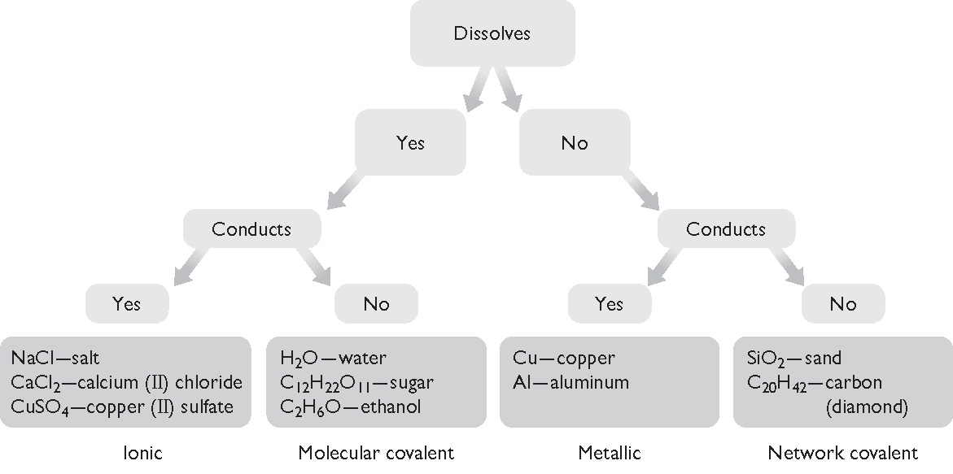
Discussion Notes (cont.)
The chart created in the previous lesson can now be labeled with the four types of bonds.

Slide 12
Discussion Notes (cont.)
Bonding also relates to the type of atom in the substance—metal or nonmetal.
Metal atoms
Metallic
Nonmetal atoms
Network Molecular
covalent covalent
Metal and nonmetal atoms
Ionic

Slide 13
Wrap Up
How are atoms connected to one another?
  A chemical bond is an attraction between atoms involving valence electrons.
  There are four types of bonds: ionic, network covalent, molecular covalent, and metallic.
  Valence electrons are distributed differently depending on the type of bond.

Slide 14
Check-In
Imagine that you have a mystery substance that does not dissolve in water and does conduct electricity.
  What type of bonding will you probably find in your substance? Explain.
  List one other property of your mystery substance.

