Slide 1
Living By Chemistry
SECOND EDITION
Unit 1: ALCHEMY
Matter, Atomic Structure, and Bonding

Slide 2
Lesson 25: You Light Up My Life
Classifying Substances

Slide 3
ChemCatalyst
If you were to drop a spoonful of salt, NaCl, into a glass of water, what would happen?
If you were to drop a gold ring into a glass of water, what would happen?
What do you think is different about the atoms of these two substances? Why do you suppose the gold atoms don’t break apart?

Slide 4
Key Question
How can substances be sorted into general categories?

Slide 5
You will be able to:
classify substances into four categories based on solubility and conductivity
explain the difference between the terms soluble and insoluble
begin to describe the atomic makeup of substances based on whether they are soluble and/or conduct electricity

Slide 6
Prepare for the Lab
Work in pairs.
Wear safety goggles at all times during the lab.
Dissolve: To disperse evenly into another substance. For example, a solid can dissolve in a liquid.
Conductivity: A property that describes how well a substance transmits electricity.

Slide 7
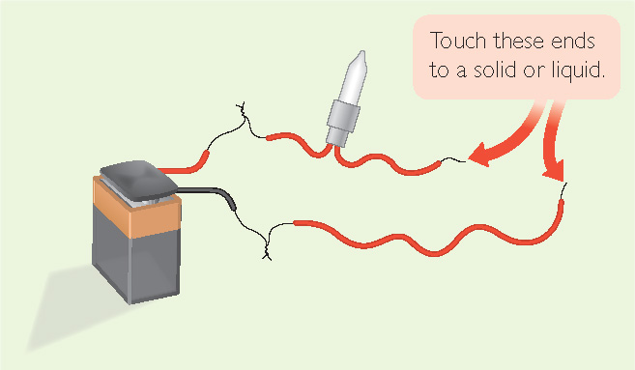
Prepare for the Lab (cont.)
Dissolving and conductivity can be demonstrated with a powdered sports drink and a light bulb assembly like the one shown below.

Slide 8
Discussion Notes
Generalizations about substances that do not light up the bulb:
  Compounds made up of C, H, and O atoms do not conduct electricity.
  Compounds made up entirely of nonmetals do not light up the bulb.
  Compounds made up of a combination of metals and nonmetals do not light up the bulb when they are in their solid form.

Slide 9
Discussion Notes (cont.)
Generalizations about substances that do light up the bulb:
  Everything that lights up the bulb has a metal atom in it.
  Compounds made of metal and nonmetal atoms, such as salts, light up the bulb when they are dissolved in water. (The sports drink is a solution of water, various salts, sugar, and a dye.)
  Metal solids light up the bulb.

Slide 10
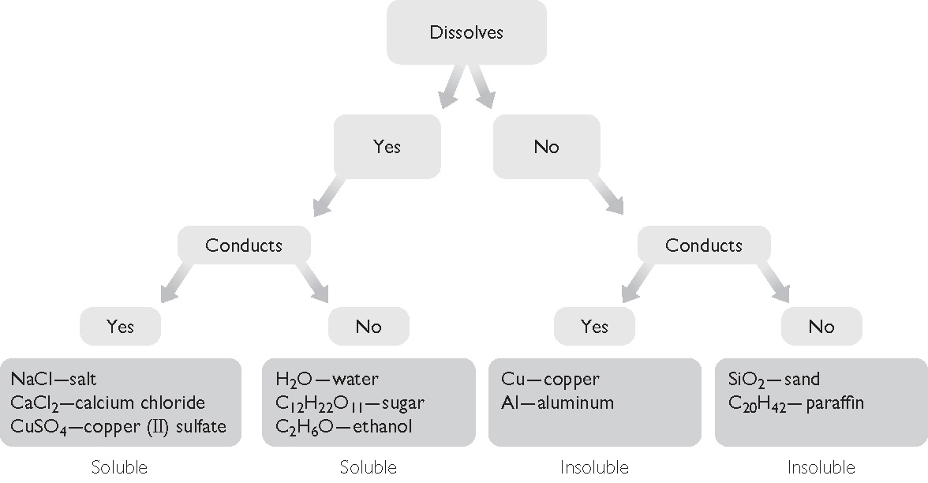
Discussion Notes (cont.)
Solubility and Conductivity

Slide 11
Discussion Notes (cont.)
We can place all the substances tested into one of the four categories.
Soluble: Describes a substance that is capable of being dissolved in another substance.
Insoluble: Describes a substance that is incapable of being dissolved in another substance.

Slide 12
Wrap Up
How can substances be sorted into general categories?
  Not all substances dissolve in water.
  Not all substances conduct electricity.
  Solid metals and metal–nonmetal compounds dissolved in water conduct electricity.

Slide 13
Check-In
Predict whether MgSO₄(aq), commonly known as Epsom salts, will conduct electricity. State your reasoning.

