Slide 1
Seahurst Park
What’s in the water?

Slide 2
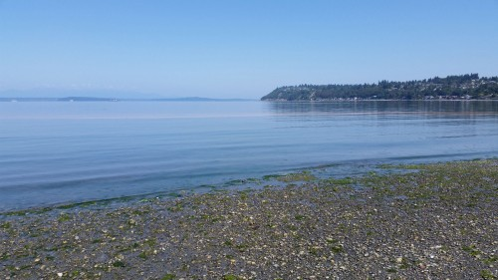
May 2015
Picture yourself at Seahurst Park looking out across Puget Sound toward the Olympic Mountains. Smell the salt water on the breeze. Look closely and notice the seaweed floating on top of the water. Do you notice the water has a reddish tint to it?

Slide 3
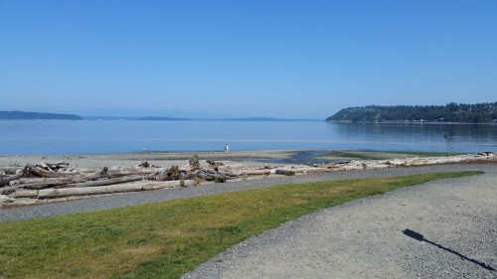
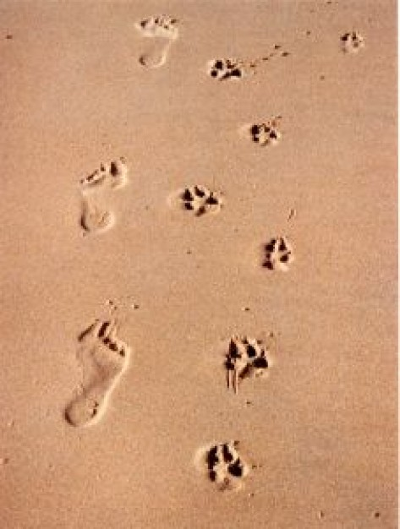
You take a few steps back up the hill...

Slide 4
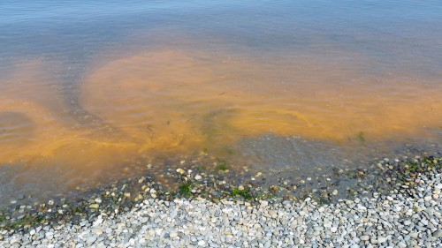
The water near the shoreline looks like tomato soup! Your dog normally likes to fetch the ball you throw out into the Sound, but today you decide to keep him out of the water. Why is that? What is going on?

Slide 5
Your Mission:
Identify possible solutions to reducing the frequency of harmful algal blooms in Puget Sound in order to limit the harmful effects of those algal blooms on the local ecosystem.

Slide 6
Know
Need to Know

Slide 7
Identify the Stakeholders

Slide 8
Initial Ideas

