Slide 1
Living By Chemistry
SECOND EDITION
Unit 1: ALCHEMY
Matter, Atomic Structure, and Bonding

Slide 2
Lesson 11: Atomic Pudding
Models of the Atom

Slide 3
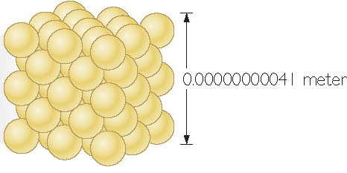
ChemCatalyst
The drawing shown here is a model of a very tiny cube of gold.
1. What do you think a scientific model is?
2. The spheres in this model represent atoms. What do you think atoms are?
3. How could you draw a model of the element copper to show that it is different from the element gold?
0.00000000041 meter

Slide 4
Key Question
How are the smallest bits of matter described?

Slide 5
You will be able to:
describe the historical development of the current atomic model
describe and draw an atomic model and explain the evidence that supports the existence of atomic structures
describe the dynamic nature of scientific models

Slide 6
Prepare for the Activity
Work in groups.
Model: A simplified representation of something more complex, that facilitates understanding certain aspects of a real object or process.
Atoms: The smallest unit of an element that retains the chemical properties of that element.

Slide 7
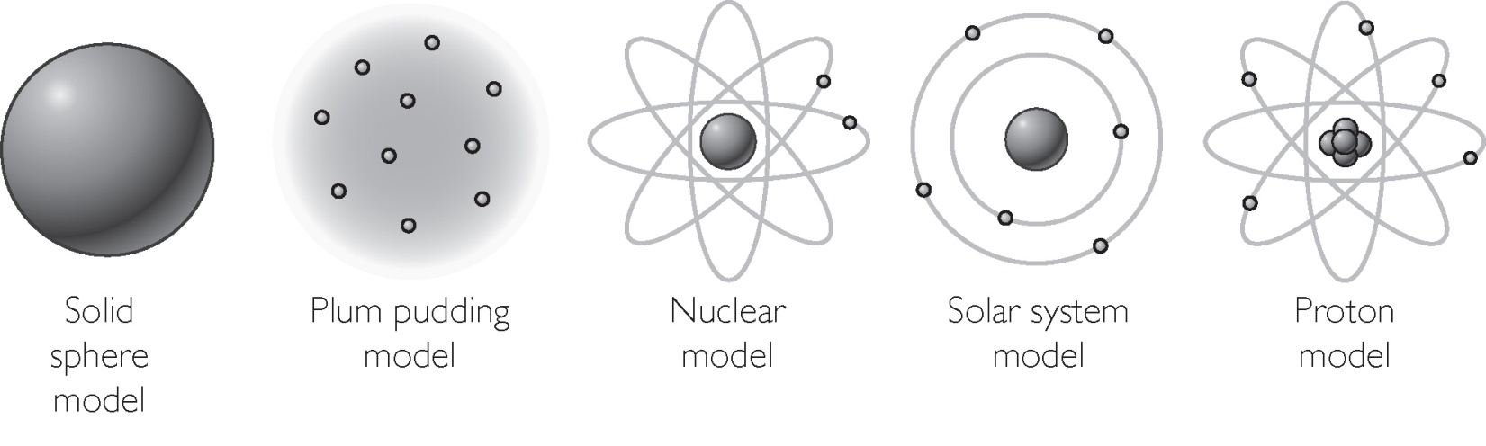
Discussion Notes
The Atomic Model Through Time

Slide 8
Discussion Notes (cont.)
Contemporary scientists are in agreement that matter is made up of tiny particles called atoms.

Slide 9
Discussion Notes (cont.)
Nucleus: The dense, positively charged structure found in the center of the atom. It is composed of protons and neutrons.
Proton: A particle with a positive charge, found in the nucleus of atoms.
Electron: A particle with a negative charge. Electrons move very fast around the outside of the nucleus of atoms.
Neutron: A particle that does not have a charge, found in the nucleus of atoms.

Slide 10
Discussion Notes (cont.)
Scientists have created models to describe atoms.
Scientific evidence is a collection of observation that everyone agrees on.

Slide 11
Wrap Up
How are the smallest bits of matter described?
All matter is made up of extremely small particles called atoms. These particles are too small to be seen directly, even under a microscope.
The atom is composed of even smaller particles called protons, neutrons, and electrons. The protons and neutrons are located in the dense nucleus of the atom. The electrons surround the nucleus. Protons are positively charged, neutrons have no charge, and electrons are negatively charged.

Slide 12
Wrap Up (cont.)
Science is theoretical and dynamic.
Models and theories are continually being revised or replaced with new models and theories as new evidence is gathered.

Slide 13
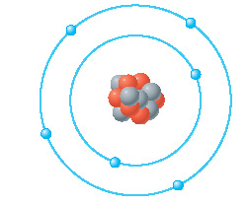
Check-In
Here is a model of a carbon atom.
1. List two things this model tells you about the carbon atom.
2. List something this model does not tell you about the carbon atom.

