Slide 1
Living By Chemistry
SECOND EDITION
Unit 1: ALCHEMY
Matter, Atomic Structure, and Bonding

Slide 2
Lesson 7: Now You See It
The Copper Cycle

Slide 3
ChemCatalyst
Answer these safety questions about the lab you will be doing today. If you can’t answer these questions, go back and reread the procedure.
  Name three things that could be dangerous in this lab.
  Why must part of the lab be done in a fume hood?
  What do you need to put on before starting the lab? Why?

Slide 4
Key Question
What happens to matter when it is changed?

Slide 5
You will be able to:
follow a lab procedure safely
describe a chemical change or chemical reaction

Slide 6
Prepare for the Lab (cont.)
During the lab, follow these safety guidelines:
Wear your safety goggles at all times.
Be very careful when handling chemicals. If any gets on your skin, wash the area immediately with water and inform your teacher.
Use the fume hood when adding the nitric acid to the copper; do not breathe in any of the gas.
When using the hot plate, set it at a medium setting. Be careful not to splash when stirring the chemicals.

Slide 7
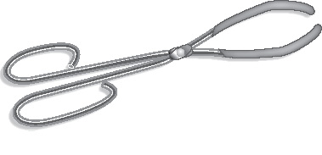
Prepare for the Lab (cont.)
Remove the beaker from the hot plate with beaker tongs.

Slide 8
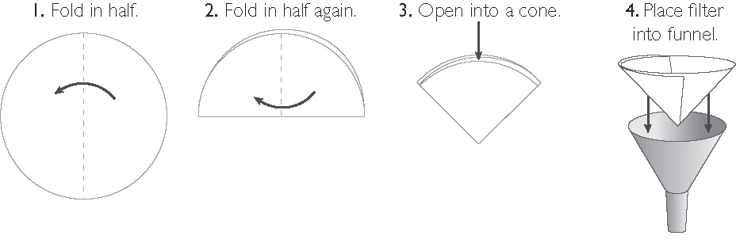
Prepare for the Lab (cont.)
Set up and use the funnel and filter paper following the instructions.

Slide 9
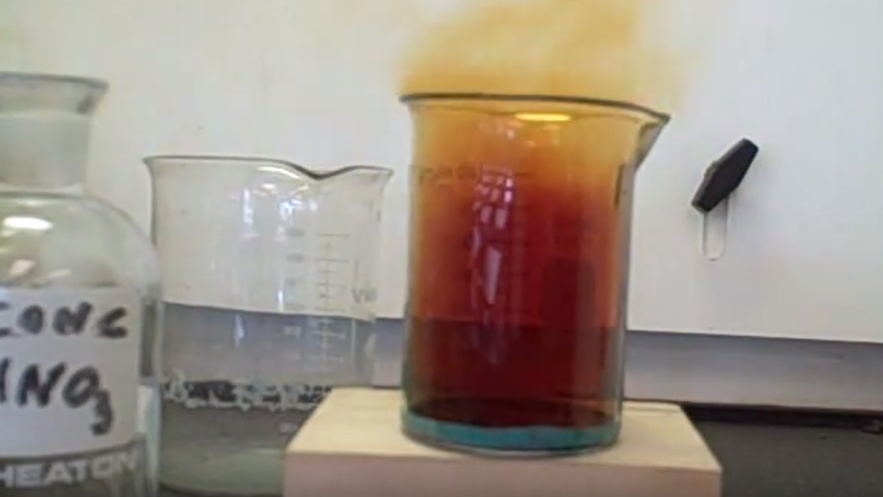
The Copper Cycle Video

Slide 10
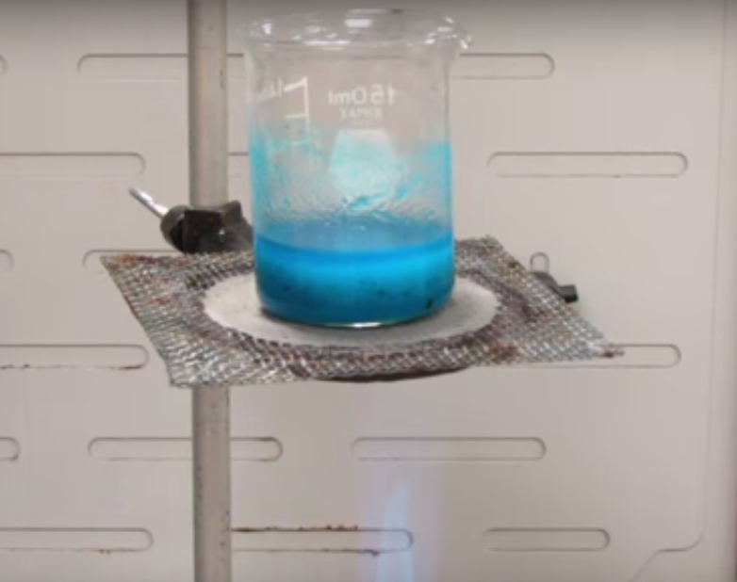
Another Copper Cycle Video

Slide 11
Check-In
You could see copper only in the first and last steps of today’s lab. Where do you think the copper was the rest of the time? Be specific.

