Slide 1
Entry Task
Take a few minutes to reflect on all you have learned this year in biology.
On a scale of 1-10, how prepared do you feel for the End of Course exam on Thursday? Why?
What do you need over the next two days to do your best on the Biology EOC?

Slide 2
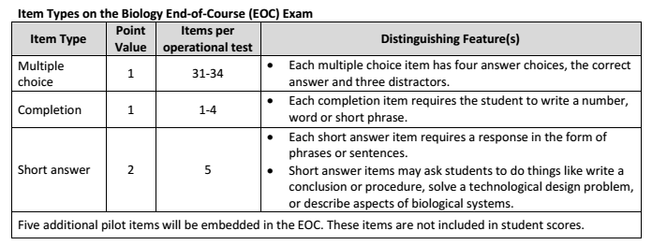
Biology End-of-Course Item Types

Slide 3
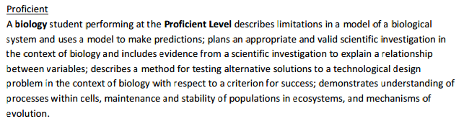
Biology EOC Scale Scores
To pass the Biology EOC, you must earn a score of 400 or better to demonstrate a proficient understanding of biology.

Slide 4
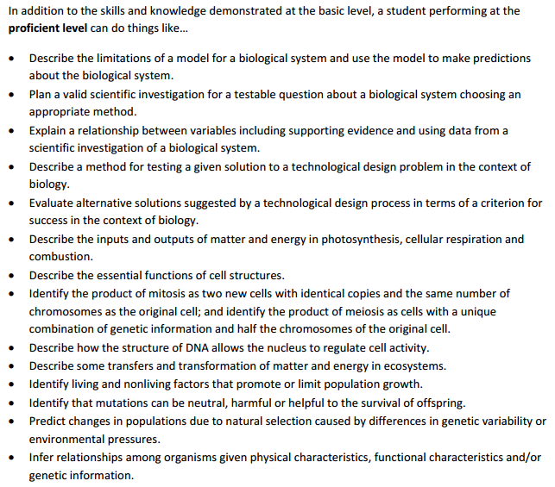

Slide 5
Short Answer Question Types
Conclusion ✔
New Procedure ✔
Field Study Procedure ✔
Research & Explore ✔
Redesign ✔
Criteria & Constraints
Test Solution
Unintended Consequences ✔

Slide 6
Research & Explore
Procedure
Conclusion
Test Solution
Redesign

Slide 7
Writing an EOC-Style Conclusion
Required elements:
Answer the experimental question
  Use your words!
  Explain what the data tells you.
High-Low
  Look at the average data extremes (high and low)
  Write it out! At the high MV, the RV results were…
Duh! Compare the high and low results using math.
So? Explain the results using science thinking, even if you don’t actually know the reason why.

Slide 8
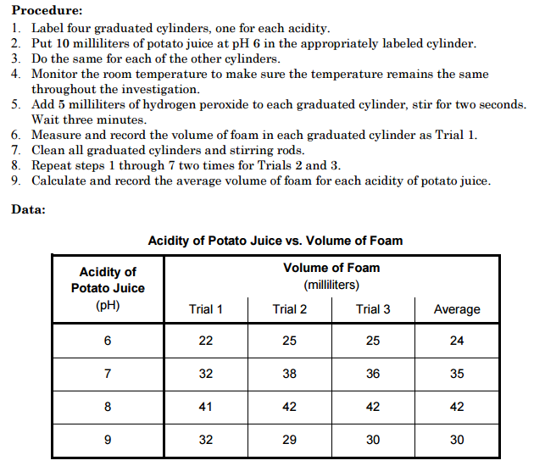
Conclusion Example (2012 Practice EOC)
Can you identify the Answer, High/Low, Duh!, and So?

Slide 9
New Procedure
Step 1: Use the EOC as a resource!
The word new implies there is an existing procedure to use as a model (do not copy!).
Step 2: Be logical!
Your procedure should be written as a list of numbered steps so you can easily repeat steps as needed (i.e. repeat steps 2-5 for three days). Make sure to include all of the listed elements.

Slide 10
Existing EOC Procedure

Slide 11
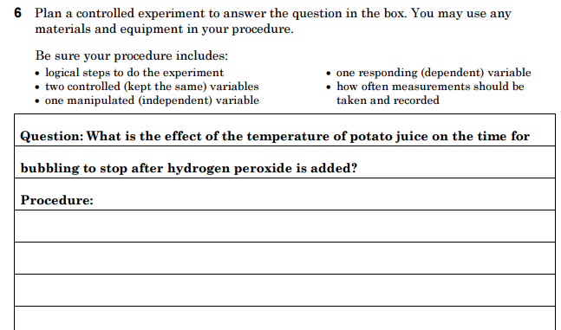
Write a New Procedure

Slide 12
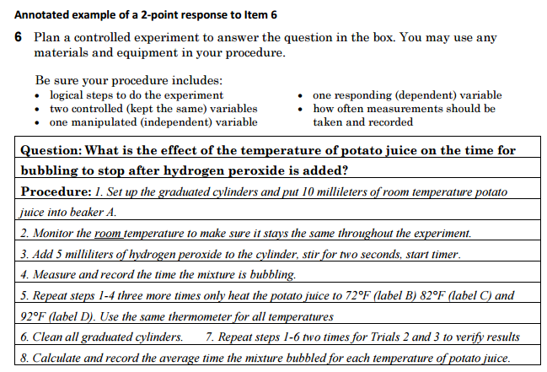
Full-Credit (2-point) New Procedure

Slide 13
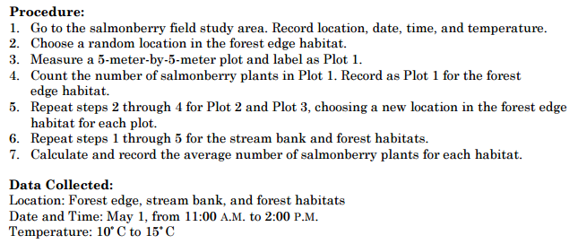
Field Study Procedure

Slide 14
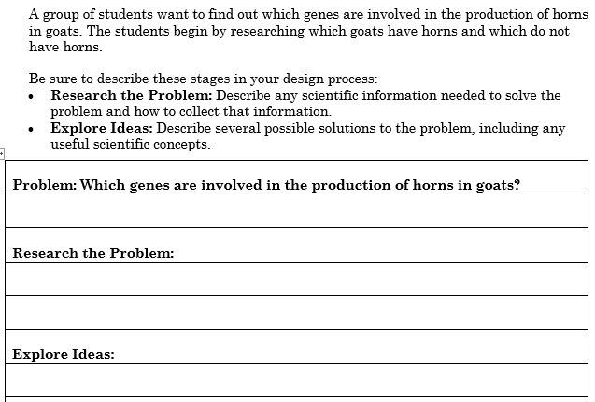
Research & Explore

Slide 15
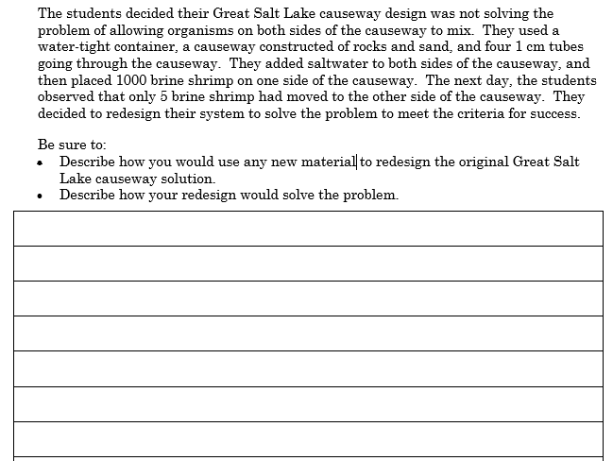
Redesign

Slide 16
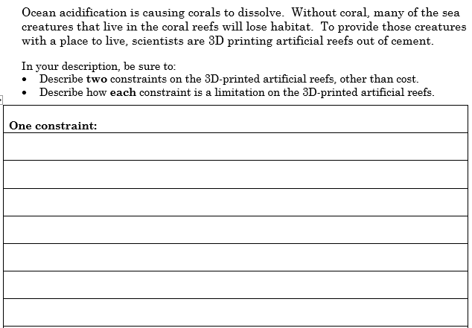
Criteria & Constraints

Slide 17
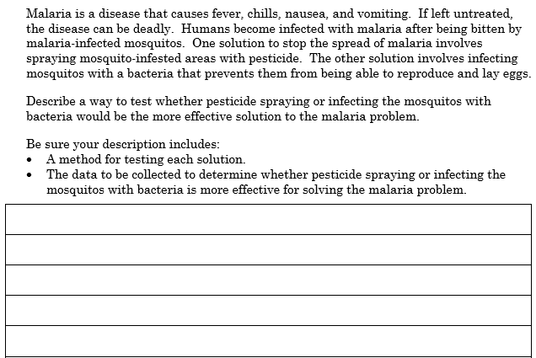
Test Solution

Slide 18
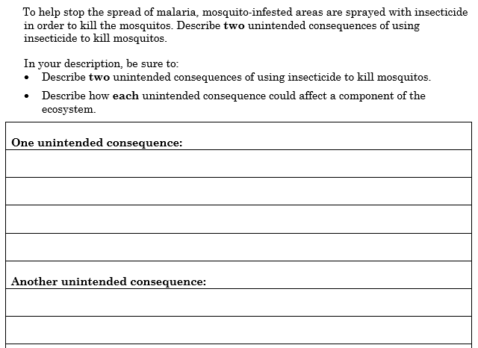
Unintended Consequences

Slide 19
Research & Explore
Procedure
Conclusion
Test Solution
Redesign
EOC Booklet, Class Website, Textbook, Classmates, Teacher...

Slide 20
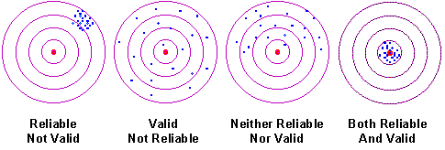
Reliability vs Validity
Use the contextual clues present in the graphic to explain the difference between reliability and validity.

