Slide 1
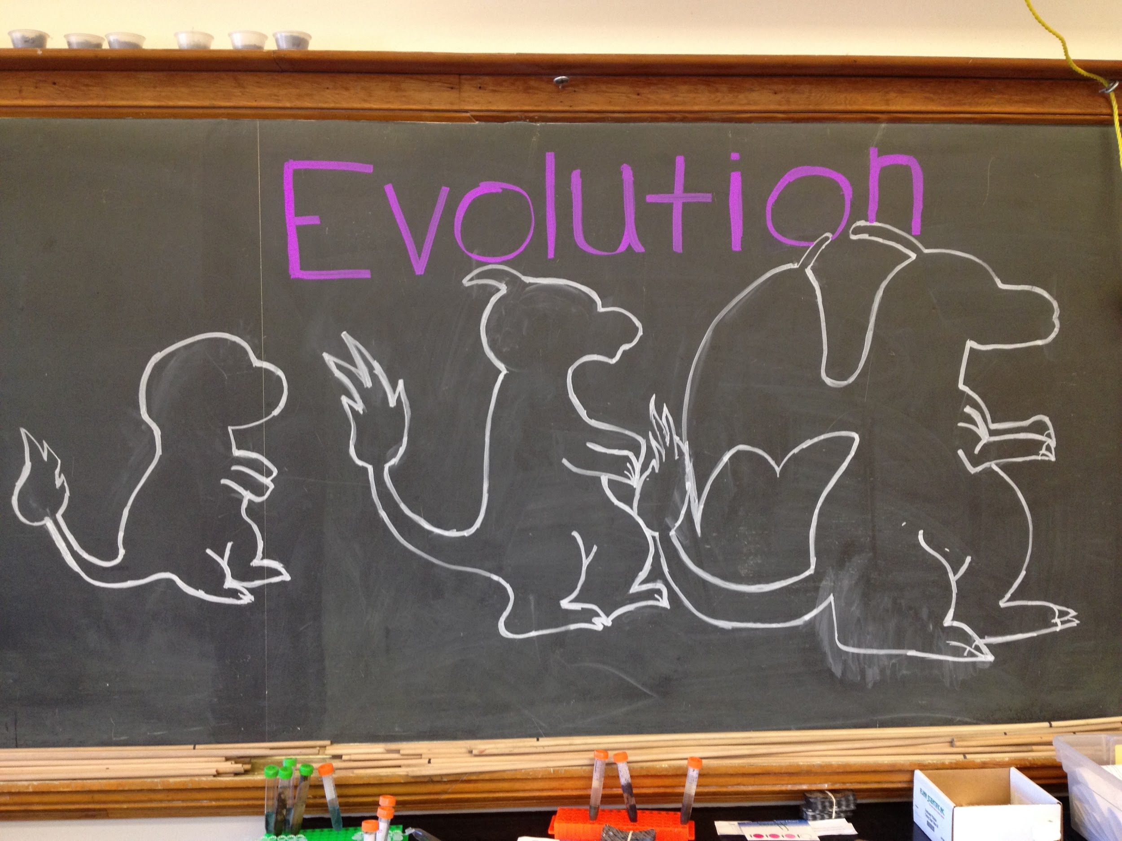
Entry Task: Lab Notebook 5/12/15
Is this evolution? In at least four written sentences, explain why or why not. Support your reasoning with science thinking!

Slide 2
What do we know about evolution? - P1

Slide 3
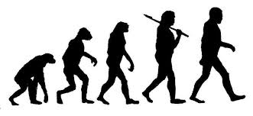
What is evolution?
Evolution: a cumulative change in the characteristics of organisms or populations from generation to generation.

Slide 4
How can we observe evolution?
Common ancestry:
Similar anatomical structures
Similar embryological development
Similar DNA sequences

Slide 5
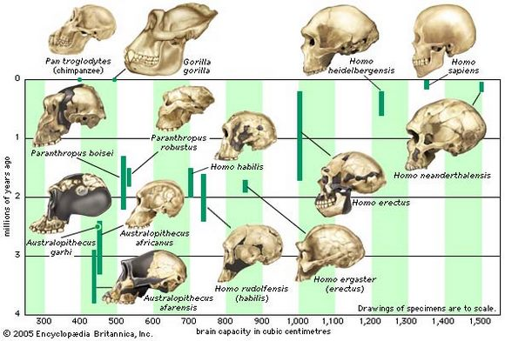
Similar anatomical structures
Over millions of years of evolution, human:
brain volume has increased
tooth size has decreased
brow ridge is greatly reduced
jaws is smaller
face is smaller
chin is pointier

Slide 6
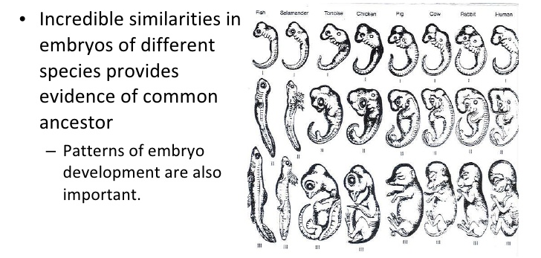
Similar embryological development

Slide 7
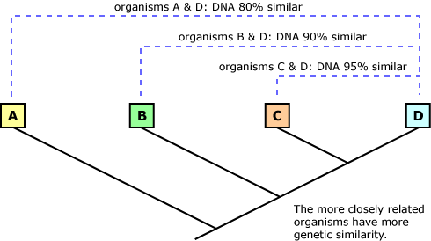
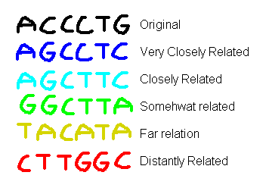
Similar DNA sequences
The more closely related organisms have more genetic similarity.

Slide 8
Common Ancestry:
DNA Mutations and Evolution
A mutation is a change in an organism’s genetic information, or DNA.
Mutations occur at random, at any time, and in the DNA of any type of cell.
When mutations occur in genes, they may result in new phenotypes that natural selection acts upon.

Slide 9
Heritability of Mutations
Mutations that occur in somatic (body) cells only affect the individual in which they occur.
Mutations that occur in gametes (egg and sperm) can be passed on to the next generation.

Slide 10
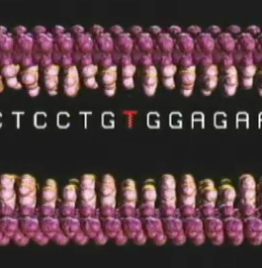
Types of Mutations
Mutations can occur on a small scale, most often affecting one or two nucleotides of DNA, or they can involve large segments of a chromosome or an entire chromosome.
Any mutation in a gene’s DNA can alter the function of the protein encoded by the gene.
Notes:
Can we add some art here? Maybe another DNA or chromosome photo of some sort?

Slide 11
Point Mutations
Most mutations are point mutations, or changes in a single nucleotide of an organism’s DNA.
They include substitutions, insertions, and deletions.
Insertions and deletions also can involve two or more nucleotides.

Slide 12
Substitution Mutations
A substitution is the replacement of a single nucleotide with another. It is classified by its effect on the protein produced:
  Silent mutations have no effect on the protein.
  Missense mutations result in a single amino acid change in the translated sequence.
  Nonsense mutations result in an amino acid codon being replaced by a “stop” codon. Nonsense mutations end translation prematurely and result in a truncated protein.

Slide 13
Substitution Examples
Location | Wild-Type (unmutated) | Silent Mutation | Missense Mutation | Nonsense Mutation
DNA | GTC | GTT | GTG | ATC
Messenger RNA (mRNA) | CAG | CAA | CAC | UAG
Amino acid | Glutamine | Glutamine | Histidine | Stop

Slide 14
A Closer Look at Duplications
Chromosomal duplications result in two copies of a gene or genes.
Two genes are paralogous if they exist at different chromosomal locations in the same organism and if they arose from a common ancestral gene.
Gene duplication can lead to new traits, and it plays a major role in the evolution and diversification of life.

Slide 15
Gene Duplication Outcomes
When an entire gene is duplicated:
  one of the two gene copies can lose its function by accumulating mutations over generations;
  one of the two gene copies can gain a novel function through subsequent mutation (this only happens if the original gene duplication event does not severely affect the organism and persists over generations); or
  the two copies of the gene split the total function of the ancestral gene into two unique but related functions for more-efficient expression.

Slide 16
The “Death” of Genes
Genes can lose their protein-producing abilities or stop being expressed. Such genes are called pseudogenes. As species have evolved, diverged, and gone extinct, so have their genes.
Genes become pseudogenes when they accumulate mutations over a long time. This only happens if the mutations do not compromise the organism’s survival; otherwise, natural selection would eliminate the mutations.

Slide 17
Examples of Gene Death
These two examples demonstrate the evolutionary significance of genes losing their functions.
Olfactory receptor genes in humans and mice: Mice have about 1,500 olfactory receptor genes, while humans have about 1,000. Only 20 percent of mouse olfactory receptor genes are pseudogenes, compared to about 60 percent in humans.
Myoglobin gene in some icefish species: Myoglobin is an oxygen-binding protein found in muscles, similar to hemoglobin in red blood cells. Myoglobin is absent from muscles, including the heart, of several, but not all, icefish species.

Slide 18
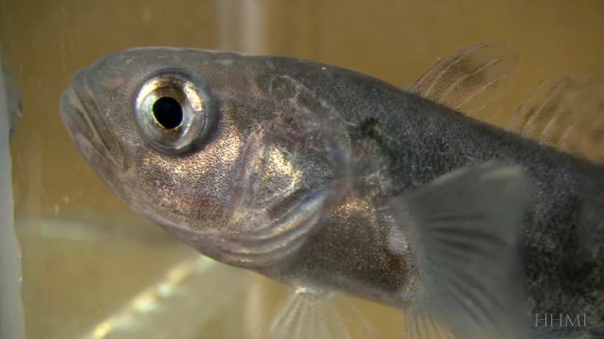
Gene Birth and Death in Icefish
Icefish are an excellent example of both the birth and death of genes.
Click to view the short film The Making of the Fittest:
The Birth and Death of Genes.
http://www.hhmi.org/biointeractive/making-fittest-birth-and-death-genes

