Slide 1
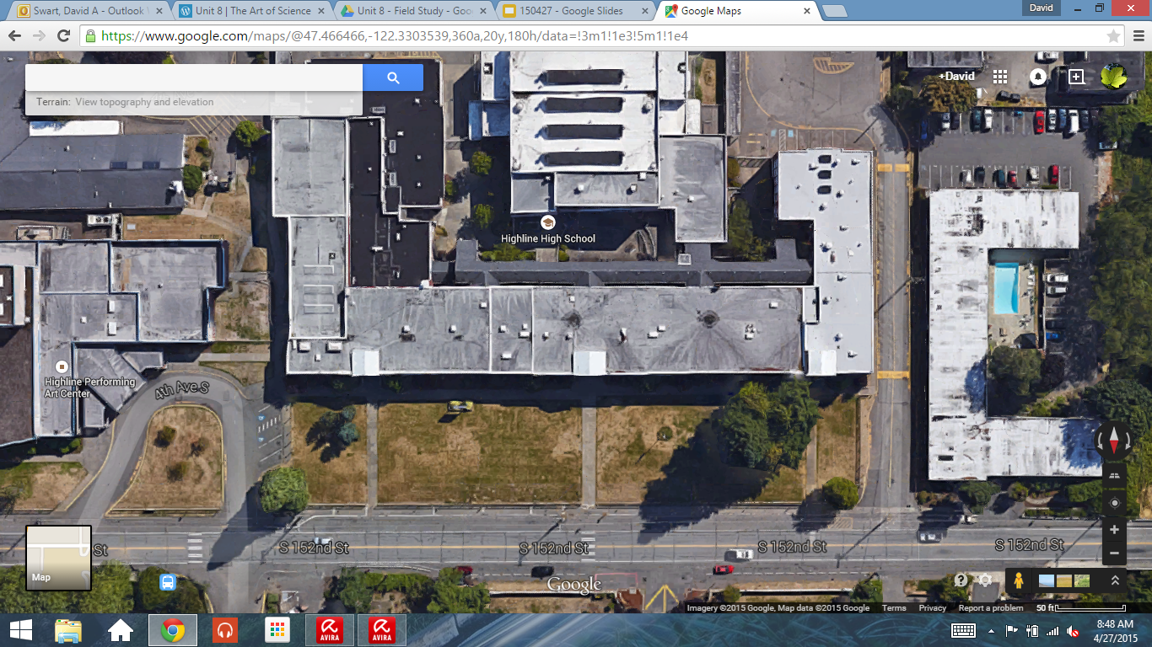
Entry Task 4/29/15
Step 1: Review your group’s field study procedure
Step 2: Gather materials needed for data collection
Step 3: List materials on the Day 1 worksheet
Step 4: Wait patiently until everyone is ready to go outside
1 4 7 10 13 16 19 22 25 28
2 5 8 11 14 17 20 23 26 29
3 6 9 12 15 18 21 24 27 30
S. 152nd S. 152nd S. 152nd S. 152nd S. 152nd

