Slide 1
Entry Task: Lab Notebook 4/27/15
You are a member of a consulting team hired to assess the environmental impact of reconstructing Highline High School. Your first job is to conduct a field study of the ecology of the front lawn. As part of your field study, what data you would like to collect? Explain what you would study first, how you would study it, and why in your lab notebook.
field study: a research project carried out in the field
ecology: the branch of biology that deals with the relationship of organisms to one another and to their physical surroundings.

Slide 2
Field Study Project Timeline / Rubric
4/27-28: Field Study Procedure (15 points - team)
4/29-30: Day 1 Field Work
5/1: Day 2 Field Work / Lab Work
5/4-5: Day 3 Field Work / Lab Work (30 points - team)
5/6-7: Data Analysis (30 points - team)
5/8: Conclusion Writing (25 points - individual)

Slide 3
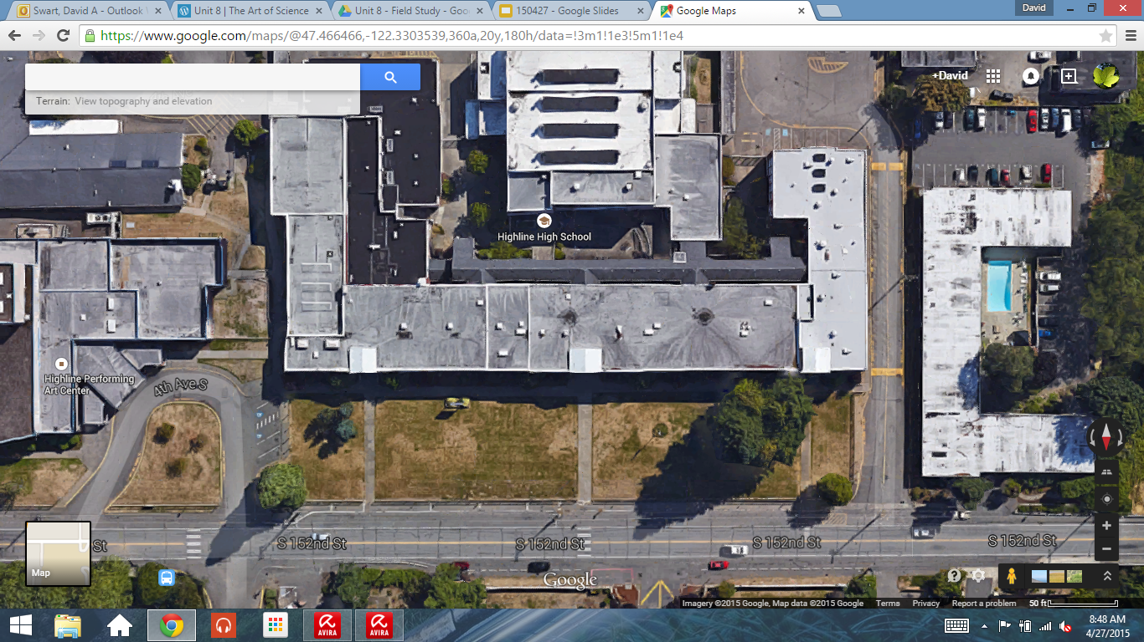
What is the effect of [infrastructure] on the [ecology] of Highline’s front lawn?
Front Lawn of Highline High School
126 meters
30 meters
S. 152nd S. 152nd S. 152nd S. 152nd S. 152nd

Slide 4
Defining the Variables
For the field study, work with your partner to complete the Field Study Question:
How does [manipulated variable] affect the [responding variable]?
Working with a partner, come up with at least three field study questions.

Slide 5
Field Study Question Examples
How does distance from S. 152nd affect the number of plants growing on the front lawn?
How does distance from HHS affect the composition of the front lawn soil?
How does the amount of shadows cast by buildings and trees affect the diversity of species on the front lawn?

Slide 6
Field Study Ideas
Water quality testing
pH
Pollution
Soil testing
Composition
pH
Temperature
Air quality
O₂ and CO₂
Pollution
Animal diversity
Macro and Micro
Plant diversity
Species
Biomass
Land Use
Developed / Undeveloped
Surface permeability
Surface water plan
Pollution

Slide 7
Field Study Primer
Step 1: Define the study area.
Step 2: Create a coordinate map.
Step 3: Select regions within coordinate map.
Front Lawn of Highline High School
1 4 7 10 13 16 19 22 25 28
2 5 8 11 14 17 20 23 26 29
3 6 9 12 15 18 21 24 27 30
S. 152nd S. 152nd S. 152nd S. 152nd S. 152nd

