Slide 1
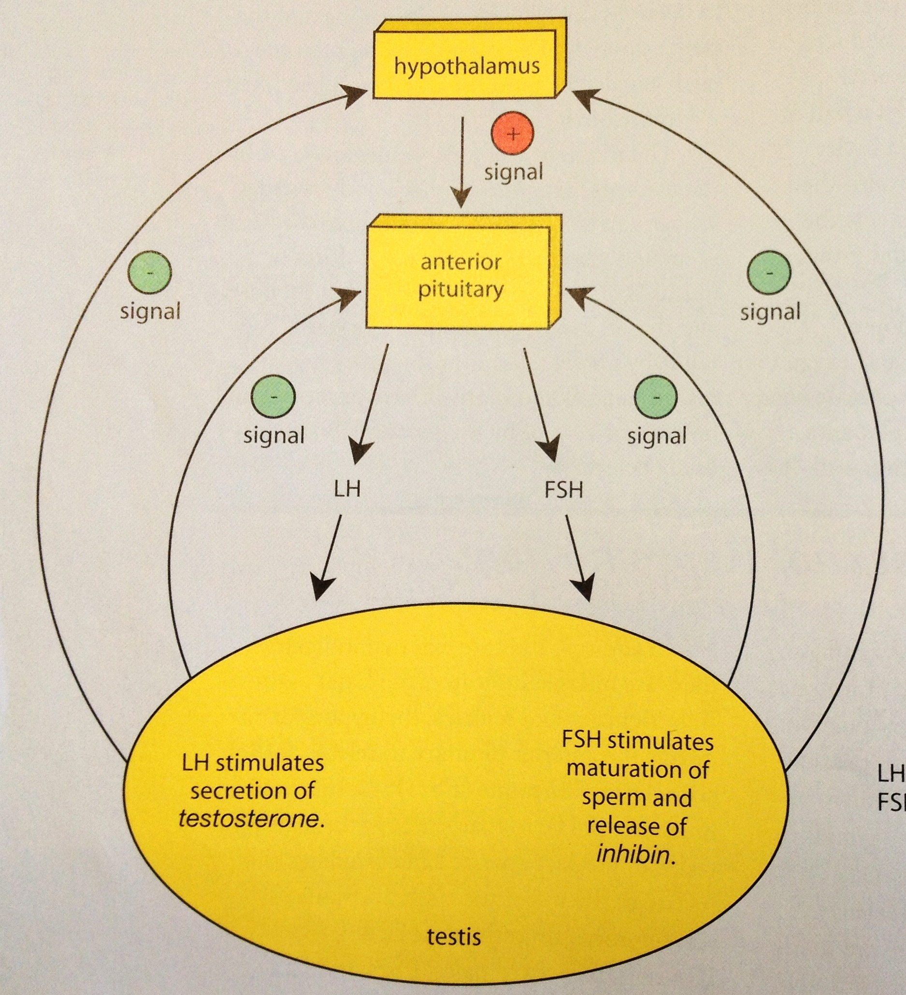
Entry Task: Lab Notebook 4/23/15
= Positive Feedback
= Negative Feedback
In your lab notebook, using the vocabulary of positive and negative feedback, explain the interaction of hormonal signals between the brain and the testes in the human male.
Fig. E10.7, p.482 of BSCS
+
-
LH = Luteinizing Hormone
FSH = Follicle Stimulating Hormone

Slide 2
Hormones and Sexual Reproduction
Working with your table partner, read pages 481-484 and complete the worksheet.
Read “Making Sense of Human Reproduction” on pages 407-408. Complete “Process and Procedures” steps 1 and 2 (pages 408-410), using the Birth Control Brochure Rubric.
Brochure and worksheet due by end of class today.

Slide 3
Unit 7 Exam Tomorrow
Be sure to review:
Sources of genetic errors (p.503-10)
Continuity Through Reproduction (p.474-6)
Making More People (p.477-81)
Non-human Mating Patterns (p.486-9)
Human Mating Patterns (p.489-91)
Hormones & Sexual Reproduction (p.481-4)
Dihybrid Crosses

