Slide 1
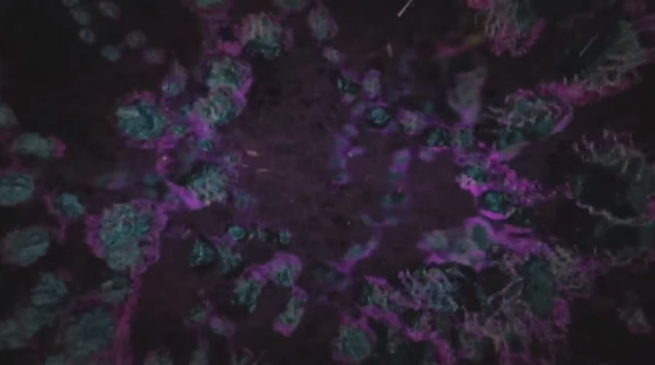
UV Light Damages DNA
https://www.youtube.com/watch?v=uN82GLQYAUQ

Slide 2
Entry Task: Lab Notebook 4/20/15
Ultraviolet (UV) light from the sun can damage DNA, leading to skin cancer. Are DNA mutations to skin cells caused by UV light passed along from parent to child? Why or why not?

Slide 3
The Genetic Basis of Variation
Turn to page 438 of the BSCS textbook
For Part A, questions 1-3, copy the histograms the white boards into lab notebook
  Answer questions 4a-4g in lab notebook
Complete Part B
  Read pages 503-510
  Answer questions 1-3 on pages 439-440 in lab notebook
Complete Analysis
  Answer questions 1-5 on p.440 in lab notebook
When finished, show Mr. Swart for credit

