Slide 1
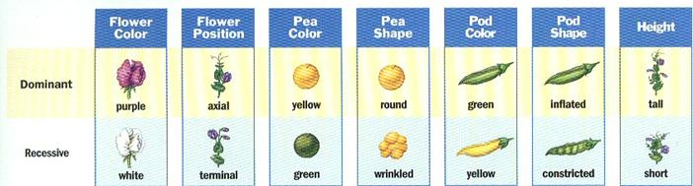
Entry Task: Lab Notebook 4/15/15
A pea plant is heterozygous dominant for the traits of flower position and pod color. What are all of the possible allele combinations it can pass along to its’ offspring for those two genes?
P A Y R G I T
Alleles
p a y r g i t

Slide 2
Objectives
Content: Predict the outcome of a genetic cross involving two traits.
Language: Describe the phenotype of the offspring from a dihybrid cross.

Slide 3
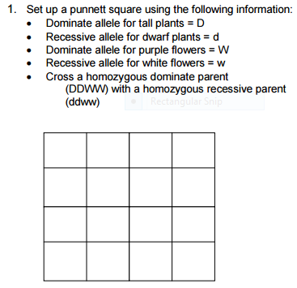
Dihybrid Cross Allele Combinations
What are all four of the possible allele combinations each parent plant can pass along to the offspring plants?

Slide 4
Homozygous Dominant Parent
Homozygous Recessive Parent
D D W W
d d w w
DW DW DW DW
dw dw dw dw
What do you notice about the allele combinations from a parent homozygous for two traits?

Slide 5
Dihybrid Crosses
dw
dw
dw
dw
Homozygous Dominant Parent
DW DW DW DW
DW
DW
DW
Homozygous Recessive Parent
dw dw dw dw
DW

Slide 6
Homozygous Recessive Parent
dw
dw
dw
dw
DW
DdWw
DdWw
DdWw
DdWw
DW
DdWw
DdWw
DdWw
DdWw
Homozygous Dominant Parent
DW
DdWw
DdWw
DdWw
DdWw
DW
DdWw
DdWw
DdWw
DdWw

Slide 7
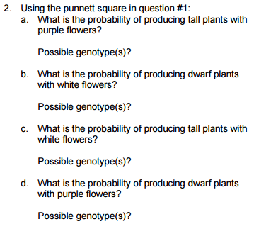
What Does It All Mean?
D = tall
d = dwarf
W = purple
w = white
__ / 16
DDWW, DdWW, DDWw, DdWw
__ / 16
______
__ / 16
______ , ______
__ / 16
______ , ______

Slide 8
Quiz on Friday - be prepared!
Review:
Key unit vocabulary (on the blackboard)
Mitosis vs meiosis
One-trait Punnett Squares
Two-trait Punnett Squares (dihybrid crosses)
The importance of genetic variety (alleles)

