Slide 1
Entry Task: Pop Quiz! 4/14/15
Do you think there is a connection between the following terms?
Male
Female
Dominant Allele
Recessive Allele
Write your explanation in your lab notebook!
Private think/write time! No talking!!!

Slide 2
Share Out
A/B structured partner talk
  30 seconds per partner - practice listening
  30 second mental processing break
  30 second rebuttal - argue respectfully!
Class share out
  Be prepared to share your partner’s strongest argument with the class
  Be prepared to share whether you and your partner agreed or disagreed
  Be prepared to share one question you and/or your partner have about the entry task

Slide 3
Do you know men and women with brown eyes? How about blue eyes?
Yes!
Yes!
Mom or Dad
B
B
B = brown eyes
b = blue eyes
b
Bb
Bb
b
Bb
Bb

Slide 4
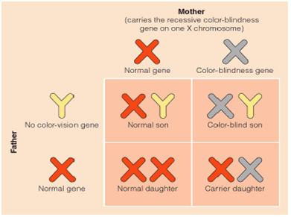
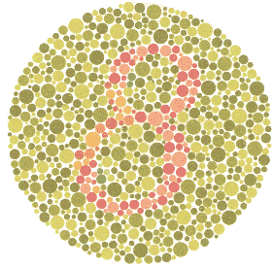
Sex-Linked Traits: Color-blindness

Slide 5
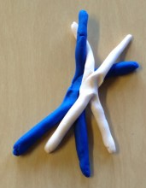
Homologous Recombination:
Endless Genetic Possibilities
1. With your table partner, model the steps of meiosis. Document your work!
2. What are all of the possible combinations of alleles for genes A and B that can be passed along to haploid gamete cells after recombination? (Hint: there are 4)
3. Challenge! Why might the distance between two genes (for example, genes A and B) matter when it comes to recombination?
B
B
b
A
a
b
a
A
Gene A alleles: A and a
Gene B alleles: B and b

