Slide 1
Welcome Back!
Take the first 5 minutes of class to catch up with your classmates. What was your favorite moment of Spring Break?

Slide 2
Entry Task: Lab Notebook 4/13/15
In at least four sentences, explain your best understanding of the connection between Central Dogma and inherited traits.
Write down any questions you have.
You already know a lot, but you should have a lot of questions!

Slide 3
From Central Dogma to Traits - P1
Central Dogma: DNA → RNA → Protein
Questions:
How are chromosomes connected to traits?
How do genetics control behavior?
How many genes are required for each trait?

Slide 4
From Central Dogma to Traits - P2
Central Dogma: DNA → RNA → Protein
Questions:
What determines codon sequence?
What are codons?
How do we get from chromosomes to traits?
How many genes does it take to code for one trait?
What is a trait?

Slide 5
From Central Dogma to Traits - P3
Central Dogma: DNA → RNA → Protein
Questions:
What are traits?
  Personality
  Physical traits
  Something born with (inherited)
How many genes does it take to code for a trait?

Slide 6
From Central Dogma to Traits - P4
Central Dogma: DNA → RNA → Protein
Questions:
How does DNA code for protein?
How exactly do proteins connect with inherited traits?
How many proteins does it take to code for a trait?
Can we change DNA?

Slide 7
From Central Dogma to Traits - P5
Central Dogma: DNA → RNA → Protein
Questions:
How do proteins affect inherited traits?
What happens if amino acids in a protein change?
Are changes to DNA dangerous?

Slide 8
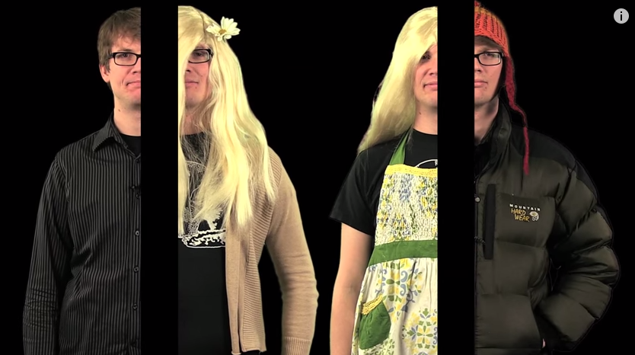
Crash Course: Meiosis
https://www.youtube.com/watch?v=qCLmR9-YY7o

Slide 9
Mitosis vs Meiosis
Mitosis
One diploid cell divides to produce two identical diploid cells (23 pairs of chromosomes)
Produces somatic cells (body cells, or non-gametes)
No recombination, so all homologous chromosomes in daughter cells are identical to parent cell
Meiosis
One diploid cell divides to produce four non-identical haploid cells (23 chromosomes)
Produces gametes (eggs/ova and sperm)
Homologous chromosome recombination (crossing over) creates new combinations of chromosomes in daughter cells

Slide 10
Homologous Recombination Part 1: Chromosome Duplication
Chromosomes 1-22
What step of meiosis does this occur in?
Chromosomes
Duplicate
Interphase
B
b
B
B
b
b
a
A
a
a
A
A
Mom
Dad
Mom
Dad

Slide 11
Homologous Recombination Part 2: Duplicated Chromosomes Pair Up
What step of meiosis does this occur in?
Duplicated Chromosomes
Pair Up
Prophase
B
B
b
b
B
B
b
b
a
a
A
A
a
a
A
A
Mom
Dad
Mom
Dad

Slide 12
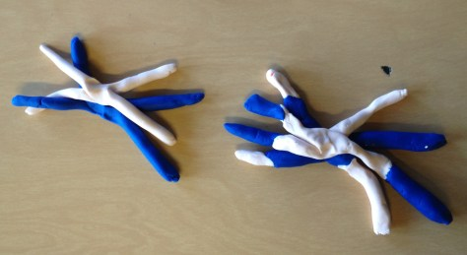
Homologous Recombination Part 3: Crossing Over
Duplicated homologous
chromosomes
exchange segments of DNA
B
B
b
b
B
b
a
B
b
A
a
a
A
A
A
a
What step of meiosis does this occur in?
Prometaphase

Slide 13
Vocabulary Review
Homozygous = two of the same alleles
Homozygous dominant (AA)
Homozygous recessive (aa)
Heterozygous = two different alleles
One dominant and one recessive (Aa)
Phenotype from dominant allele (A)

