Slide 1
Chapter 5: Chromosome 5
DNA Sequence
Chromosome
86,240
Name of Protein
5
Name of Gene
Fibroblast Growth Factor 10
FGF10
transcription
Amino acid sequence
mRNA
208 aa
translation
What does this protein make up or do?
important processes such as cell division, regulation of cell growth and maturation
Condition/Disease
lacrimo-auriculo-dento-digital syndrome

Slide 2
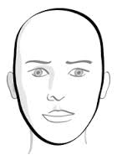
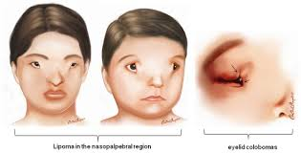
lacrimo-auriculo-dento-digital syndrome
Symptoms and characteristics
    Lacrimo-auriculo-dento-digital syndrome is a disorder that affects the mouth , ears , eyes and hands.
    At first, they man experience kidney problems.
    If lacrimo-auriculo-dento-digital syndrome is a rare condition . 60 cases have been described in the scientific literature.

Slide 3
Description of Lacrimo-Auriculo-Dento-Digital Syndrome(cont.)
Who is affected?
~ Rare Condition
Outlook or quality of life
~ Can lose hearing loss.
~ Have salivary glands which impair with production.
~ Opening roof in the mouth with a split in the upper lip.
~ Thumb can be duplicated and have 3 bones instead of 2 bones

Slide 4
References
http://ghr.nlm.nih.gov/condition/lacrimo-auriculo-dento-digital-syndrome
http://www.ncbi.nlm.nih.gov/gene/2255

