Slide 1
Name of Gene
DNA Sequence
Name of Protein
LMNA lamin A/C [ Homo sapiens (human) ]
50,522
USH1C
Chromosome 11
Condition/Disease
Protein makes up/Does
Charcot-Marie-Tooth Disease
Amino Acid Sequence
The protein makes up the matrix and is highly conserved in the evolution
533aa

Slide 2
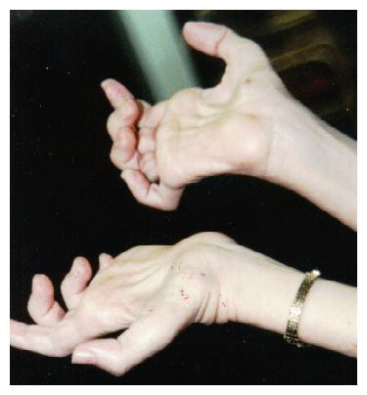
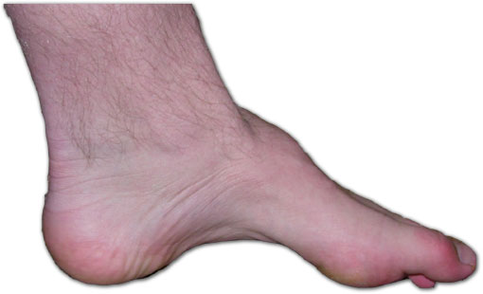
Description of Charcot-Marie-Tooth Disease
Symptoms and Characteristics
Charcot-Marie-Tooth disease is a group of progressive disorders that affect the peripheral nerves. Peripheral nerves connect the brain and spinal cord to muscles and to sensory cells that detect sensations such as touch, pain, heat, and sound. Damage to the peripheral nerves can result in loss of sensation and wasting (atrophy) of muscles in the feet, legs, and hands.
Frequent tripping or falling
Loss of muscle bulk in legs, ankles and feet
Difficulty lifting your foot to your ankle

Slide 3
Description of Charcot-tooth disease continue….
Quality or Outlook of life
Who it affects?
No cure, treatment can help to relieve
Symptoms and mobility
People living with this condition may have
Problems performing everyday task like opening
cans, typing or picking objects up
Not life threating, most people with condition
Have the same life expectancy as a person who
Doesn’t have the Charcot-Marie-Tooth Disease
Leaves deformity in your limbs such as flat feet
High foot arches, and curvature of the spine
Charcot-Marie-Tooth disease usually becomes apparent in adolescence or early childhood, but onset may occur anytime from early childhood through late adulthood
People with a family history of Charcot-Tooth Disease

Slide 4
Websites Used
AJ
Created By:
http://www.mayoclinic.org/diseases-conditions/charcot-marie-tooth-disease/basics/symptoms/con-20029920
http://ghr.nlm.nih.gov/gene/ABCC8
http://www.genecards.org/cgi-bin/carddisp.pl?gene=USH1C

