Slide 1
Chapter 23: Chromosome Y
Chromosome
Name of Gene
DNA Sequence
Name of Protein
Y
IL3RA
46,089
Interleukin 3
transcription
Amino acid sequence
mRNA
378 aa
translation
Cytoplasm
A Cell
Nucleus
What does this protein make up or do?
Regulates blood-cell production by controlling the production, differentiation and function of granulocytes
Condition/Disease: Leukaemia

Slide 2
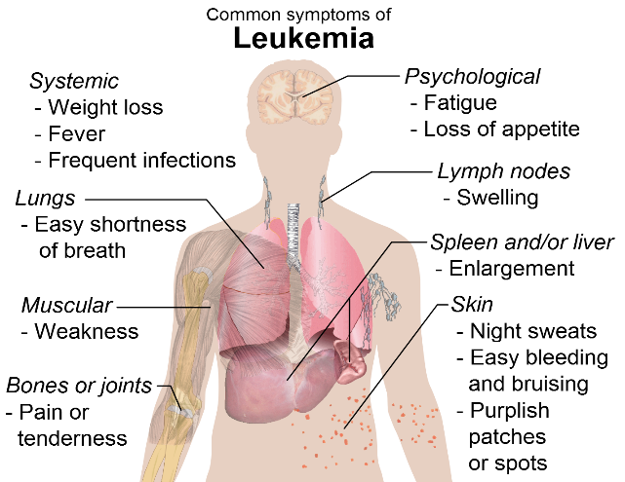
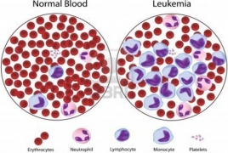
Description of Leukaemia
Symptoms and characteristics
    Leukaemia is a disease in which the bone marrow and other organs produce increased numbers of immature or abnormal leukocytes (white blood cells).
    Symptoms are weight loss, Pain in bones and joints, weakness and purplish patches or spots on skin.
    If Leukaemia remains untreated, people may become very weak and fragile and can cause death.
    Leukaemia is detected through either a blood or bone marrow blood test.

Slide 3
Description of Leukaemia (cont.)
Who is affected? Anyone, but the following have a higher risk
  Children between the ages of 2 and 3 years
  more frequently in males than in females
  Caucasian children than any other race
Outlook or quality of life
  Survivors must maintain a healthy weight and a healthy diet.
  Without treatment patients will die.
  Treatments include steam cell transfusion and chemotherapy.
  Treatments can lead to other cancers such as t-AML
Researcher: YF

Slide 4
References
NCBI. Genes and Disease: IL3RA [online]. 2015. [March 4, 15]. Available at URL: www.ncbi.nlm.nih.gov/gene?cmd=retrieve&dopt=full_report&list_uids=3563
GeneCards. IL3RA [Online] 2015. [March 4, 15] Available at URL: http://www.genecards.org/cgi-bin/carddisp.pl?gene=IL3RA
WebMD. Leukemia [online] 2015 [March 4, 2015] Available at URL: www.webmd.com/cancer/tc/leukemia-topic-overview

