Slide 1


Biology Special Episode

Slide 2
Cellular Organization
Genetics
Energy & Matter
Systems Biology
$200
$200
$200
$200
$400
$400
$400
$400
$600
$600
$600
$600
$800
$800
$800
$800
$1000
$1000
$1000
$1000

Slide 3
Cellular Organization
Genetics
Energy & Matter
Systems Biology
$200
$200
$200
$200
$400
$400
$400
$400
$600
$600
$600
$600
$800
$800
$800
$800
$1000
$1000
$1000
$1000

Slide 4
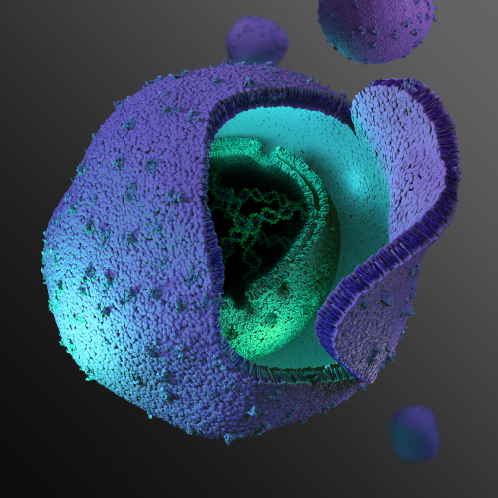
Cellular Organization $200
This organelle is where most of the DNA in eukaryotic cells is located

Slide 5
Cellular Organization $400
Acquired by symbiosis, this organelle generates energy in both animal and plant cells.
Name the organelle
Name the “energy currency” of cells

Slide 6
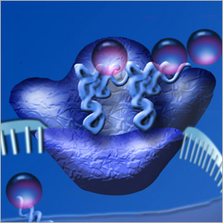
Cellular Organization $600
This organelle is found in the cytoplasm or attached to rough endoplasmic reticulum. It “reads” mRNA to build proteins.

Slide 7
Cellular Organization $800
Plant cells differ from animal cells in that plant cells have:
an endoplasmic reticulum
vesicles
Golgi complexes
a central vacuole
organelles

Slide 8
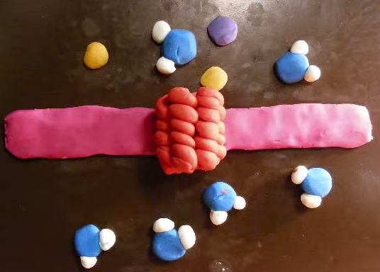
Cellular Organization $1000
Aquaporin protein channels facilitate the movement of water molecules across the lipid bilayer plasma membrane. Diagram how water molecules move across the membrane.

Slide 9
Cellular Organization $200 - Answer
Nucleus

Slide 10
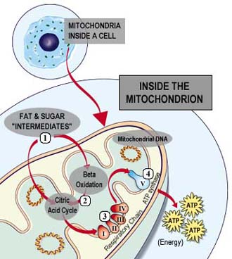
Cellular Organization $400 - Answer
Mitochondria
ATP

Slide 11
Cellular Organization $600 - Answer
This organelle is found in the cytoplasm or attached to rough endoplasmic reticulum. It “reads” mRNA to build proteins.
Ribosome

Slide 12
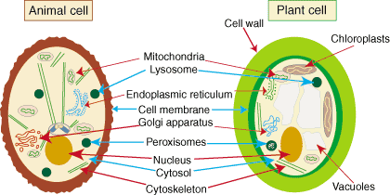
Cellular Organization $800 - Answer
Plant cells differ from animal cells in that plant cells have:
an endoplasmic reticulum
vesicles
Golgi complexes
a central vacuole
organelles

Slide 13
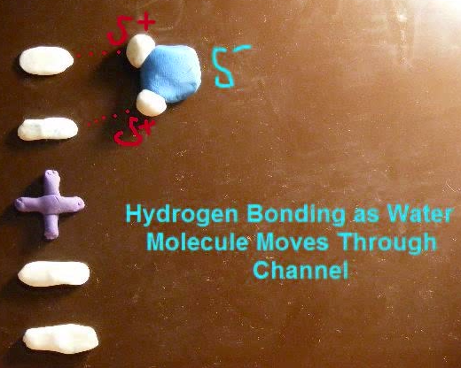
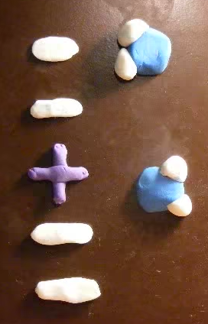
Cellular Organization $1000 - Answer

Slide 14
Genetics $200
The Central Dogma is:

Slide 15
Genetics $400
Convert the following strand of DNA to RNA:
TACCAGCCTAAGATTACA

Slide 16
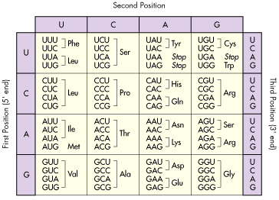
Genetics $600
Convert the RNA strand to amino acids: AUGGUCGGAUUCUAAUGU

Slide 17
Genetics $800
Which process increases genetic variation among whale offspring?
Division of cells in mitosis
Fertilization of egg cells
Synthesis of proteins
Assembly of lipids

Slide 18
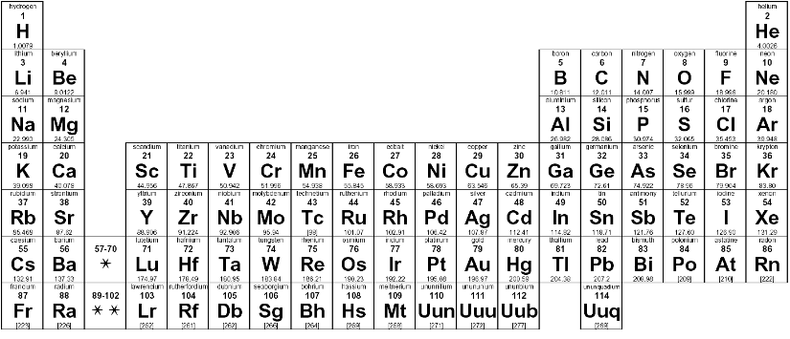
Genetics $1000
Which elements in the periodic table are found in every amino acid?

Slide 19
Genetics $200 - Answer
DNA → RNA → Protein

Slide 20
Genetics $400 - Answer
Convert the following strand of DNA to RNA:
TACCAGCCTAAGATTACA
AUGGUCGGAUUCUAAUGU

Slide 21
Genetics $600 - Answer
RNA: AUGGUCGGAUUCUAAUGU
Codons: AUG GUC GGA UUC UAA UGU
Amino Acids: Met-Val-Gly-Phe-Stop

Slide 22
Genetics $800 - Answer
Which process increases genetic variation among whale offspring?
Division of cells in mitosis
Fertilization of egg cells
Synthesis of proteins
Assembly of lipids

Slide 23
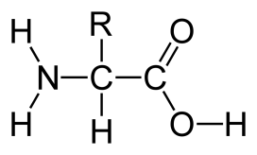
Genetics $1000 - Answer
Which elements in the periodic table are found in every amino acid?

Slide 24
Energy & Matter $200
What is the common name of the molecule with the formula H₂O?
Carbon Dioxide
Methane
Water
Glucose

Slide 25
Energy & Matter $400
What are the inputs of cellular respiration?
CO₂ + H₂O
CH₃ + O₂
CO₂ + O₂
C₆H₁₂O₆ + O₂

Slide 26
Energy & Matter $600
The correct general formula for photosynthesis is:
O₂ + C₆H₁₂O₆ → CO₂ + H₂O + ATP
CO₂ + H₂O + sunlight → O₂ + C₆H₁₂O₆
CO₂ + H₂O + ATP → O₂ + C₆H₁₂O₆
O₂ + C₆H₁₂O₆ → CO₂ + H₂O + sunlight

Slide 27
Energy & Matter $800
Using a network diagram, describe the relationship between ATP, sunlight, glucose, cellular respiration, and photosynthesis.

Slide 28
Energy & Matter $1000
How is cellular respiration by plants similar to the burning of fossil fuels?
A. Both release oxygen for organisms that are consumers
B. Both break down carbon-containing compounds
C. Both produce ATP
D. Both absorb light

Slide 29
Energy & Matter $200 - Answer
What is the common name of the molecule with the formula H₂O?
Carbon Dioxide
Methane
Water
Glucose

Slide 30
Energy & Matter $400 - Answer
What are the inputs of cellular respiration?
CO₂ + H₂O
CH₃ + O₂
CO₂ + O₂
C₆H₁₂O₆ + O₂

Slide 31
Energy & Matter $600 - Answer
The correct general formula for photosynthesis is:
O₂ + C₆H₁₂O₆ → CO₂ + H₂O + ATP
CO₂ + H₂O + sunlight → O₂ + C₆H₁₂O₆
CO₂ + H₂O + ATP → O₂ + C₆H₁₂O₆
NO₂ + C₆H₁₂O₆ → O₂ + H₂O + sunlight

Slide 32
Energy & Matter $800 - Answer
Using a network diagram, describe the relationship between ATP, sunlight, glucose, cellular respiration, and photosynthesis.
Sunlight energy
photosynthesis
cellular respiration
Glucose
ATP

Slide 33
Energy & Matter $1000 - Answer
How is cellular respiration by plants similar to the burning of fossil fuels?
A. Both release oxygen for organisms that are consumers
B. Both break down carbon-containing compounds
C. Both produce ATP
D. Both absorb light

Slide 34
Systems Biology $200
Vocabulary Challenge! In a network diagram:
_______ are connected by ________, and arrows indicate ________
Nodes, edges, the direction of flow
Edges, the direction of flow, nodes
The direction of flow, nodes, edges
Nodes, the direction of flow, edges

Slide 35
Systems Biology $400
How much energy is lost from one trophic level to the level above?
30%
50%
70%
90%

Slide 36
Systems Biology $600
Which graph best represents a population of organisms at equilibrium with the environment?
A
C
B
D

Slide 37
Systems Biology $800
Blackberry plants are found near the edge of forests. How could blackberry plants limit the population of salmonberry plants often found near streams?
Blackberry plants:
increase oxygen in the ecosystem
lack flowers that attract bees
produce dark purple berries
compete for resources

Slide 38
Systems Biology $1000
Which event might be evidence that a forest habitat is in equilibrium?
A dead tree providing nutrients for a young tree
A bird species leaving as temperatures increase
A landslide damming the stream in the habitat
A flood washing away topsoil from the ground

Slide 39
Systems Biology $200 - Answer
Vocabulary Challenge! In a network diagram:
_______ are connected by ________, and arrows indicate ________
Nodes, edges, the direction of flow
Edges, the direction of flow, nodes
The direction of flow, nodes, edges
Nodes, the direction of flow, edges

Slide 40
Systems Biology $400 - Answer
How much energy is lost from one trophic level to the level above?
30%
50%
70%
90%

Slide 41
Systems Biology $600 - Answer
Which graph best represents a population of organisms at equilibrium with the environment?
A
C
B
D

Slide 42
Systems Biology $800 - Answer
Blackberry plants are found near the edge of forests. How could blackberry plants limit the population of salmonberry plants often found near streams?
Blackberry plants:
increase oxygen in the ecosystem
lack flowers that attract bees
produce dark purple berries
compete for resources

Slide 43
Systems Biology $1000 - Answer
Which event might be evidence that a forest habitat is in equilibrium?
A dead tree providing nutrients for a young tree
A bird species leaving as temperatures increase
A landslide damming the stream in the habitat
A flood washing away topsoil from the ground

Slide 44
Final Jeopardy
Scientific Process

Slide 45
Final Jeopardy
You are a student studying forensic science. You are given the following assignment: extract DNA from a hair sample found at a crime scene. Before extracting DNA from the crime scene hair, you decide to experiment with your own hair to make sure your procedure is correct. You know how much extraction solution to use, but need to find out how much isopropyl alcohol to use.
Define the following:
Manipulated variable
Responding variable
2 Controlled variables
You have 1 minute to consult…

Slide 46
Final Jeopardy
Scientists wondered how the presence of a new type of grass could affect the population of salmonberry plants in a forest ecosystem. What kind of investigation would be most appropriate to answer this question?
A field study because factors that are hard to control could influence the results
A research paper because information is available about many kinds of plants
A controlled experiment because all the variables are kept the same
A simulation because computers are more reliable than natural resources
You have 30 seconds to consult…

Slide 47
Final Jeopardy
Scientists wondered how the presence of a new type of grass could affect the population of salmonberry plants in a forest ecosystem. What kind of investigation would be most appropriate to answer this question?
A field study because factors that are hard to control could influence the results
A research paper because information is available about many kinds of plants
A controlled experiment because all the variables are kept the same
A simulation because computers are more reliable than natural resources
You have 15 seconds to consult…

Slide 48
Final Jeopardy
You are a student studying forensic science. You are given the following assignment: extract DNA from a hair sample found at a crime scene. Before extracting DNA from the crime scene hair, you decide to experiment with your own hair to make sure your procedure is correct. You know how much extraction solution to use, but need to find out how much isopropyl alcohol to use.
Define the following:
Manipulated variable
Responding variable
2 Controlled variables
Time Is Up

Slide 49
Final Jeopardy - Answer
You are a student studying forensic science. You are given the following assignment: extract DNA from a hair sample found at a crime scene. Before extracting DNA from the crime scene hair, you decide to experiment with your own hair to make sure your procedure is correct. You know how much extraction solution to use, but need to find out how much isopropyl alcohol to use to extract as much DNA as possible.
Define the following:
Manipulated variable: Volume of isopropyl alcohol
Responding variable: Amount of DNA
2 Controlled variables: Volume of extraction fluid, hair source

Slide 50
Jeopardy
Thank you for playing another fine round of America’s favorite question and answer game.

