Slide 1

Entry Task: Lab Notebook 3/16/15
Using your notes about the phases of mitosis (from Friday), explain which phases of mitosis are represented in these pictures of a dividing African globe lily cell:
1 2 3 4 5

Slide 2
Structured Partner Talk
Using A/B talk (A=window side), explain how you determined the phases of lily cell mitosis.
Partner A explains phase of mitosis for picture 1
Partner B explains why they agree or disagree
Attempt to reach consensus through respectful scientific debate (“I disagree because…”)
Switch (partner B explains phase for picture 2)
Work through all 5 pictures
Prepare to share out in 5 minutes

Slide 3
Our Road Map
Cell Division
Mitosis
Meiosis
Replication
Heredity
Chromosomes
DNA
Genes
RNA
Traits
Protein

Slide 4
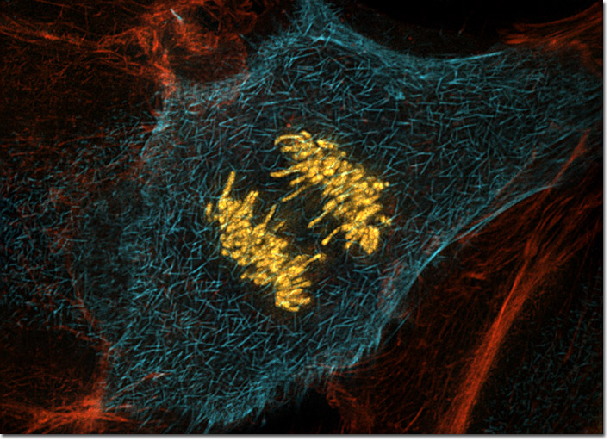
Zoom Out: Cell Division

Slide 5
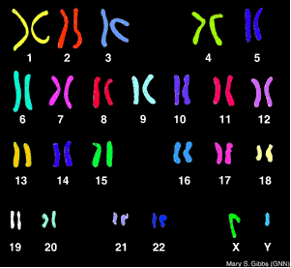
Chromosomes
Human offspring receive 23 chromosomes from mom and 23 from dad
Autosomal chromosomes are numbered from longest (1) to shortest (22) and pair up as homologous chromosomes
Sex chromosomes include X and Y:
XX for female
XY for male

Slide 6
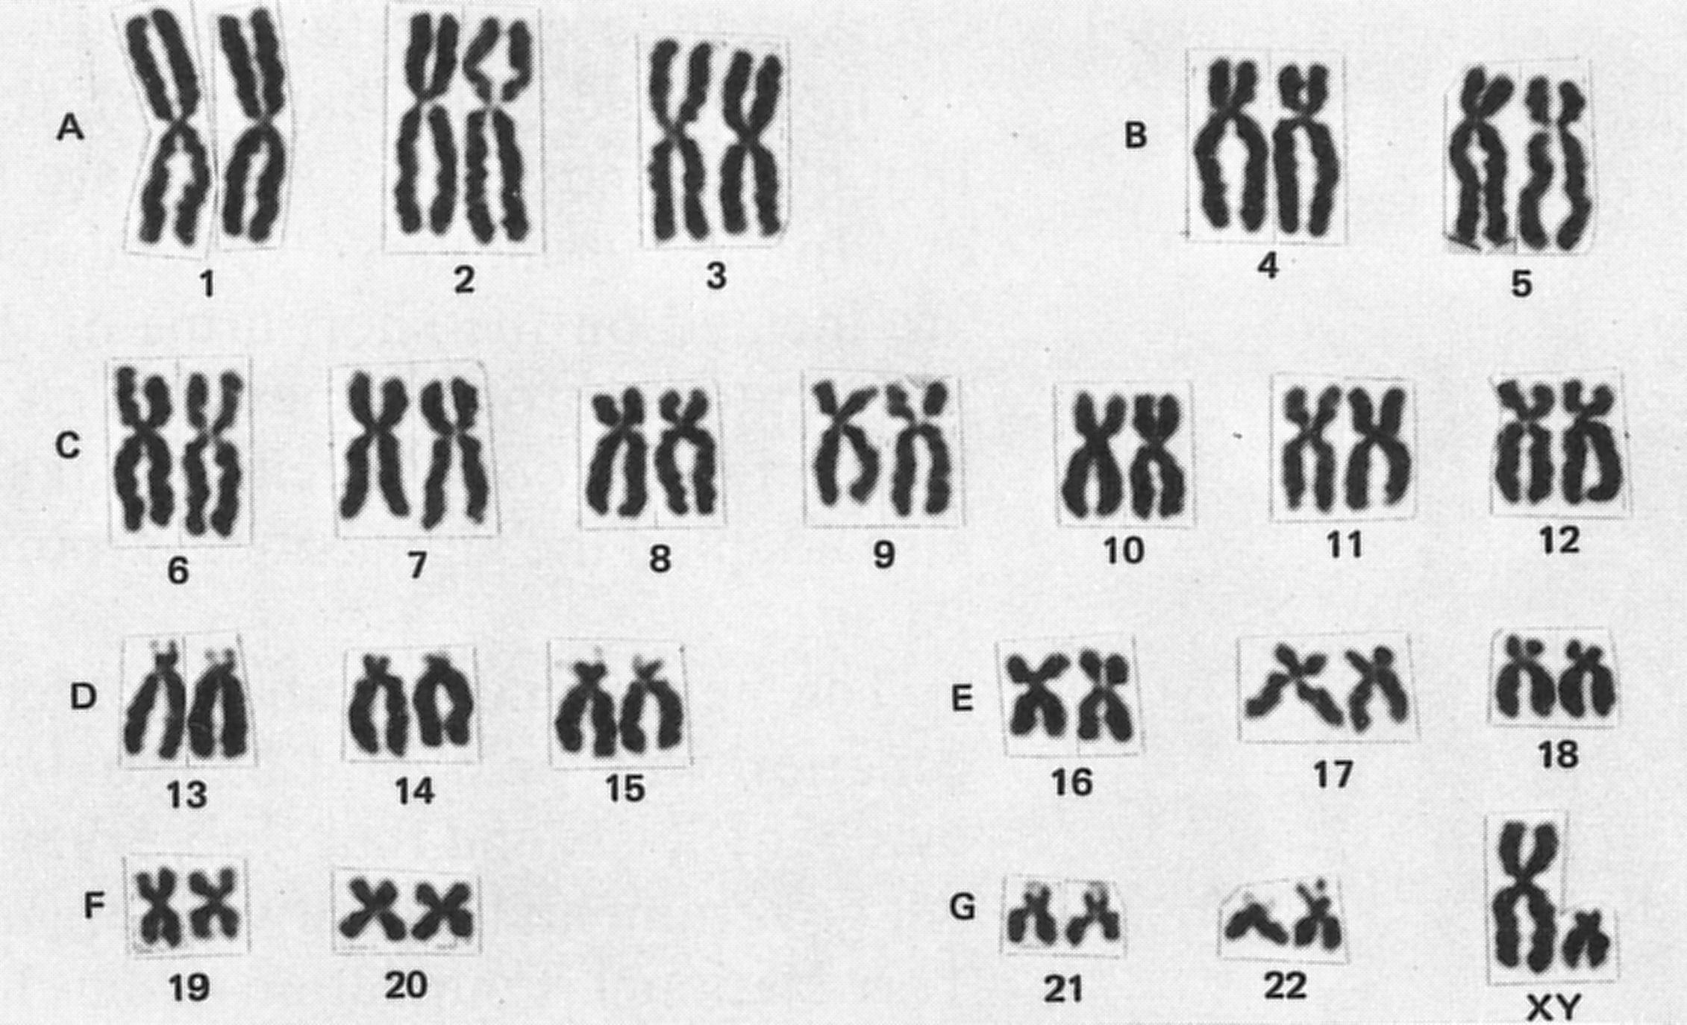
Replicated Chromosomes: Mitosis
Name the structure that links sister chromatids:
Notes:
centromere

Slide 7
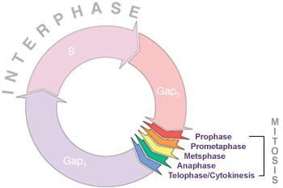
Somatic Cell Division: Mitosis
Mitosis is the process by which somatic cells divide
Scientists studying mitosis have identified 6 key phases:
  Prophase
  Prometaphase
  Metaphase
  Anaphase
  Telophase
  Cytokinesis
Somatic cells are all of the cells of the body except gametes
The gametes are eggs and sperm (meiosis unit)

Slide 8
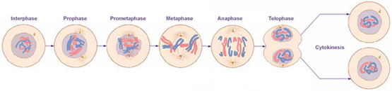
Somatic Cell Division: Mitosis
Somatic cells have 23 pairs of chromosomes (46 total) after each round of cell division
After dividing, one diploid mitotic parent cell produces two diploid daughter cells
A diploid cell has two copies of each chromosome
Why did scientists organize the process of mitosis into phases?

Slide 9
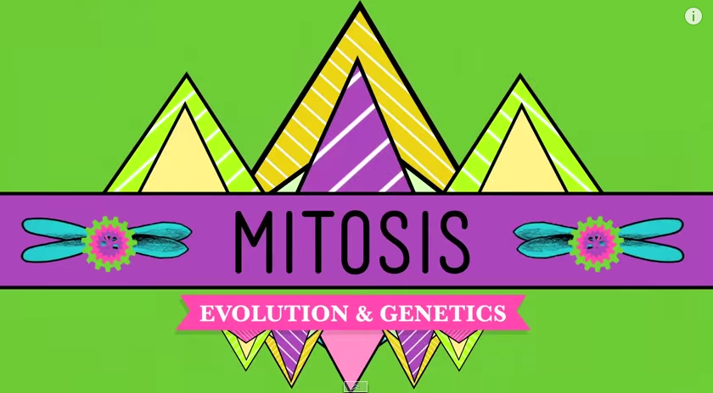
Crash Course: Mitosis
Exit Ticket: On a notecard, write your name, one thing you learned, and one question you have, and one reason mitosis is important after watching the video.

