Slide 1
2/23/15 Learning Objectives
Content Objective: Investigate the process of gene transcription.
Language Objective: Explain how genetic mutations affect protein structure and function.

Slide 2
Looking Ahead
Tuesday: Substitute with assigned reading (Chapter 1 from The New Genetics book)
Wednesday: Central Dogma Quiz
  Review DNA transcription to RNA
  Review RNA translation to amino acids
  Review types of DNA mutations w/consequences

Slide 3
Entry Task: Lab Notebook 2/23/15
On the next blank page of your lab notebook, on the first line of the page, write a random sequence of DNA 20 nucleotides long. Use capital letters (A, T, C, G) and leave a small space between each letter.
When finished, trade notebooks with your desk partner. Write the complementary DNA sequence below their DNA sequence, then trade back and check each other’s work. Explain any corrections to your partner.

Slide 4
Entry Task: Step 2
Convert (transcribe) the complementary DNA strand to RNA. Remember the pairing rules for transcribing DNA to RNA. Ask your table partner for help if needed.
Trade notebooks with your table partner. Convert (translate) the RNA sequence to amino acids using the codon chart. Trade back notebooks and check each other’s work. Explain any corrections to your partner.

Slide 5
Central Dogma
DNA RNA Protein
Helicase (unwinds DNA)
Ribosome
tRNA
RNA Polymerase
Transcription
(nucleus)
Translation
(cytoplasm)

Slide 6
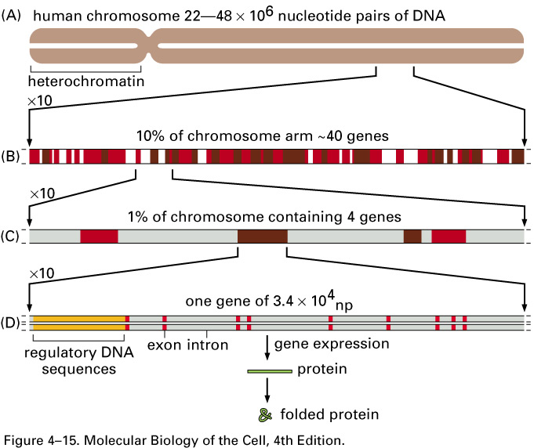
Coding and Non-Coding DNA

Slide 7
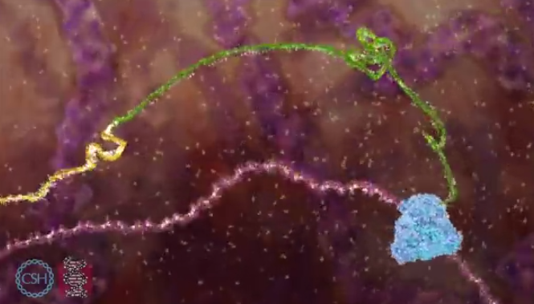
Exons and Introns

Slide 8
Messenger RNA (mRNA) Splicing
RNA polymerase transcribes all of the introns and exons in a gene into mRNA
Only the exons code for protein
The spliceosome snips out introns from the mRNA
The remaining exons are assembled into the final mRNA product
Exon # 1 2 3 4 5 6 7 8 9
A few possible final mRNA products:
Exons 1+2+3+4+5+6+7+8+9
Exons 3+4+5+6+7+8+9
Exons 5+6+7+8+9

Slide 9
Why Does Splicing Matter?
Structure Equals Function
One gene can code for multiple proteins depending on which exons are included in the spliced mRNA

Slide 10
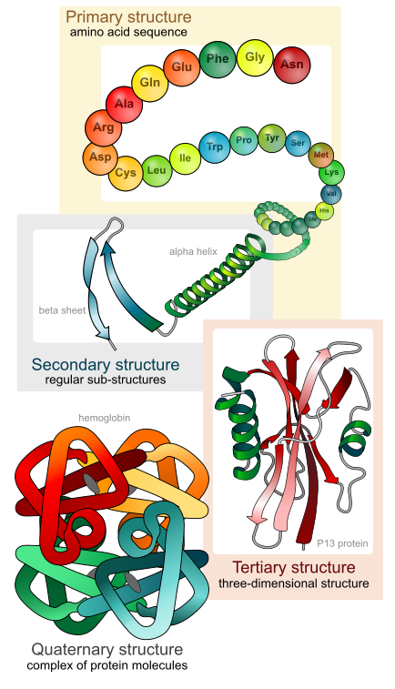
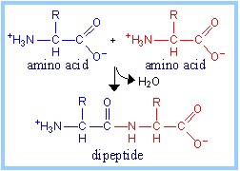
Protein Structure
Structure Equals Function

Slide 11
Why Does This Matter?
All of the cells in your body contain the same DNA*
However, only certain genes are expressed in certain cells
Gene expression = proteins
Certain cells are made of certain proteins
The unique proteins a cell expresses makes the cell unique
A collection of unique cells = a tissue
Tissues include muscle, skin, brain, lung, blood, etc
* Disclaimer: there are exceptions to every rule…

Slide 12
Real Life Applications
Medicines can be designed to treat diseases caused by cells expressing specific proteins (such as cancer)
Genes can be altered to correct genetic errors (such as cystic fibrosis)
Genes can be transferred to different organisms (such as bacteria) which can be used to make huge amounts of a desired protein (such as insulin to treat diabetes)

Slide 13
Classwork / Homework
Using the complementary DNA sequence from the Entry Task, mutate the DNA with each of the following types of mutations:
  Silent mutation (single base change with no effect to AA)
  Missense mutation (single base change to new AA)
  Nonsense mutation (single base change to stop codon)
  Delete nucleotide base 7
  Insert one base between base 6 and 7
For each mutation, transcribe the DNA into RNA and then translate the RNA to AAs.
Explain how each type of DNA mutation affects the amino acid sequence.

Slide 14
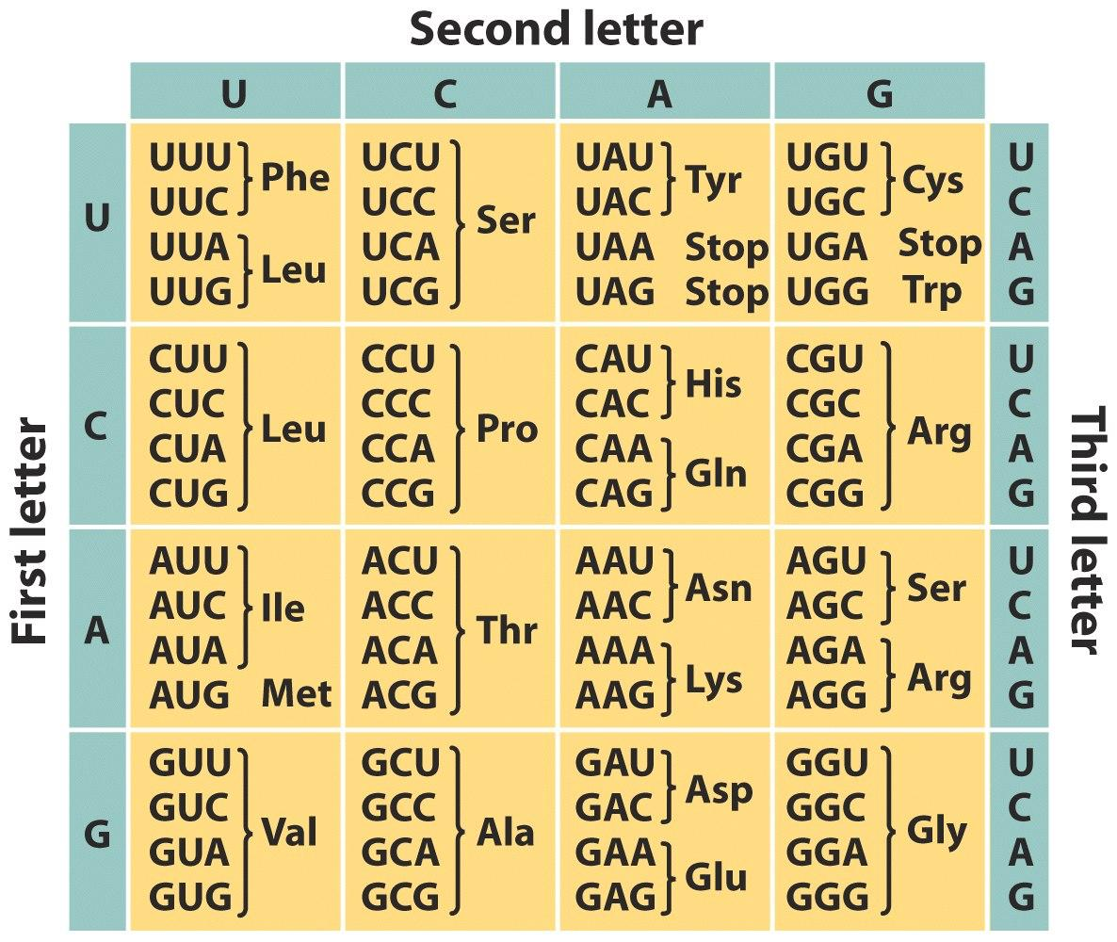
Codon Chart

